Slide 1
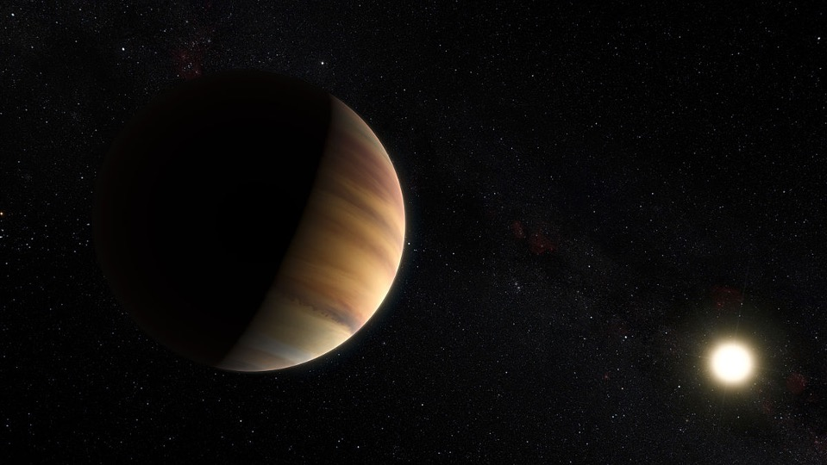
A standalone UV coronagraph instrument for the
Habitable Worlds Observatory
Roser Juanola-Parramon (NASA GSFC)
on behalf of the CTR UV-Vis point design team
JPL’s Ultraviolet Science and Instrumentation Workshop: On the Way to the NASA Habitable Worlds Observatory and Beyond
May 7, 2024
Notes:
The near-ultraviolet wavelength range contains a valuable Ozone absorption feature for characterizing the atmospheric composition of Earth-like exoplanets. Both the LUVOIR and HabEx decadal mission concept studies baselined instrumentation for obtaining photometry of directly imaged exoplanets down to wavelengths of 200 nm. Both of their proposed implementations present challenges: in the case of the HabEx starshade occulter, a separate spacecraft is required; in the case of a UV channel within the main coronagraph instrument, non-UV-optimized optics limit the performance. Yet, the science requirements allow the relaxation of some of the trades of a dedicated near-UV coronagraph. Here we present the preliminary design of a standalone UV coronagraph instrument for the Habitable Worlds Observatory concept based on the science requirements. We describe the trades and rationale behind the decision of separating the UV coronagraph from the main instrument and show the evaluation of several coronagraph designs in the UV. We assess the effect of polarization aberrations and describe potential UV detectors and wavefront sensing and control strategies.

Slide 2
A standalone UV coronagraph instrument for the HWO
Outline
The search for Exoplanets - Science access and limitations​
An introduction to Coronagraphy
Characterizing exoplanets in the UV
Standalone UV coronagraphy
Conclusions

Slide 3
The search for Exoplanets
Science access and limitations

Slide 4
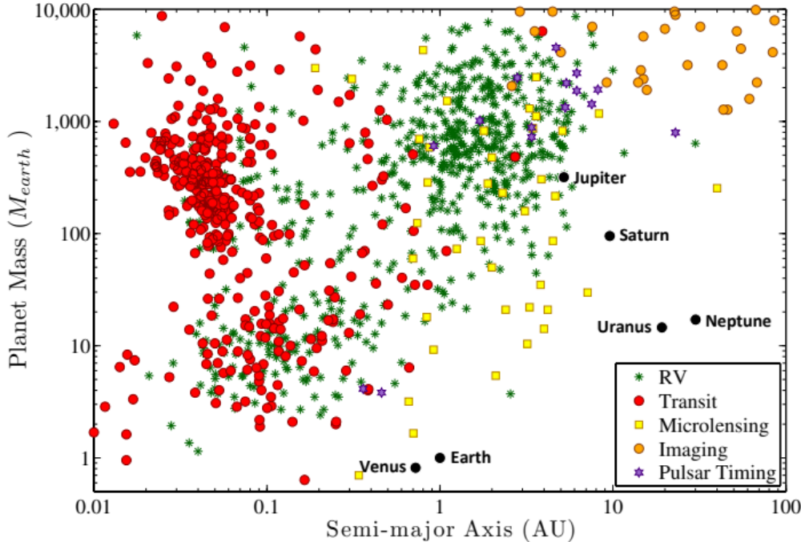

The Search for Exoplanets
Exoplanet Detection methods
Direct imaging
As of April 21, 2024 there are 5616 confirmed exoplanets
Most exoplanets (over 4000) have been detected via transits
Radial velocity has detected over 1000 planets
Direct imaging remains a very challenging method ~ 1.2%
Less than 100 exoplanets have been
directly imaged
Most are giant planets and far from their parent star
NASA Exoplanet Archive
Notes:
I think we could highlight the access from the ground and space on this plot

Slide 5
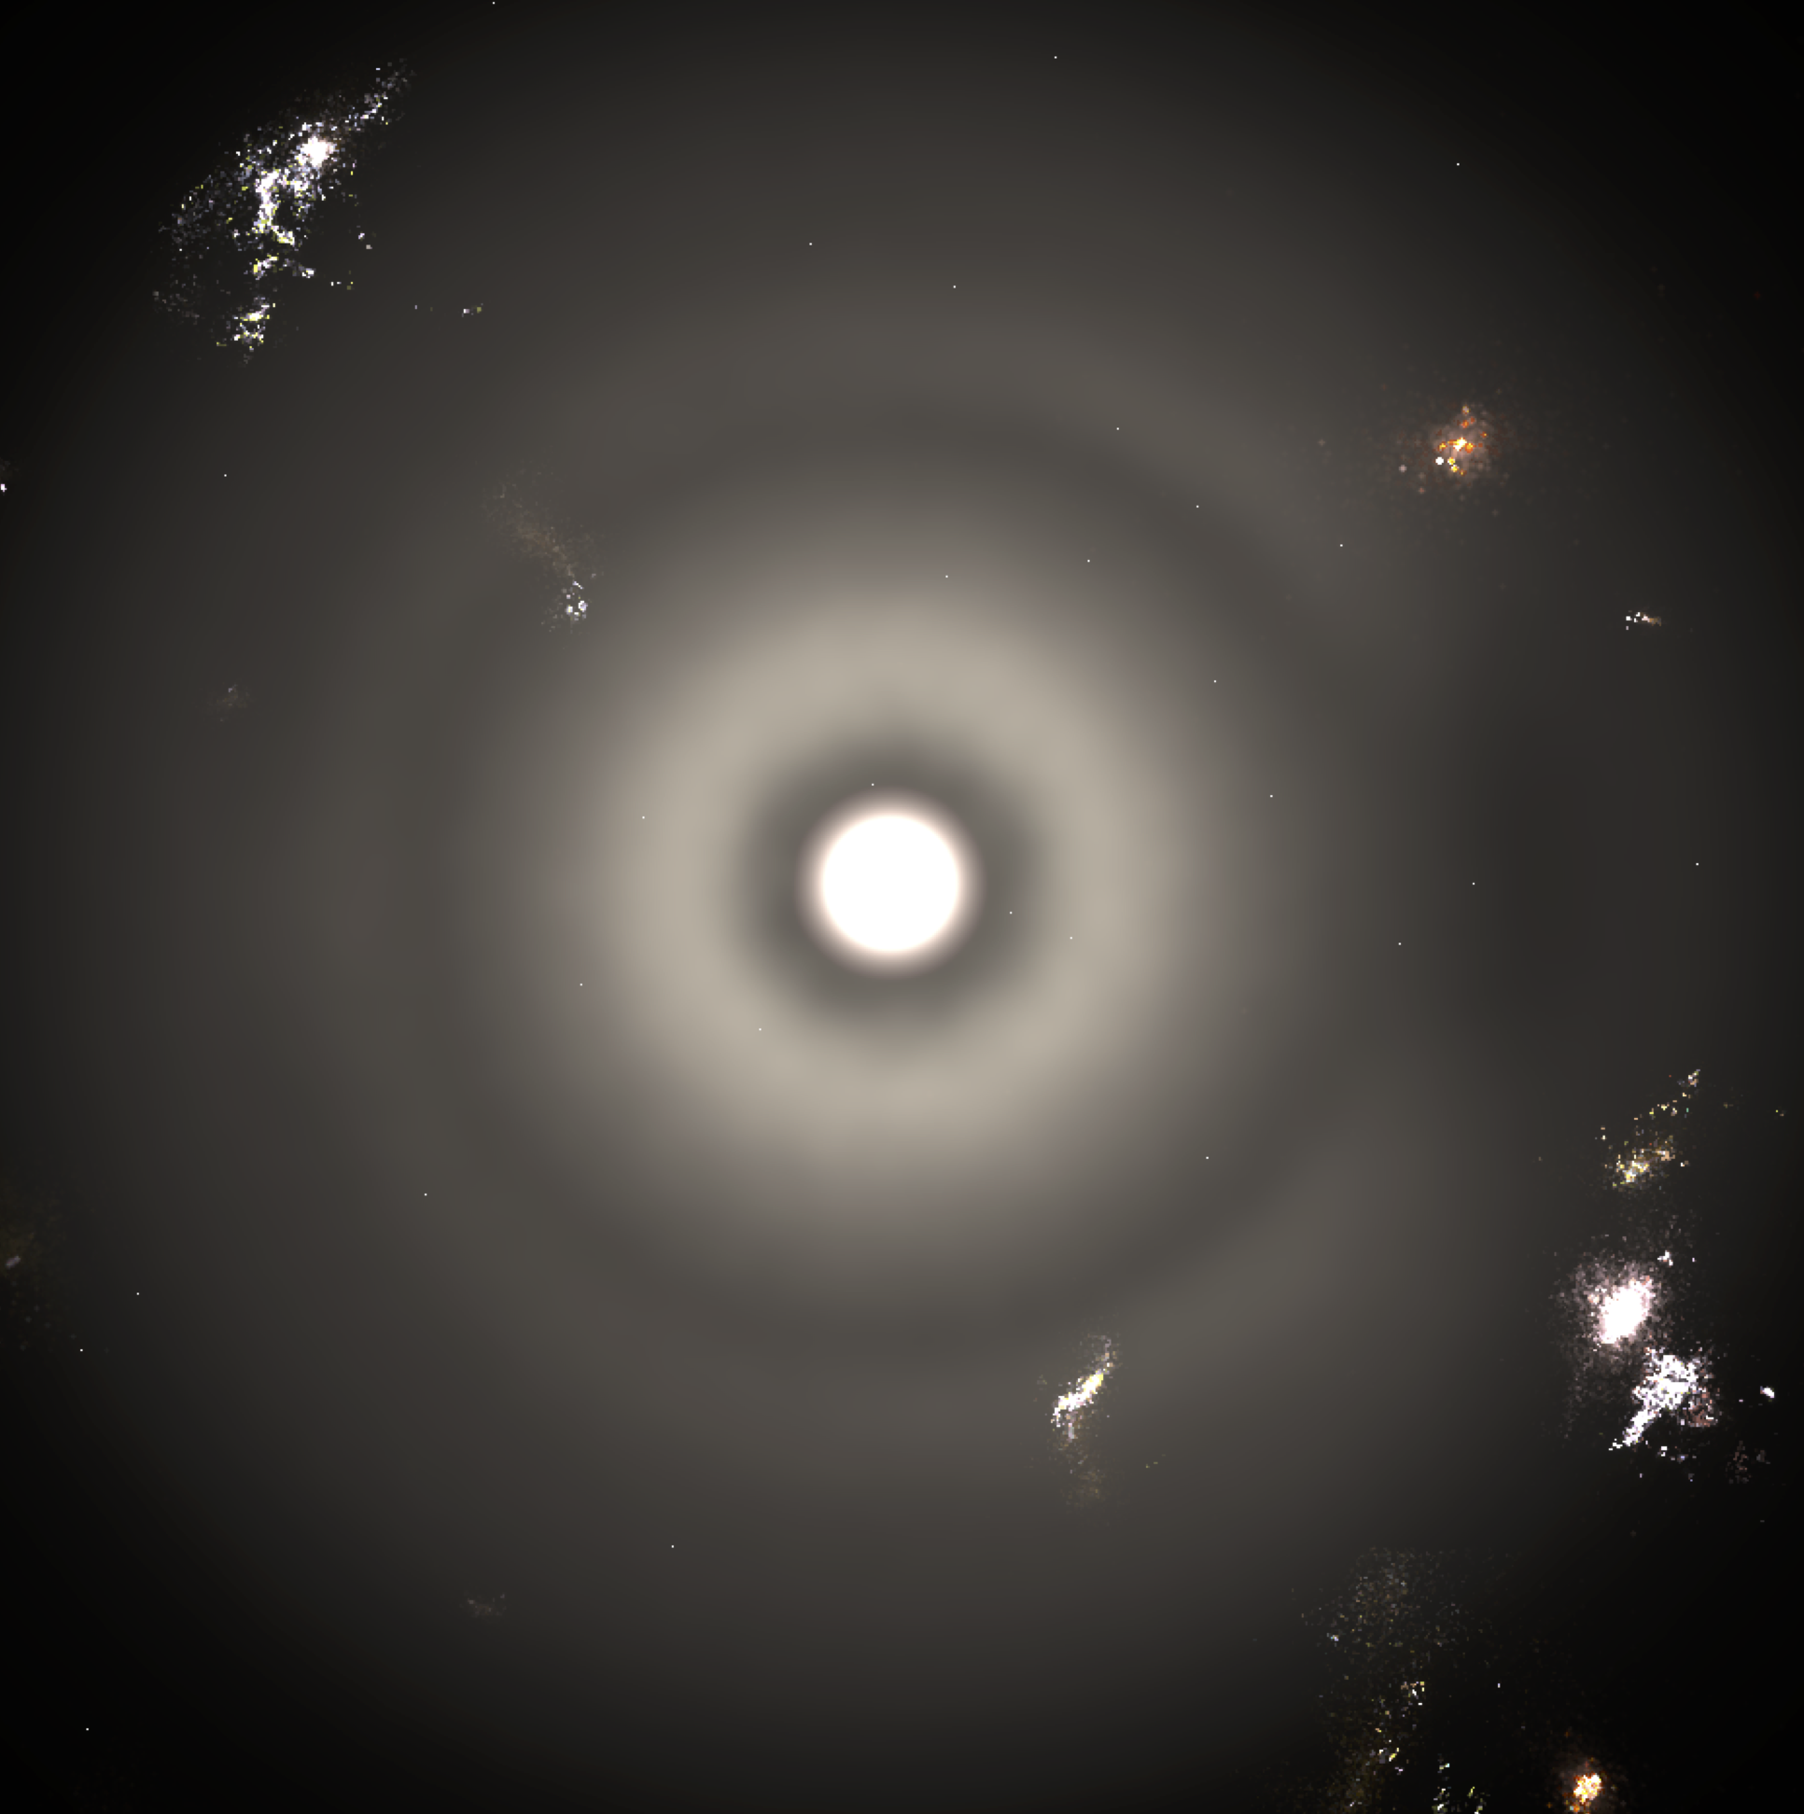
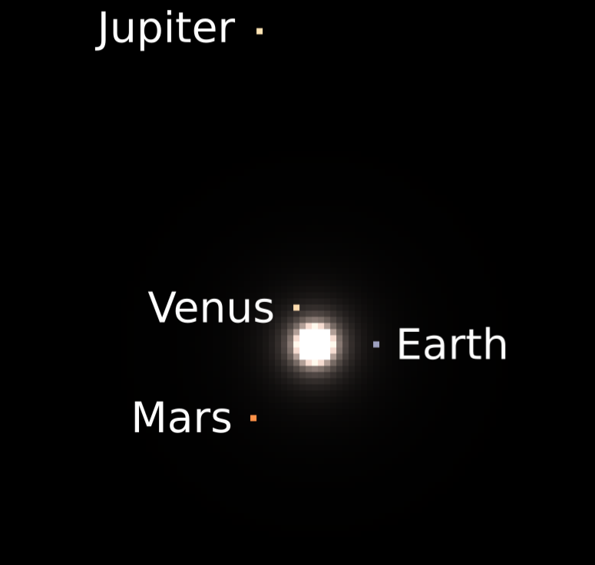
The Search for Exoplanets
Detecting and Characterizing ExoEarths
Credit: M. Turnbull
Vegetation
Inner solar system
Credit: Haystacks Team
https://asd.gsfc.nasa.gov/projects/haystacks/
Notes:
The architecture of the modern solar system, showing the interplay between planets and debris dust. The left panel shows a model of the entire system out to a radius of 50 AU from
the Sun, while the inset panel zooms in on the inner system. For ease of viewing, the Sun and possible astrophysical background sources are not included. The bright region at the center of the image is emission from warm debris dust (aka. exozodiacal dust). Two gaps in the dust are visible, the inner one caused by Jupiter and the outer one marking the 3:2 mean motion resonance with Neptune.
We use Haystacks models of the Archean and Modern solar system as inputs to the LUVOIR coronagraph model.
The models contain detailed information from the planetary architecture, the dust structure, the background stars, and the background galaxies.
Everything has spectral information from 0.3 to 2.5 um, to cover the range of interest from future planet characterization flagship missions.
But we don’t just want to find these dots. Characterizing them is the real goal. What we want is spectra of light coming from the planet, also known as direct spectra. CLICK
Direct spectra are much less sensitive to clouds, hazes, and refraction than transit spectroscopy, which can only probe a planet’s upper layers. Simulations have shown that probing the whole atmosphere of Earth-like planets around solar-type stars can only be done with direct spectroscopy.
In particular, the ultimate goal is to see if small rocky planets in the habitable zones of nearby stars are truly habitable and if they in fact harbor life. We will start by searching for signs that the planet is habitable. Namely, we’ll hunt for liquid water in the atmosphere.
This is a high-quality direct spectrum of the Earth in reflected light from optical to near-IR wavelengths. The rise in brightness on the far left is literally our blue sky. CLICK
This narrow feature is an absorption band of molecular oxygen, coming from photosynthesis. CLICK
And finally, over here is part of a methane feature. In our atmosphere, methane is largely produced by bacteria in the guts of our livestock and in swamps.
Oxygen and methane could not be present in our atmosphere at the observed concentrations without life. They are in disequilibrium, making them biosignature gases. This is what we want to observe in exoplanet atmospheres. CLICK
If we find water, we’ll search for gases produced by life, also known as biosignatures. The important biosignatures of Earth are oxygen and its photochemical byproduct ozone. Oxygen in Earth’s atmosphere comes from photosynthesis, the dominant metabolism on our planet CLICK
Another important biosignature for Earth is methane, which is produced by simple microbes. Methane-producing metabolisms may have been among the earliest to evolve on our planet. CLICK
The spectrum of planet Earth reveals atmospheric and surface signatures that indicate habitability and life – and that could be detected
We could also look for surface reflectance signatures from plant life, which is labeled here as “vegetation”. CLICK

Slide 6
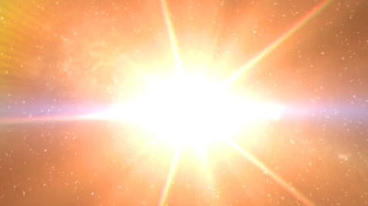

Slide 7
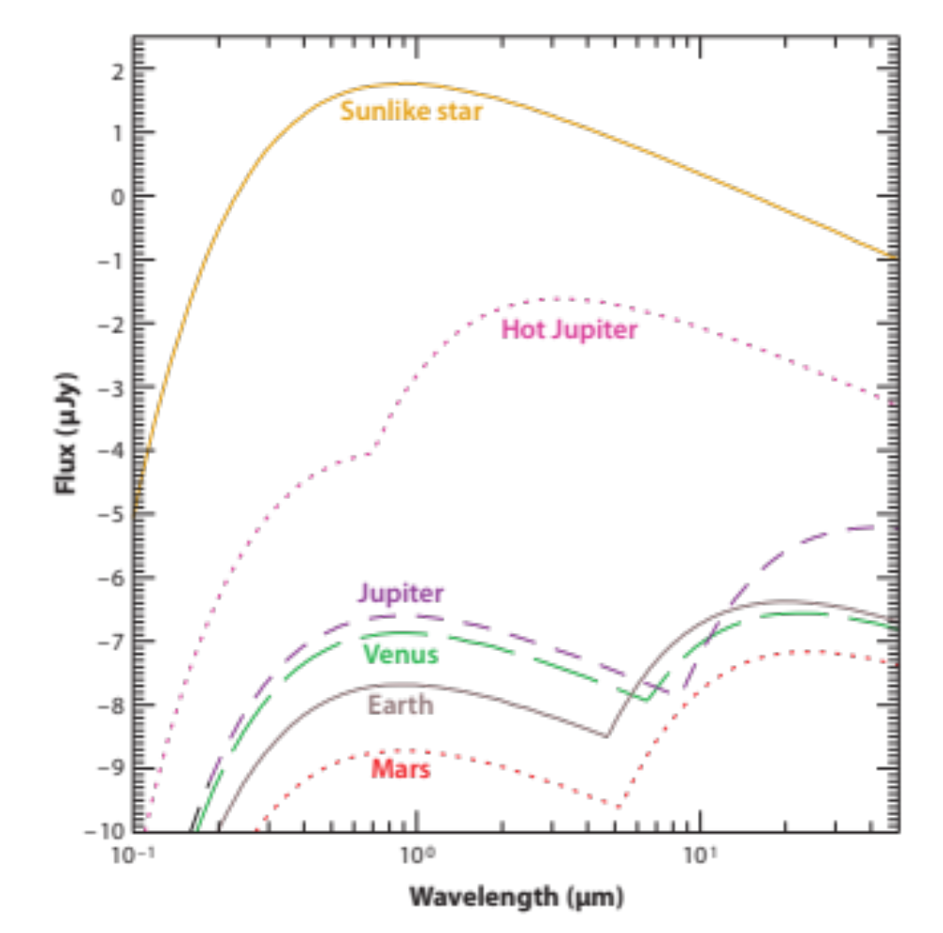
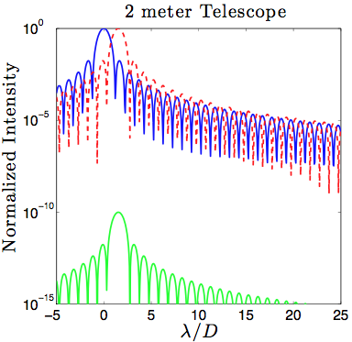
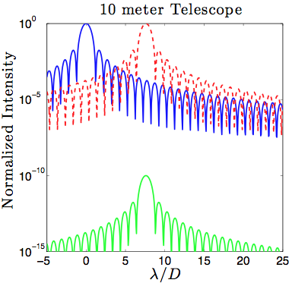
The Search for Exoplanets
Direct imaging of ExoEarths
Direct imaging of ExoEarths is extremely challenging due to:
  The flux ratio between the planet and the parent star: 10⁻¹⁰ in the visible
  The proximity of the planet to the parent star
Seager, S., Deming, D. 2010, Ann. Rev. Astron. And Astrophys., 48:631-672
Notes:
Earth is 1x10⁻¹⁰ times dimmer than the Sun.
Need D ~ 2 km for 1 AU separation at 10 pc
A solution: Beat diffraction with a coronagraph
The complexity of imaging exoplanets resides in the extreme ratio in flux with respect to their parent star, in addition to their sub-arcsecond angular proximity. For this reason, not only large telescope apertures with extreme sensitivity are required, we also need coronagraph instruments for starlight suppression.

Slide 8
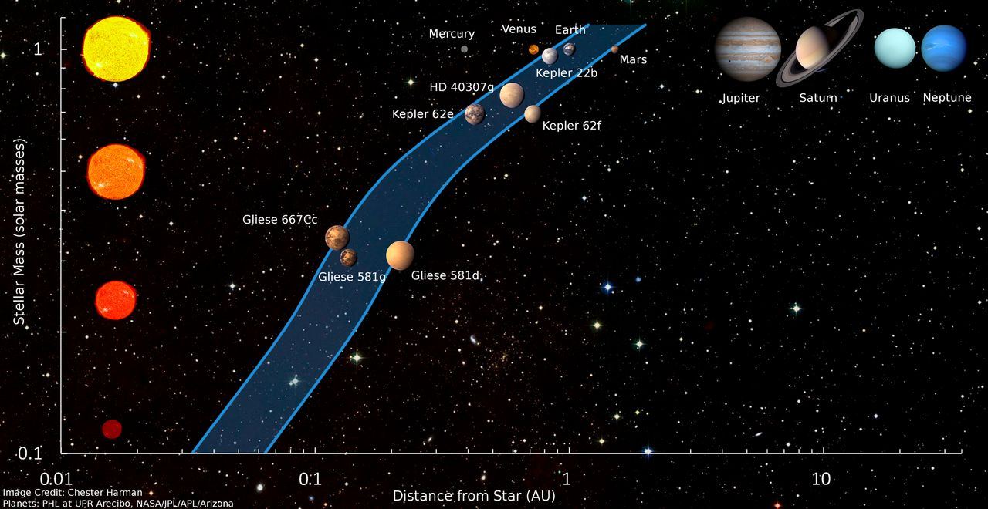
The Search for Exoplanets Access to habitable zones
Credit: ESO
Notes:
The complexity of imaging exoplanets resides in the extreme ratio in flux with respect to their parent star, in addition to their sub-arcsecond angular proximity. For this reason, not only large telescope apertures with extreme sensitivity are required, we also need coronagraph instruments for starlight suppression.
G2V (yellow dwarf)
M3V
(red dwarf) at 6.3 pc

Slide 9
An Introduction to Coronagraphy
A story of PSFs, and why it is hard

Slide 10
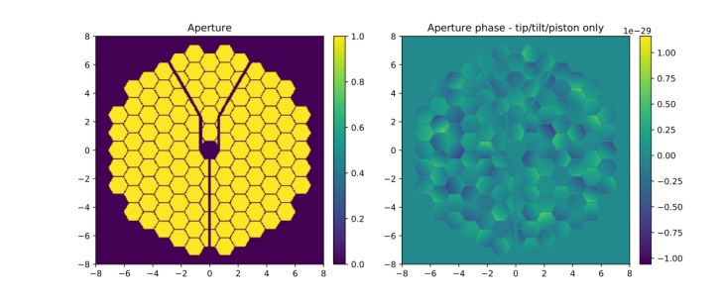
An introduction to Coronagraphy
The ‘perfect’ Apodized Pupil Lyot Coronagraph (APLC)
Soummer 2004
Aperture
Star light
Entrance pupil
Camera
Apodizer
Final focus
Notes:
Principle of operation of an APLC. Starlight (orange) and planet light (blue) enter the optical system and, after being modulated by the apodizer, are focused on the FPM plane. The stellar PSF is highly suppressed in a dark zone prescribed by the apodizer’s transmission pattern, while off-axis planet light propagates through attenuated only by the apodizer and Lyot stop.

Slide 11
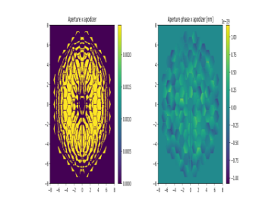
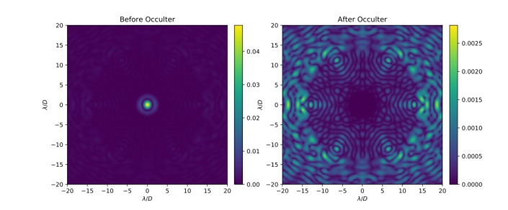
An introduction to Coronagraphy
The ‘perfect’ APLC
Before Apodizer
After Apodizer
Star light
Entrance pupil
Camera
Apodizer
Before FPM
Final focus
Notes:
Principle of operation of an APLC. Starlight (orange) and planet light (blue) enter the optical system and, after being modulated by the apodizer, are focused on the FPM plane. The stellar PSF is highly suppressed in a dark zone prescribed by the apodizer’s transmission pattern, while off-axis planet light propagates through attenuated only by the apodizer and Lyot stop.

Slide 12
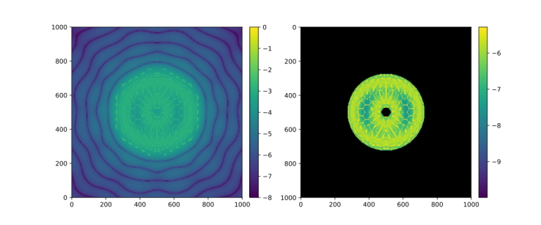
An introduction to Coronagraphy
The ‘perfect’ APLC
Before Apodizer
After Apodizer
Before Lyot Stop
Star light
Entrance pupil
Camera
Focal Plane Mask (FPM)
Apodizer
Before FPM
After FPM
Final focus
Notes:
Principle of operation of an APLC. Starlight (orange) and planet light (blue) enter the optical system and, after being modulated by the apodizer, are focused on the FPM plane. The stellar PSF is highly suppressed in a dark zone prescribed by the apodizer’s transmission pattern, while off-axis planet light propagates through attenuated only by the apodizer and Lyot stop.

Slide 13
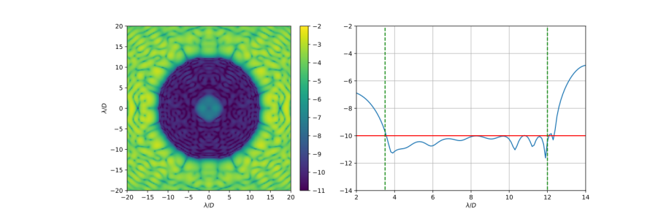
An introduction to Coronagraphy
The ‘perfect’ APLC
Before Apodizer
After Apodizer
Before Lyot Stop
After Lyot Stop
Star light
Entrance pupil
Camera
Focal Plane Mask (FPM)
Lyot Stop
Apodizer
Before FPM
After FPM
Final focus – on-axis dark zone
Notes:
Principle of operation of an APLC. Starlight (orange) and planet light (blue) enter the optical system and, after being modulated by the apodizer, are focused on the FPM plane. The stellar PSF is highly suppressed in a dark zone prescribed by the apodizer’s transmission pattern, while off-axis planet light propagates through attenuated only by the apodizer and Lyot stop.

Slide 14
An introduction to Coronagraphy
The ‘perfect’ APLC
Before Apodizer
After Apodizer
Before Lyot Stop
After Lyot Stop
Star light
Planet light
Entrance pupil
Camera
Focal Plane Mask (FPM)
Lyot Stop
Apodizer
Before FPM
After FPM
Final focus – on-axis dark zone

Slide 15
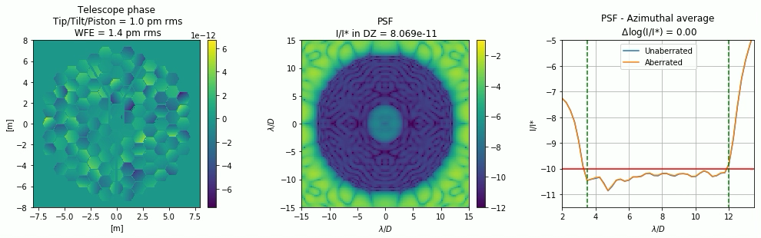
An introduction to Coronagraphy
But things are never perfect…
  Piston and tip/tilt induced phase errors added to each segment independently (random normal distribution).
Notes:
Coronagraph sensitivity to telescope aberrations

Slide 16
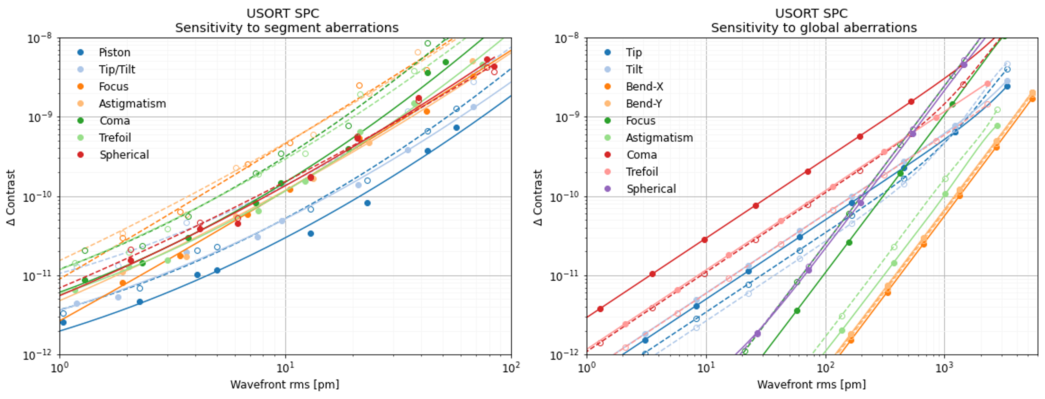
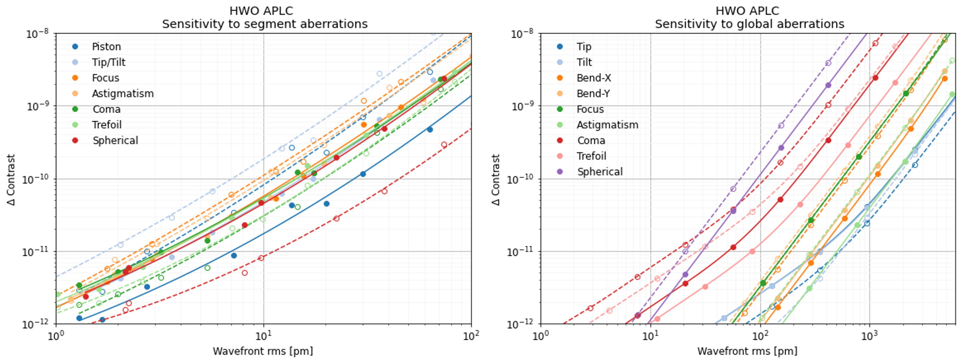
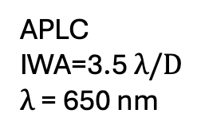
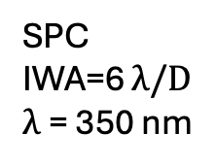
Sensitivity to telescope aberrations
Segment aberrations
Global aberrations
SPC
IWA=6 $λ/D$
$λ$= 350 nm
APLC
IWA=3.5 $λ/D$
$λ$= 650 nm

Slide 17

Coronagraph sensitivity to telescope aberrations
Wavefront sensing and control
Coronagraphs are sensitive to global aberrations and segment phasing errors
We can increase the tolerance to telescope aberrations with wavefront sensing and control (WS&C)
 | (Quasi) Static aberrations | Dynamic aberrations
Segment | Pair-wise EF estimation + EFC (Electric Field Conjugation) | Payload metrology (edge sensors)
Global | Phase retrieval | LOWFS (Low Order Wavefront Sensing)
Tip/tilt
Piston
Segment jitter
Segment drift
LoS pointing error
Notes:
Global aberrations:
spherical: 55.53
trefoil: 366.91
coma: 158.18
astigmatism: 1309.46
focus: 749.76
bend-y: 1064.69
bend-x: 1123.97
Segment phasing errors:
piston:9.24
tiptilt: 11.16
focus:17.92
astigmatism: 16.49
coma: 29.20
trefoil: 29.33
spherical: 42.26
nbw
Out[81]: 5
bw
Out[82]: 10.0
wavelength_c
Out[83]: 5.75e-07
coro.wavelength_c
Out[84]: 5.75e-07

Slide 18
An introduction to Coronagraphy
WFS&C + Coronagraph
Planet light
Pupil
Star light
DM1
Apodizer
Lyot Stop
DM2
Focal Plane Mask (FPM)
OAP2
OAP3
OAP4
OAP5
Camera
OAP1
Wavefront sensing
and control
Coronagraph instrument

Slide 19
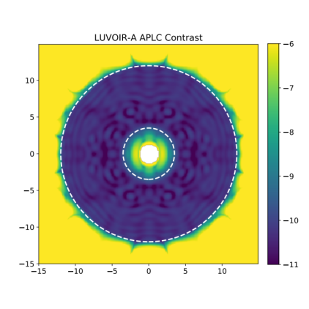
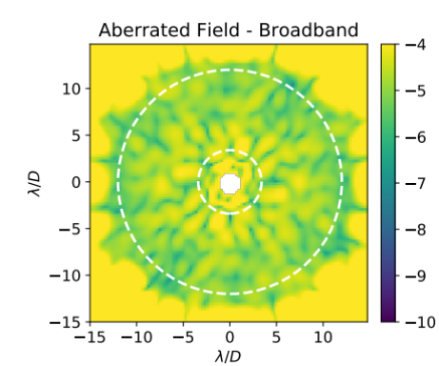
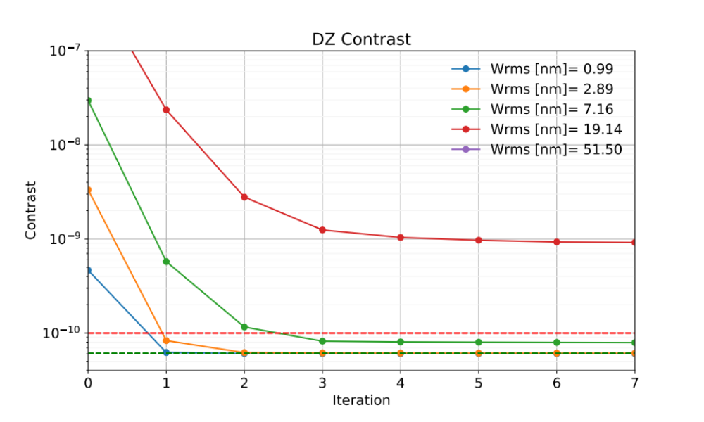
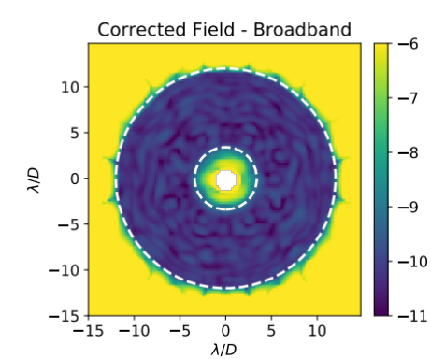
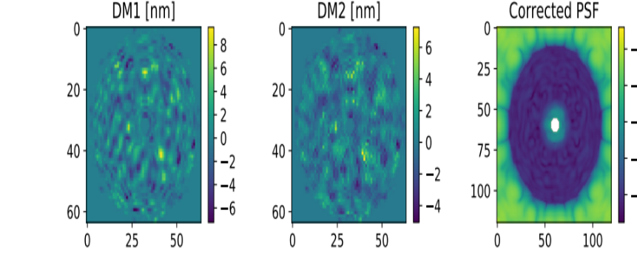
An introduction to Coronagraphy
APLC + WFS&C
Broadband EFC (10%) with 2 deformable mirrors (DM) (64 x 64 actuators per DM)
Perfect APLC
Phase error
Aberrated APLC
Corrected APLC
P/T/T rms = 7.07 nm
Notes:
err_val [1.00000000e-09, 2.66072506e-09, 7.07945785e-09, 1.88364909e-08]
initial aberrated: array([4.06546029e-07, 2.70497859e-06, 1.92158416e-05, 1.25318803e-04])

Slide 20
Characterizing exoplanets in the UV

Slide 21
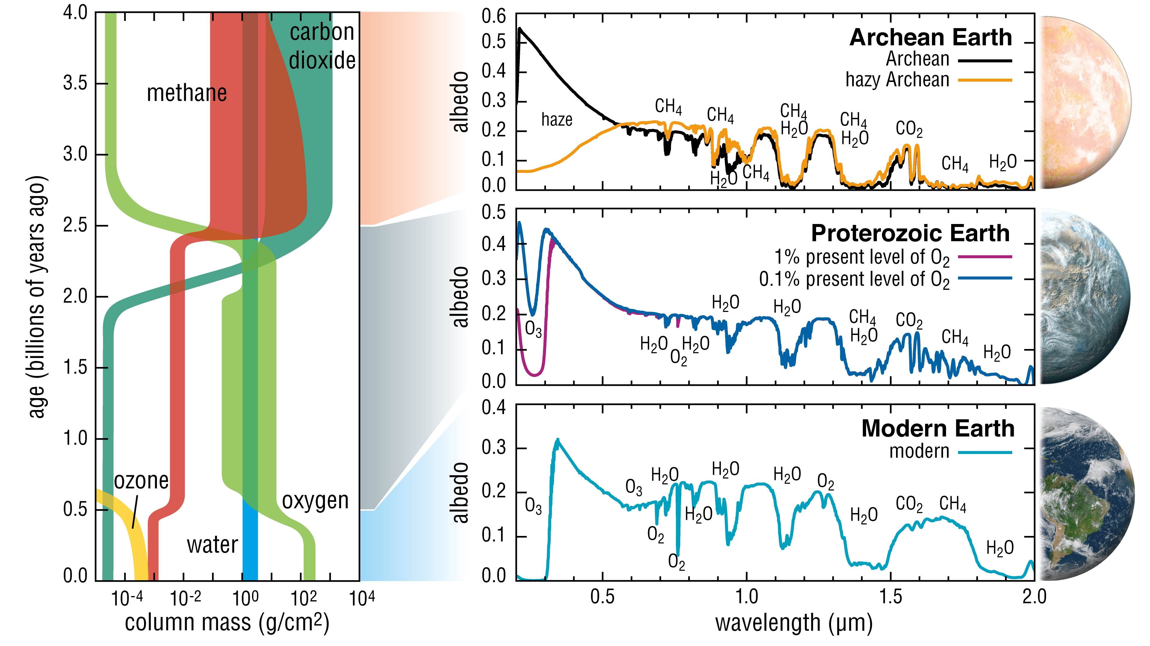
Characterizing exoplanets in the UV
UV observations inform a planet’s lifetime
O3 has been detectable longer than O2
Notes:
high value of near-ultraviolet wavelength coverage for characterizing the atmospheres of Earth-like exoplanets. In particular, the EASS panel noted that a key biosignature, O2, was only detectable remotely during the past 1-2 Gyr of Earth’s history. The O3 Hartley-Huggins absorption band at 200–350 nm, however, is a much more sensitive indicator of the presence of Oxygen, presenting a strong feature in Earth’s reflected light spectrum even when O2 was at the much lower concentrations that occurred during the Proterozoic epoch (0.1%): “UV observations therefore critically enhance sensitivity to signs of photosynthesis over a larger range of a planet’s lifetime.”
Motivated in large part by the high sensitivity of the O3 Hartley-Huggins band as a proxy for photosynthetically produced Oxygen, as well as the measurement of spectral slope features induced
by scattering from atmospheric hazes, both the LUVOIR and HabEx decadal mission concept studies baselined instrumentation for characterizing the atmospheres of directly imaged exoplan- ets down to wavelengths of 200 nm. The coronagraph instrument concepts for both LUVOIR-A and LUVOIR-B included a near-UV channel for direct coronagraphic imaging with a delta-doped EMCCD over a 200–525 nm wavelength range. Broadband photometry of an exoplanet over a series of color filters in this range enables an effective spectral resolution of R∼6, which is suffi- cient to sample the profile of the Hartley-Huggins absorption band. In the HabEx mission concept baseline, only the Starshade Instrument (SSI) operates at near-UV wavelengths;

Slide 22
A standalone UV coronagraph

Slide 23
Characterizing exoplanets in the UV
UV coronagraphy is hard
UV coronagraphy is one of the most challenging endeavors for several reasons. If one was to consider a UV channel as part of the main coronagraph instrument, the issues could be summarized as follow:
  Presence of optical components with non-UV optimized coatings
  Need of dichroics - nonuniformity across the pupil and leaked out-of-band light entering the coronagraph
  A large number of low reflectivity optical components
  Speckle intensity scales with λ⁻² -> more strict wavefront error requirements than at visible wavelengths
BUT
UV coronagraphy can be simplified

Slide 24
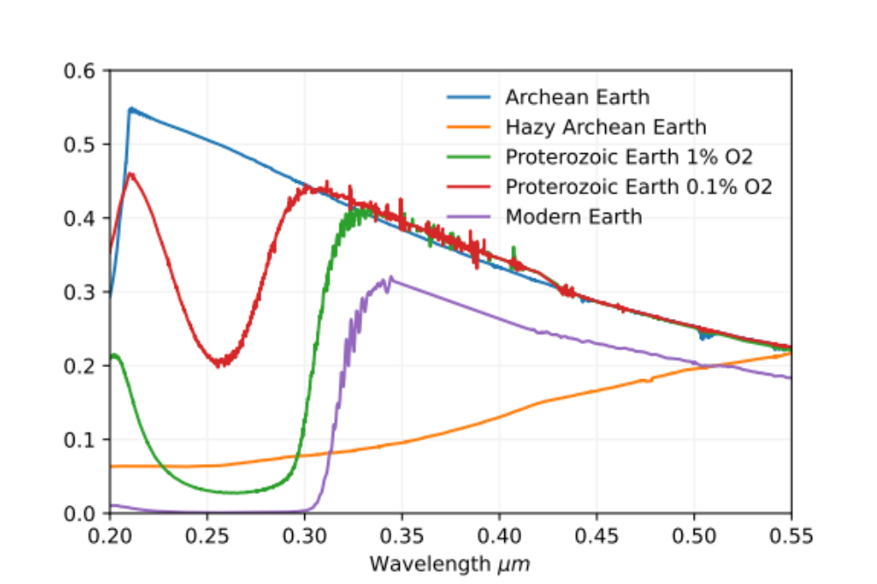
A standalone UV coronagraph
Facts/assumptions
From a science perspective
UV observations are required AFTER visible detection and characterization
What type of spectral features do we want to detect? broad, NUV features
From a technology perspective
Non-parallel observations – standalone instrument
What is our spatial region of interest? We can redefine the dark zone
Spectroscopy is not required – photometry is enough
O3 Hartley-Huggins absorption band -> strong proxy for Oxygen

Slide 25
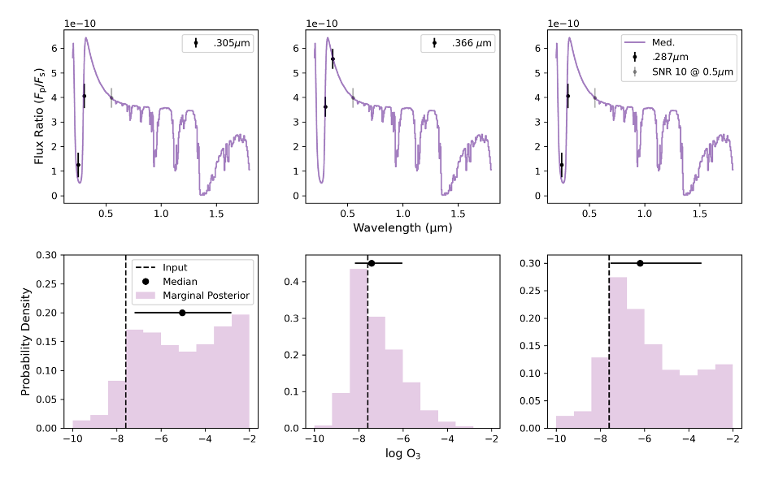
A standalone UV coronagraph
From science to instrument requirements
Preliminary retrievals of O3 on a moderate O2 abundance (0.5% PAL) Earth twin.
Two 20% photometric bandpasses near the red edge of the O3 feature appear adequate with reasonable SNR
Credit: Amber Young
Notes:
Preliminary retrievals of O3 on a moderate O2 abundance (0.5% PAL- present atmospheric level) Earth twin. Two 20% photometric bandpasses near the red edge of the O3 feature appear adequate with reasonable SNR (Amber Young, private communication)
Observations to search for O3 would most likely occur along the red edge of the O3 band- pass, where stellar flux is significantly brighter. As shown in the middle panel of Figure 4, pre- liminary efforts to retrieve O3 on moderate O2 abundance (0.5% PAL) Earths suggest that only two photometric bandpasses straddling the red edge of the feature are required to detect O3, with one bandpass near the continuum and the other solidly within the feature (Amber Young, private communication). These bandpasses were assumed to be 20% (R=5) and exposure times were benchmarked to achieve an SNR=10 at 550 nm. Results are similar for an even lower abundance scenario. These results assume O3 is the only absorber in the UV and no confusion exists from SO2 .
Esentially Proterozoic Earth had much less oxygen than present day where estimates for the O2 abundance range anywhere between 0.1% and 10% of present day levels. The simulations I did were actually on the low range at 0.5% and 0.05% (sorry it's not quite the same as the older labeled plot above but I made sure the correct values were quoted in the report)

Slide 26

Simplification #1
Reshape the DZ - Increase of design IWA
The IWA is proportional to the wavelength
In the UV, we want to access exoplanets already detected in the visible
The UV is more sensitive to aberrations – same phase error for a smaller surface displacement
The IWA required in the UV is ~2 x IWA_{VIS}
300 nm
Outer Working Angle (OWA)
Inner Working Angle
(IWA)
600 nm
IWA
OWA
IWA, OWA $∝λ/D$
Advantage: increase tolerance to aberrations, increase throughput for shaped pupil coronagraphs

Slide 27
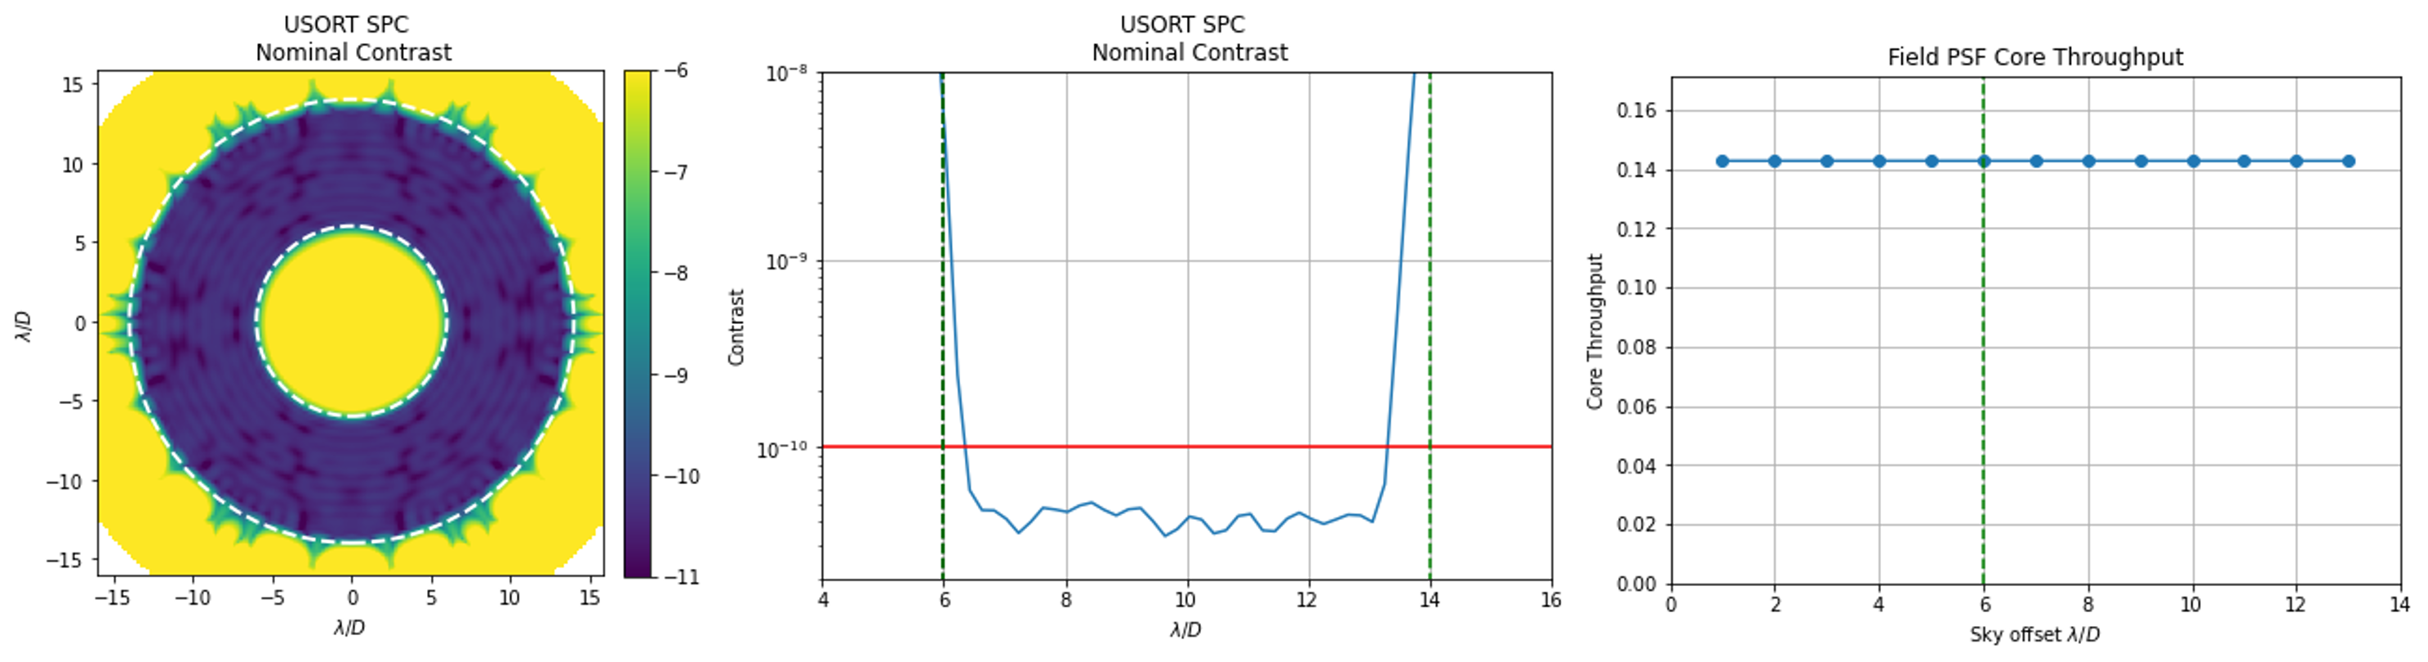
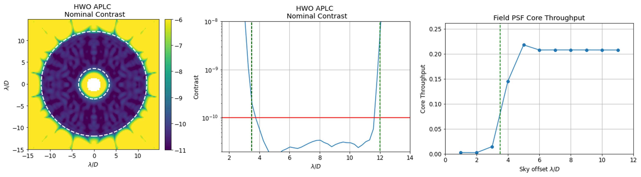
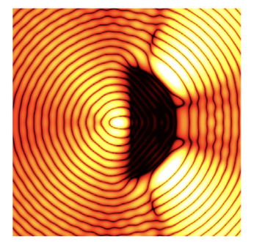
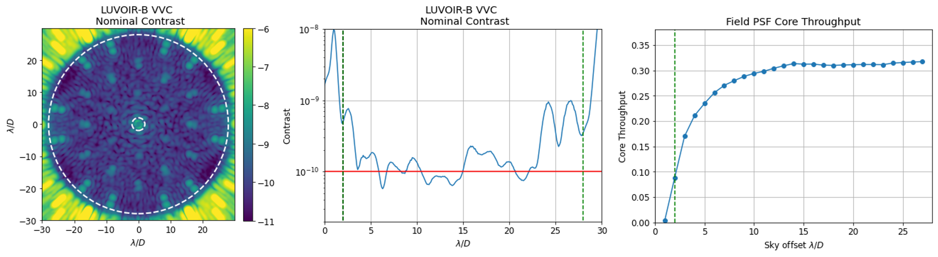
Simplification #1
Reshape the DZ
Because the UV coronagraph is a UV characterization only instrument, the dark zone does not need to be circular/symmetric
Current available designs:
  SPC (HWO design, circular DZ, larger IWA)
  APLC (HWO design, circular DZ, larger IWA)
  VVC (circular DZ, LUVOIR-B design)
In progress:
  PAPLC (HWO design,
  half DZ, larger IWA)
  VVC (HWO design, circular DZ, larger IWA)
Advantage: increase throughput, reduce complexity, increase contrast

Slide 28
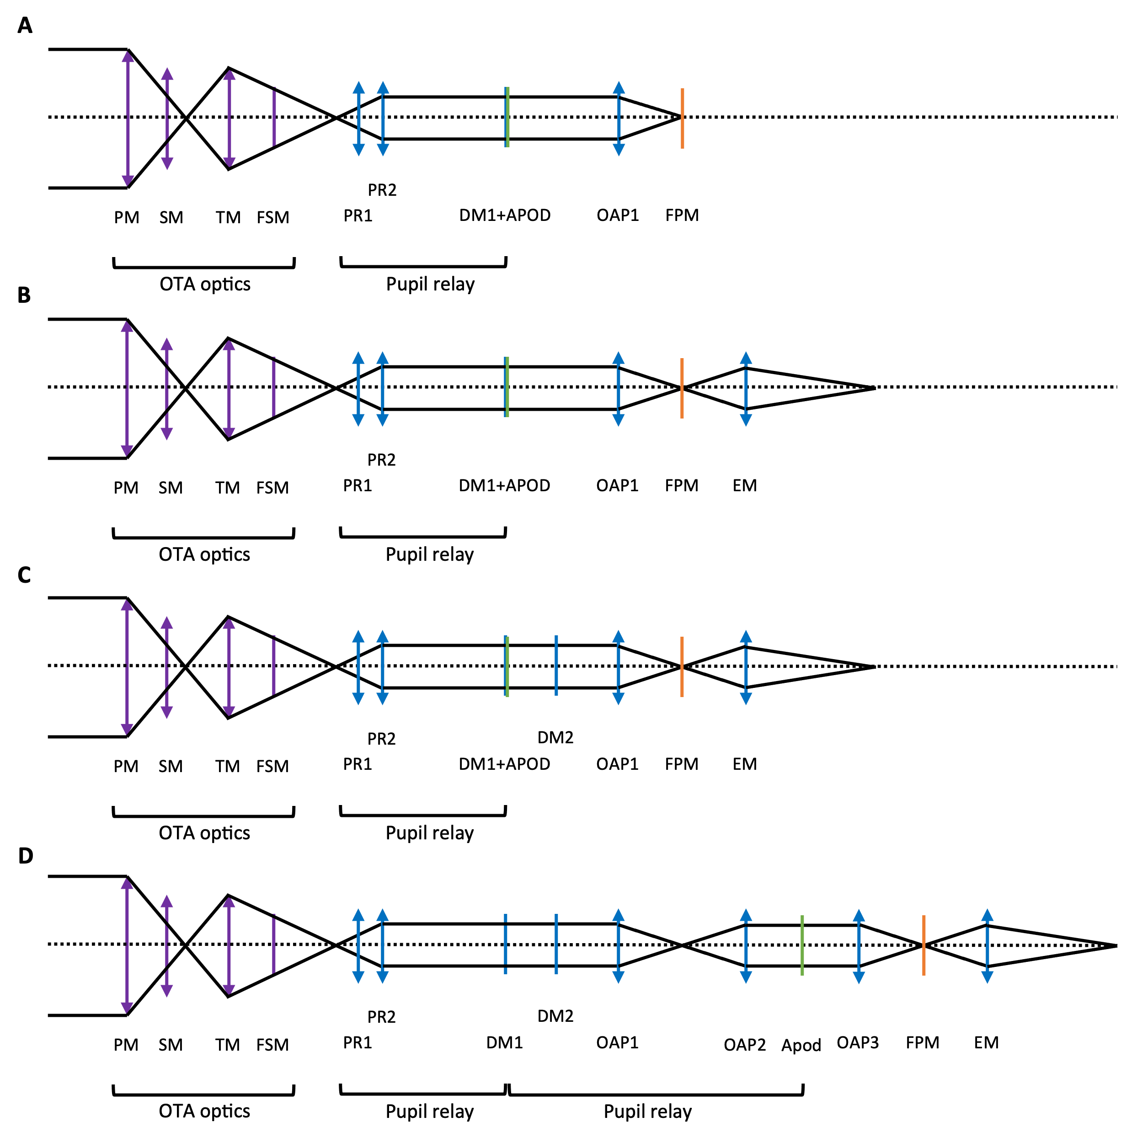
Simplification #2
Reduce the number of optics
Possible designs from simplest to more complex:
A: for a half dark zone, theoretically only one DM is needed; FPM/FS on the detector
B: half DZ, separate FPM to allow different coronagraph designs
C: full DZ with 2DM control, APOD on DM2
D: LUVOIR ECLIPS design
Advantage: increase throughput, reduce volume, reduce optical train aberrations

Slide 29
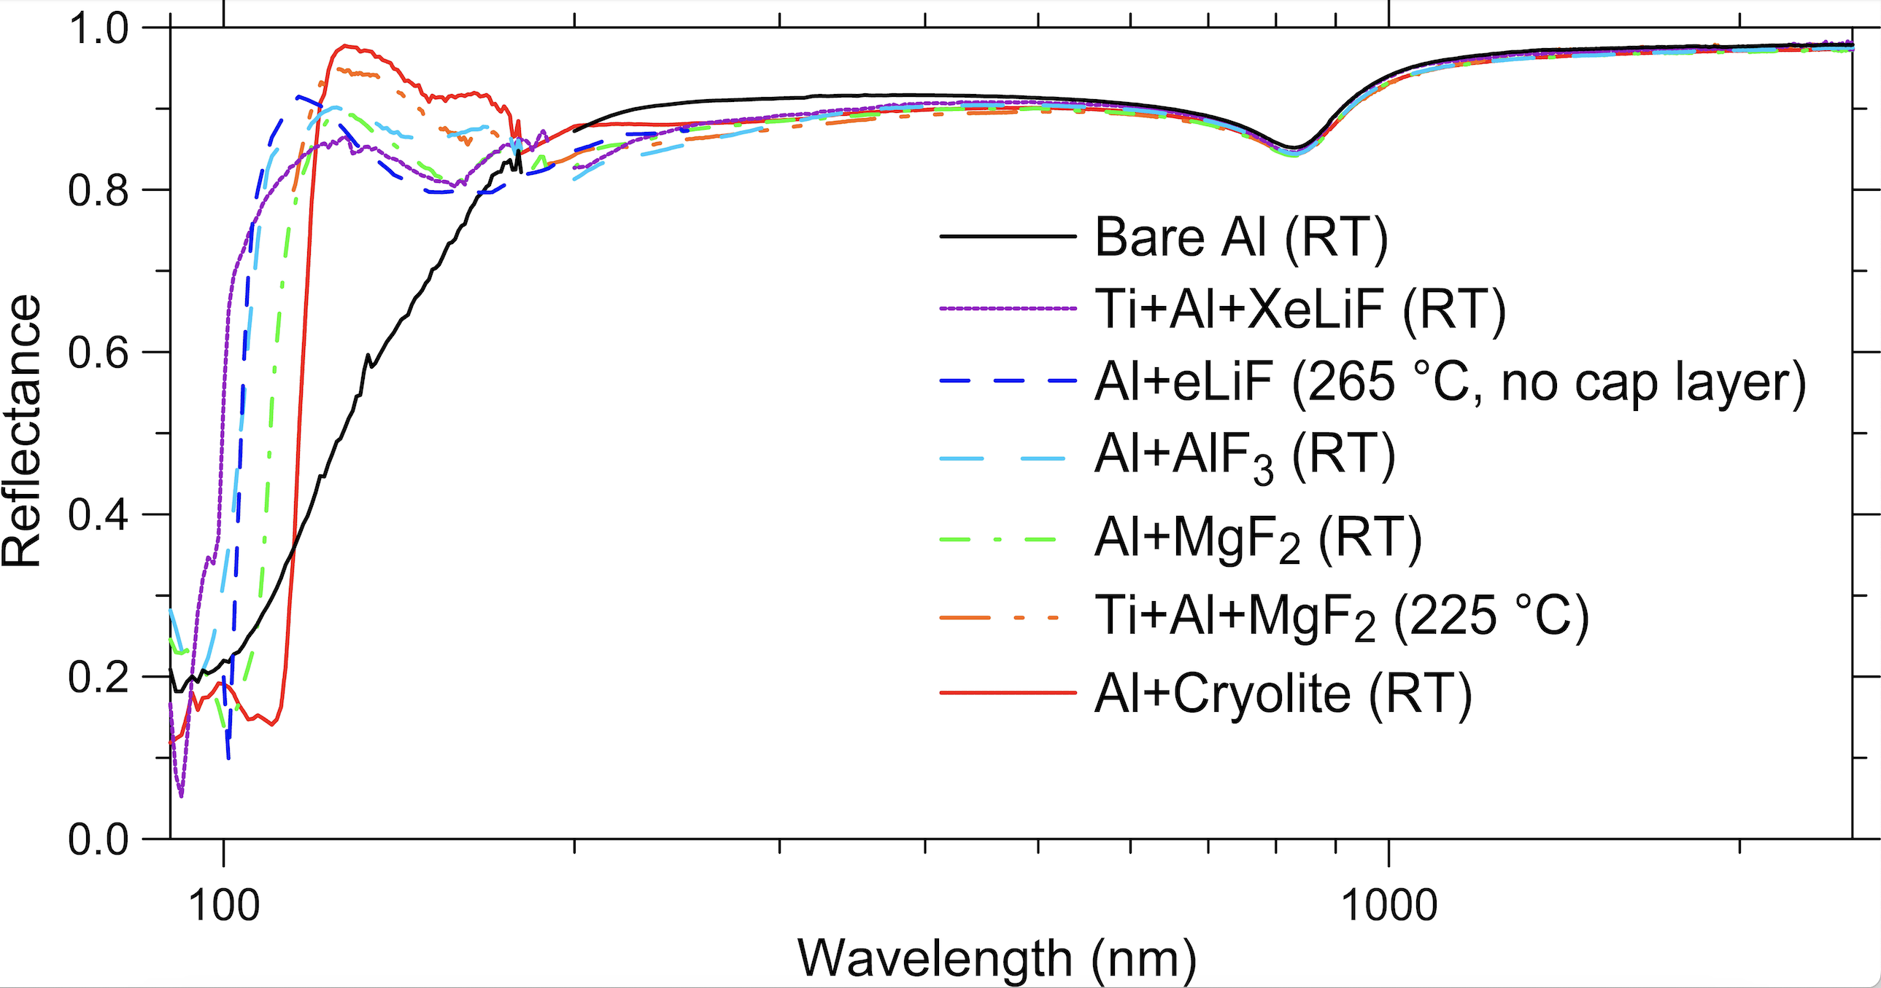
A standalone UV coronagraph
Other important considerations for a UV coronagraph
Polarization aberrations
UV Coatings
Non-negligible at the HWO required contrast levels. Larger IWA results in lower sensitivity.
Coating uniformity variations (including birefringence) can introduce additional polarization-dependent WFE. This can be ameliorated by using uniformity optimized coating chambers
MKIDS – Micorwave Kinetic Inductance Detectors
SNSPD – Superconducting nanowire single-photon detectors
TES – Transition Edge Sensors
  Only coatings with high reflectance down to ~200 are needed
  UV coated DMs pose a unique challenge due to deposition processes – but only at the FUV
  For a UV coronagraph > 200 nm, the best coating solution on the DM would be based on Al+MgF2 coating to achieve ∼ 75−80% reflectivity.
UV detectors for high contrast imaging in the NUV

Slide 30
Conclusions
Report coming out soon
Coronagraphy in general is hard
Coronagraphy in the UV is HARDER
We can simplify coronagraphy in the UV by:
  Increasing the IWA
  Reshaping the dark zone
  Redesign the optical train - reducing the number of optics
  Removing spectroscopy capabilities
Although promising, more research is needed to fully design and constrain a UV coronagraph instrument (new mask designs, coatings, UV-coated DMs, detectors, testbeds, among others)
A UV standalone coronagraph provides access to the necessary data to characterize ExoEarths at different evolutionary stages

Slide 31
