Slide 1
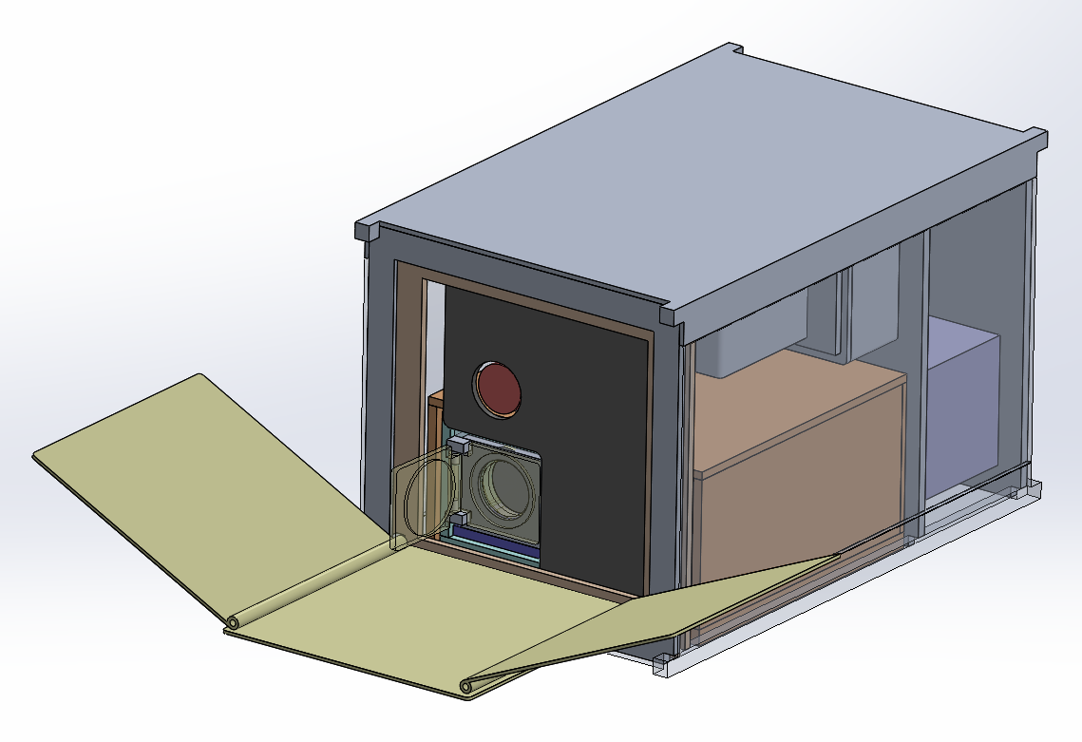
Nox: A Mission Concept for All-Sky Far-Ultraviolet Background Mapping
UV Science and Instrumentation Workshop, May 9th, 2024
Presenter: Haeun Chung (PI)
Assistant Research Professor, Steward Observatory, University of Arizona
Nox team: C. Vargas, E. Hamden, W. Harris, J. Corliss, H. Choi, S. Uppnor (U Arizona), D. Miles (Caltech), M. Quijada, M. Batkis, L. Rodriguez de Marcos (GSFC), A. Jewell, J. Hennessy, L. Moustakas (JPL), F. Grise (Penn State), D. Schiminovich (Columbia), K. Hoadley (U Iowa), K. Seon, Y. Jo (KASI)

Slide 2
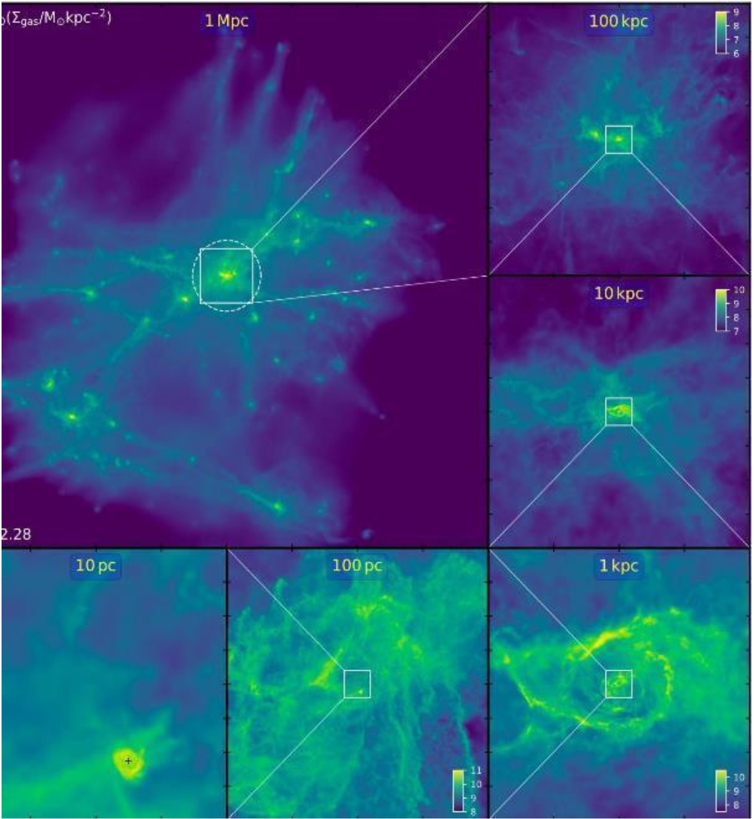
Mapping the CGM and IGM in Emission - from Astro 2020 Decadal
”Mapping the Circumgalactic Medium and Intergalactic Medium in Emission”. (CGM/IGM)
  Discovery area of the theme “Cosmic Ecosystem”, Pathway to Discovery in Astronomy and Astrophysics for the 2020s (PDAA), Galaxies
CGM/IGM in emission is often extremely faint – possibly below 10⁻²⁰ erg/s/cm²/arcsec² (PDAA, D-16).
  ~10 LU [photons/s/cm²/sr] in Far-UV
Anglés-Alcázar+21
Presenter: Haeun Chung

Slide 3
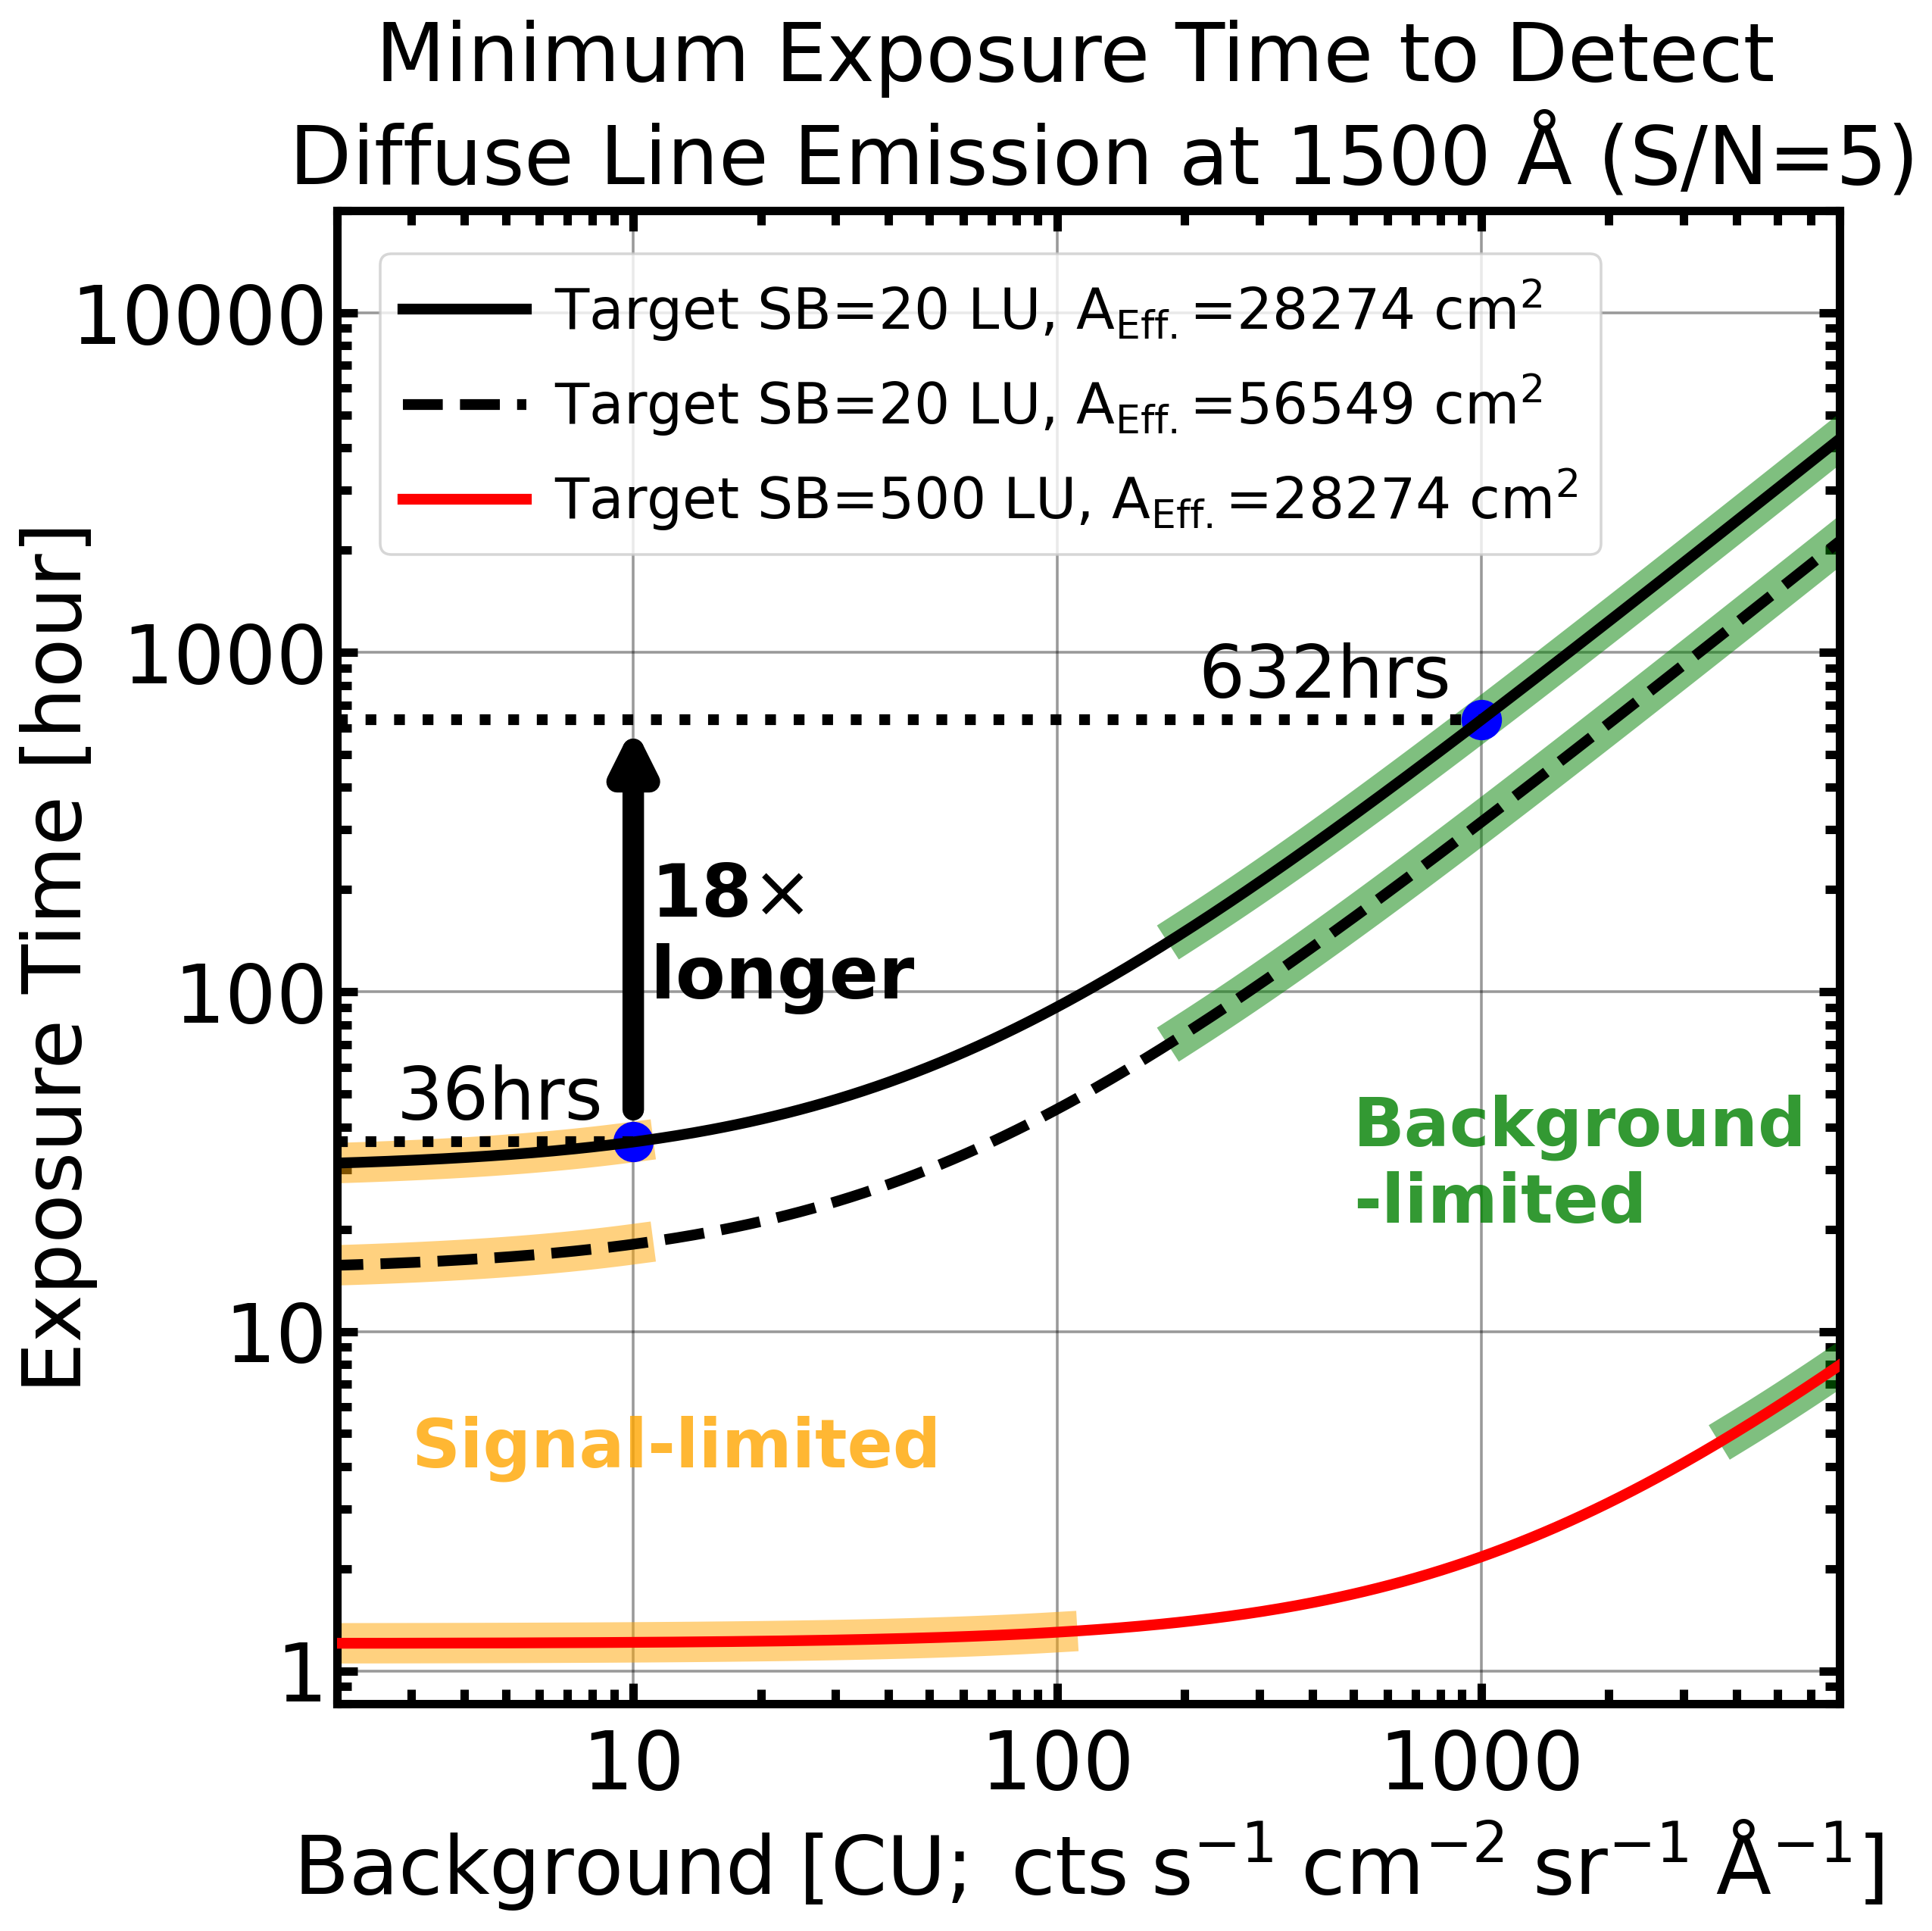
Mapping the CGM and IGM in Emission - from Astro 2020 Decadal
”Mapping the Circumgalactic Medium and Intergalactic Medium in Emission”. (CGM/IGM)
  Discovery area of the theme “Cosmic Ecosystem”, Pathway to Discovery in Astronomy and Astrophysics for the 2020s (PDAA), Galaxies
CGM/IGM in emission is often extremely faint – possibly below 10⁻²⁰ erg/s/cm²/arcsec² (PDAA, D-16).
  ~10 LU [photons/s/cm²/sr] in Far-UV
Faint diffuse emission detection is very challenging, even with 6-m class space telescope
Without knowing the background, we cannot plan for future missions.
  To detect such a faint feature, prior knowledge on background is essential.
Anglés-Alcázar+21
Presenter: Haeun Chung

Slide 4
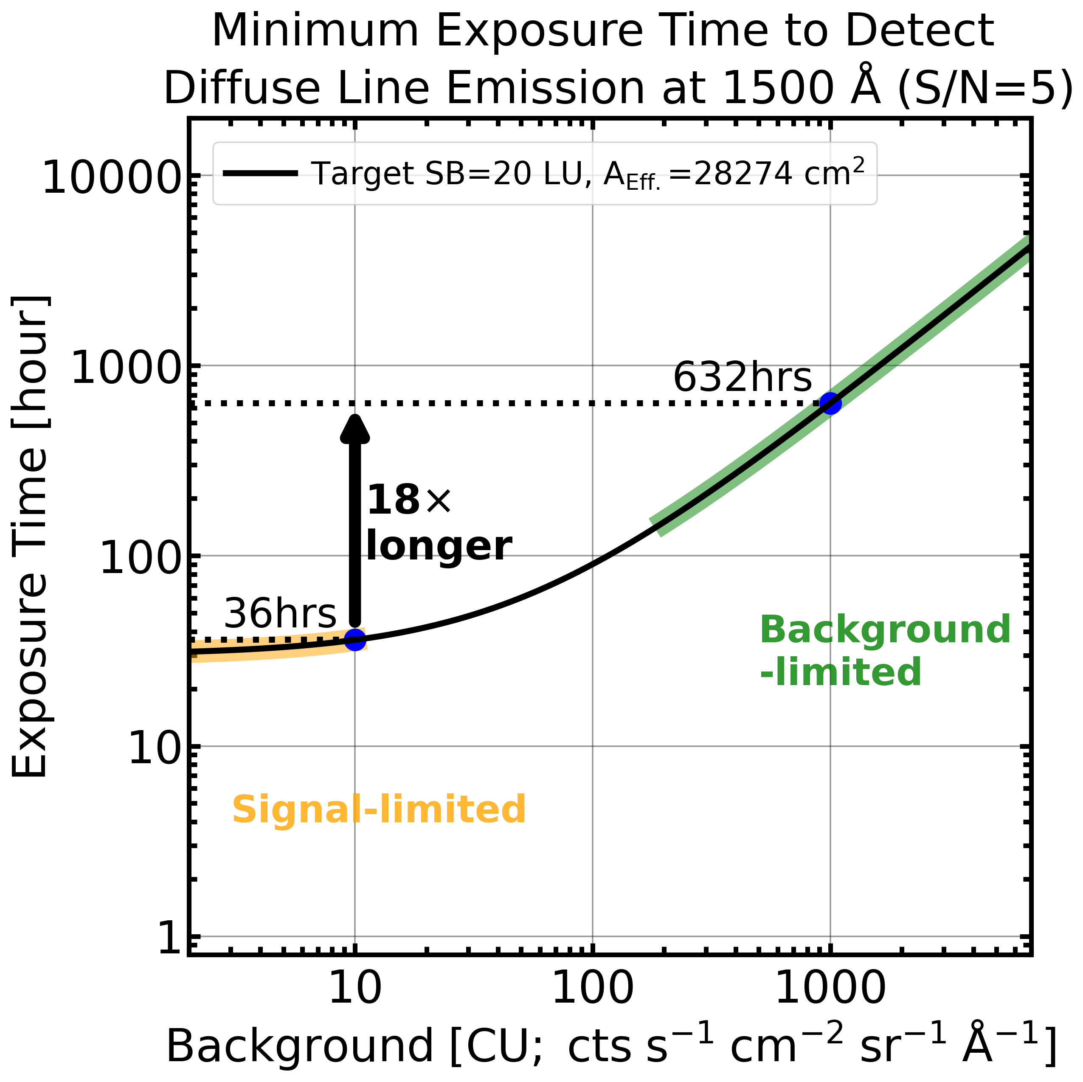
Mapping the CGM and IGM in Emission - from Astro 2020 Decadal
”Mapping the Circumgalactic Medium and Intergalactic Medium in Emission”. (CGM/IGM)
  Discovery area of the theme “Cosmic Ecosystem”, Pathway to Discovery in Astronomy and Astrophysics for the 2020s (PDAA), Galaxies
CGM/IGM in emission is often extremely faint – possibly below 10⁻²⁰ erg/s/cm²/arcsec² (PDAA, D-16).
  ~10 LU [photons/s/cm²/sr] in Far-UV
Faint diffuse emission detection is very challenging, even with 6-m class space telescope
Without knowing the background, we cannot plan for future missions.
  To detect such a faint feature, prior knowledge on background is essential.
Anglés-Alcázar+21
Presenter: Haeun Chung

Slide 5
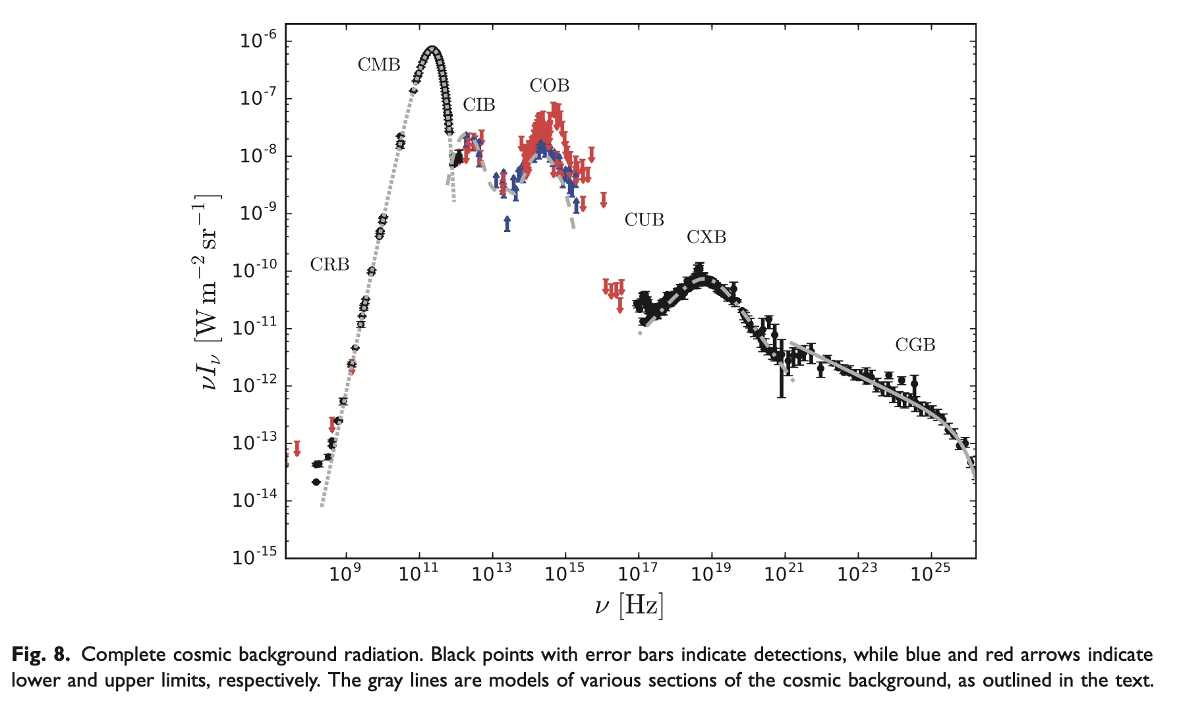
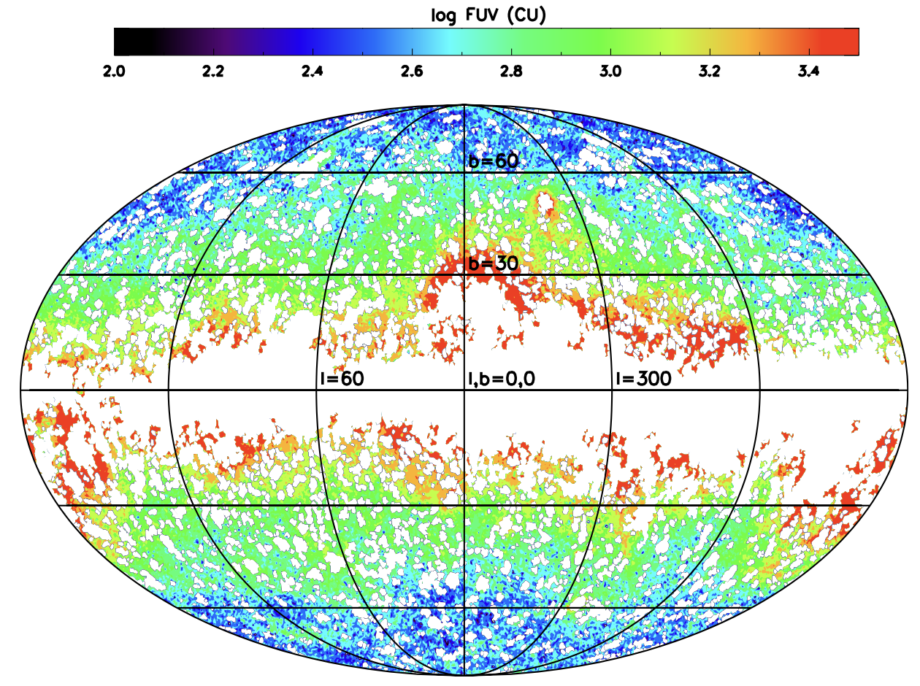
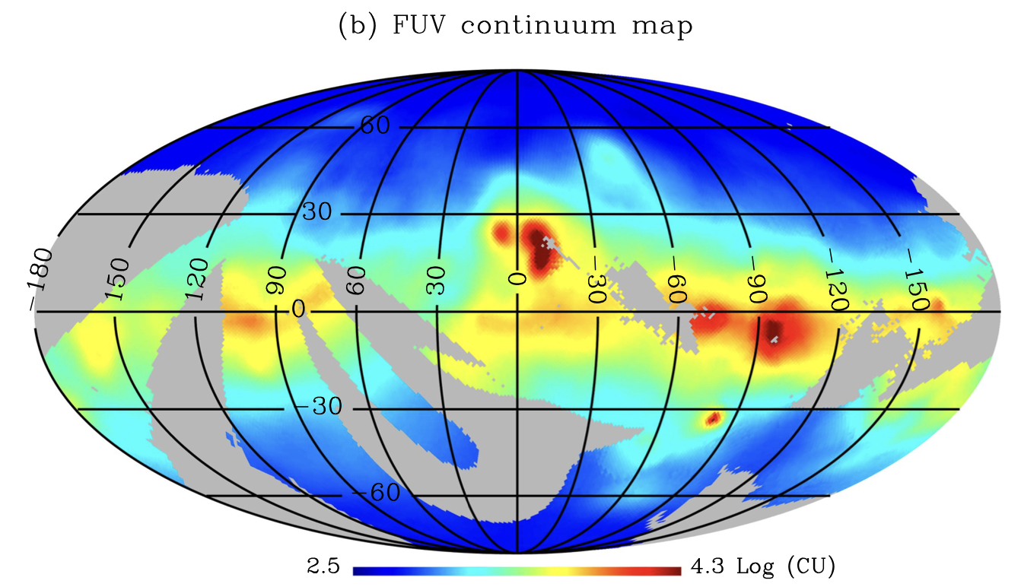
What do we know about FUV/LUV background as of year 2024
Hamden+2013
Hill+2018
At Far-UV (130 - 175 nm), we essentially have only a single data point, with spectral resolution of about 3.
  GALEX FUV imaging data (134-179 nm), 65% sky coverage
  FIMS/SPEAR L-band spectroscopic data (135-175 nm), 76% sky cov.
At Lyman-UV (LUV, 90 - 115 nm), we only know the upper limit.
Jo+2017
5
Presenter: Haeun Chung

Slide 6
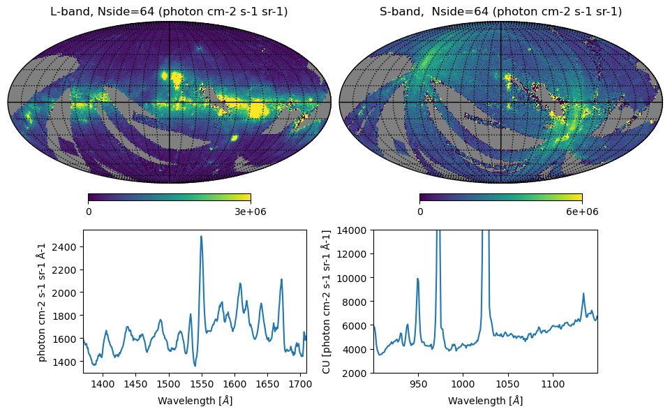
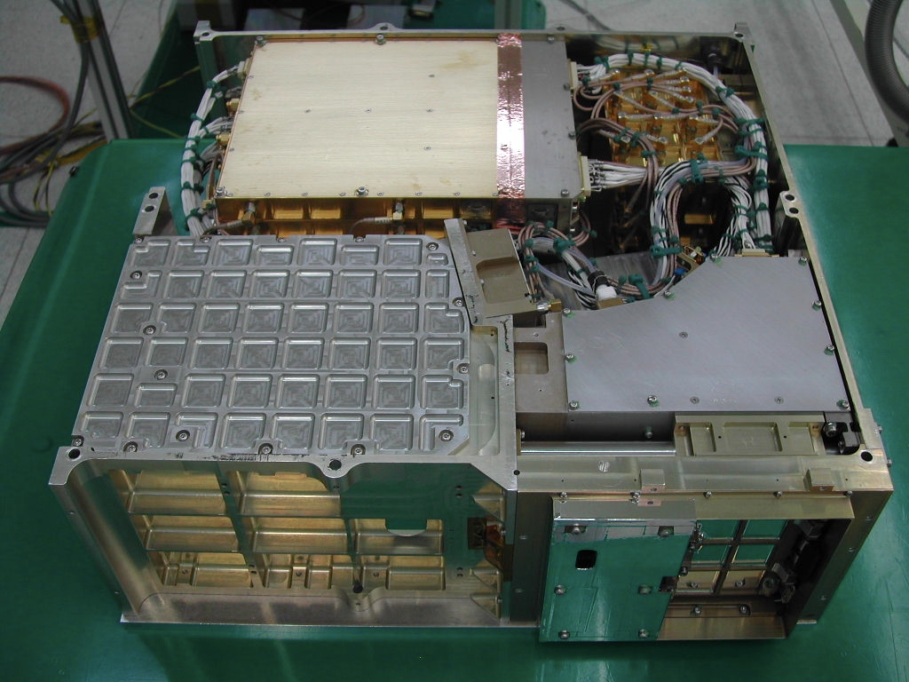
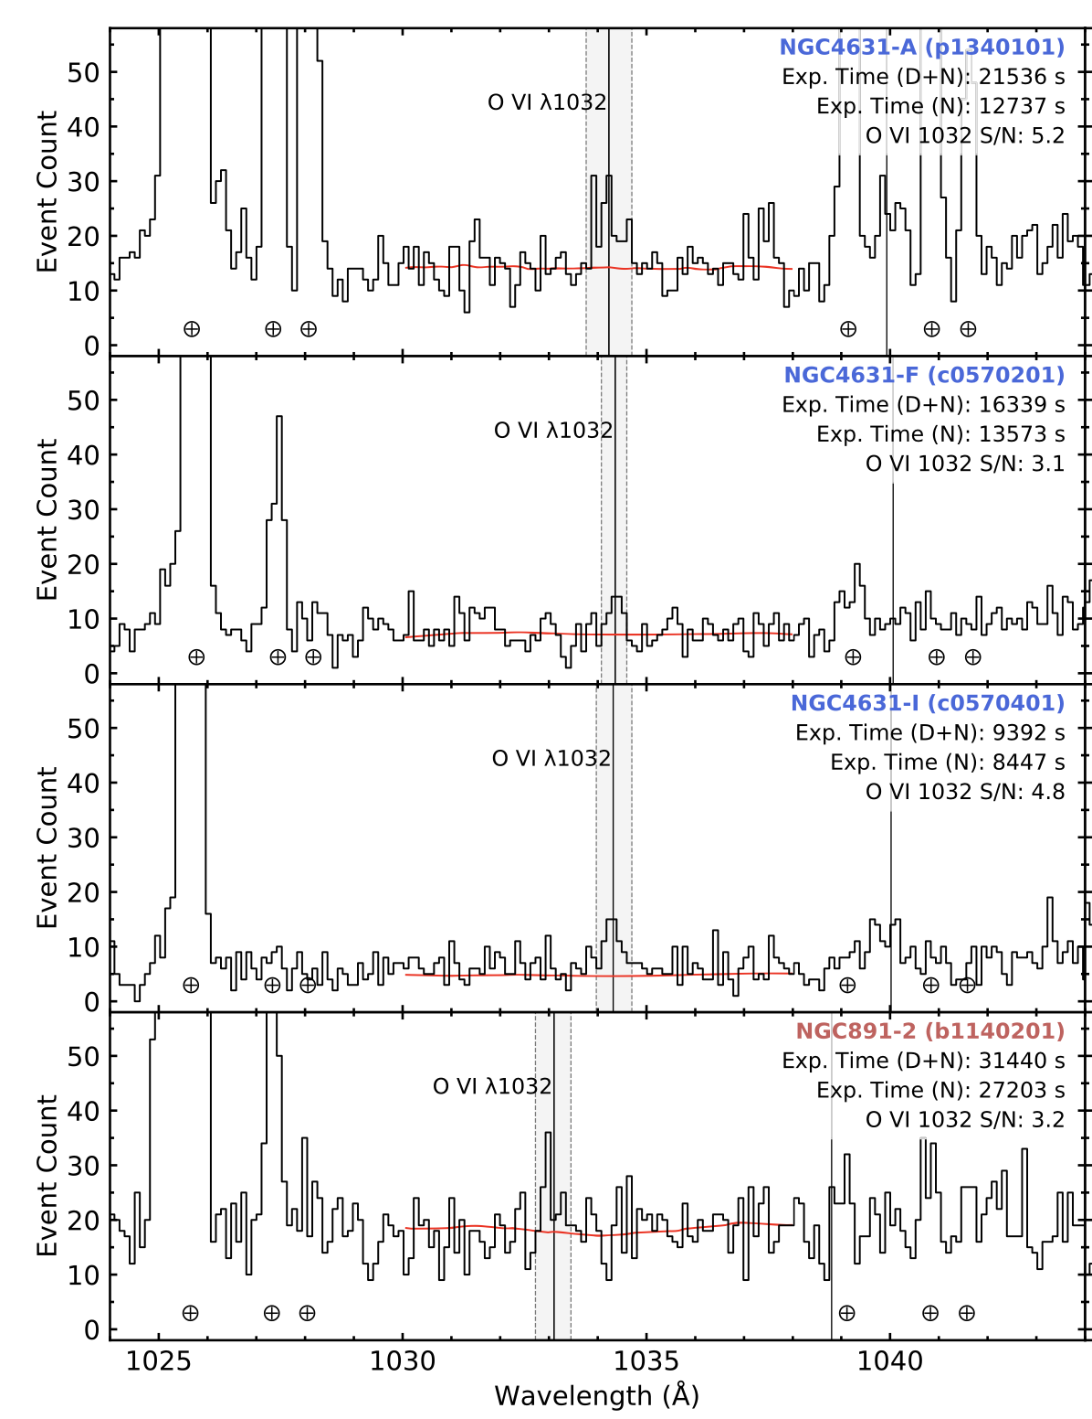
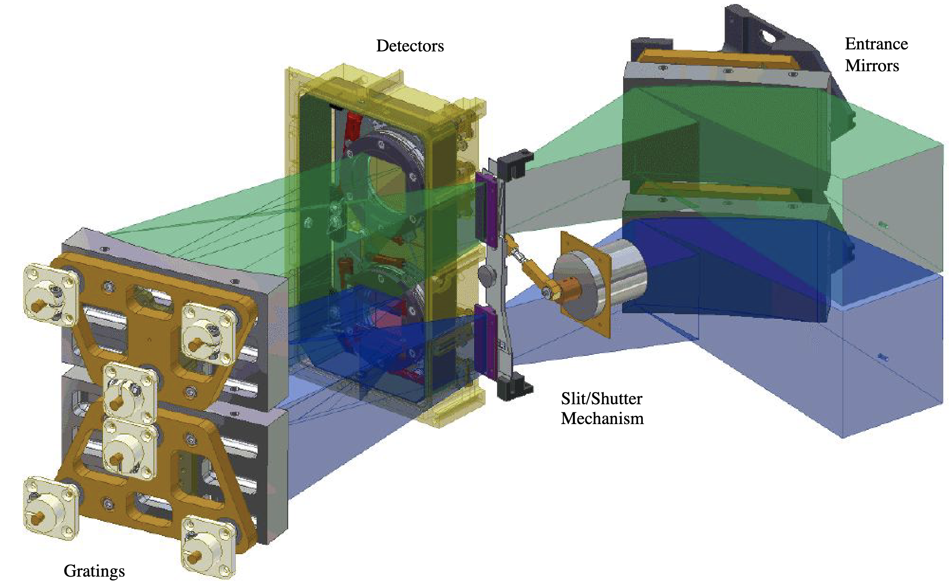
Lyman-UV Background: FIMS/SPEAR S-band
FIMS All-Sky spectrum
FIMS/SPEAR S-band
Wavelength | 900 – 1175 Å
Spectral Resolution | R ∼ 700
Slit Size | 4° x 4.6’
Sensitivity at O VI (1032A) | 1000 LU per 3° x 3°
-> Cont.: ∼5,000 CU from inst. scatter
FUSE Spectrum example (Chung+2021)
Korpela+2003
https://archive.stsci.edu/missions-and-data/fims-spear
-> Cont.: ∼10,000 CU, mostly
from the detector BG
Presenter: Haeun Chung

Slide 7
Lyman-UV Background: FIMS/SPEAR S-band
FIMS All-Sky spectrum
FIMS/SPEAR S-band
Wavelength | 900 – 1175 Å
Spectral Resolution | R ∼ 700
Slit Size | 4° x 4.6’
Sensitivity at O VI (1032A) | 1000 LU per 3° x 3°
Q.: How bright is Lyman-UV Sky Background?
-> Cont.: ∼5,000 CU from inst. scatter
FUSE Spectrum example (Chung+2021)
Korpela+2003
https://archive.stsci.edu/missions-and-data/fims-spear
-> Cont.: ∼10,000 CU, mostly
from the detector BG
Presenter: Haeun Chung

Slide 8
Lyman-UV Background: FIMS/SPEAR S-band
FIMS All-Sky spectrum
FIMS/SPEAR S-band
Wavelength | 900 – 1175 Å
Spectral Resolution | R ∼ 700
Slit Size | 4° x 4.6’
Sensitivity at O VI (1032A) | 1000 LU per 3° x 3°
Q.: How bright is Lyman-UV Sky Background?
?
(< 1000 CU ?)
-> Cont.: ∼5,000 CU from inst. scatter
FUSE Spectrum example (Chung+2021)
Korpela+2003
https://archive.stsci.edu/missions-and-data/fims-spear
-> Cont.: ∼10,000 CU, mostly
from the detector BG
Presenter: Haeun Chung

Slide 9
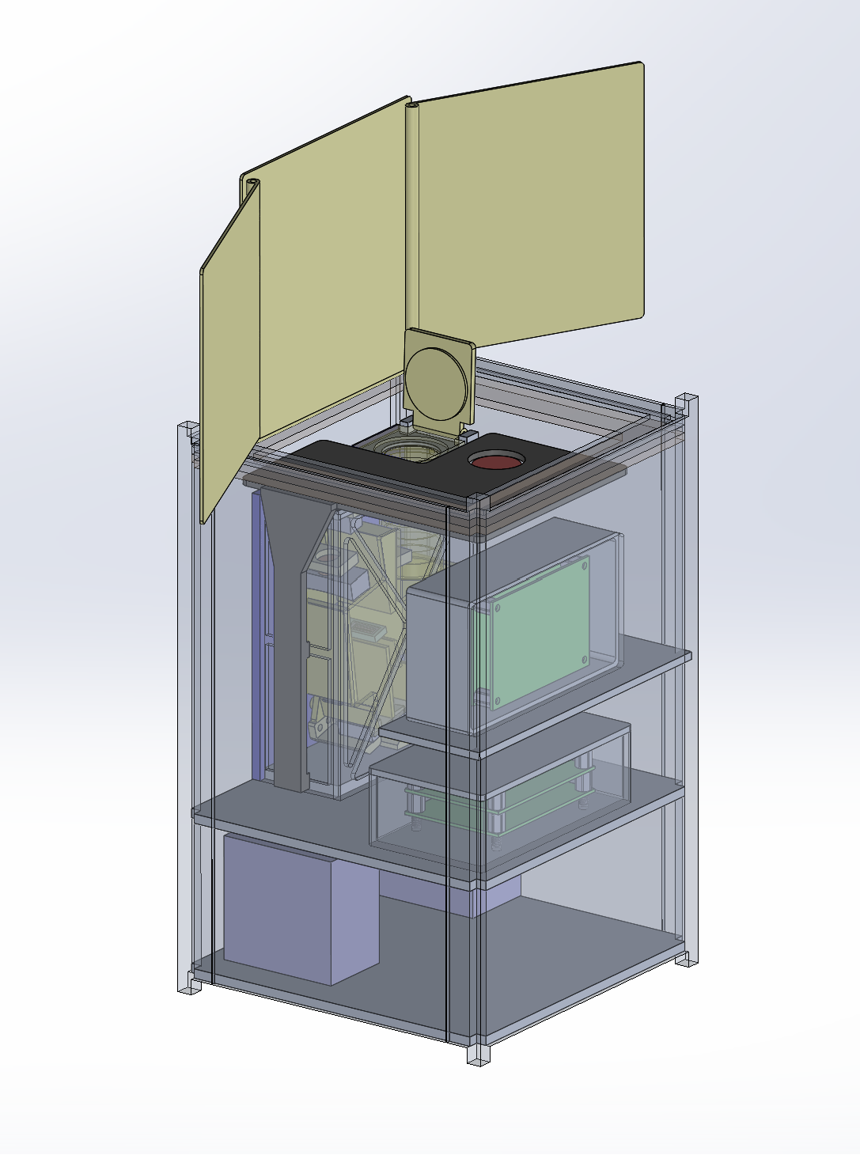
Nox: Revealing the Dark Sky in Far-Ultraviolet
Mission Concept: A SmallSat UV telescope mission to map the all-sky Far-UV background via step-and-stare concept observation
Establish foundational baseline for all future UV missions
PI: Haeun Chung (University of Arizona)
Team:
  Univ. of Arizona: Carlos Vargas, Erika Hamden, Walter Harris, Jason Corliss, and Heejoo Choi
  GSFC: Manuel Quijada, Mateo Batkis, Luis Rodriguez de Marcos
  JPL: April Jewell, John Hennessy, Leonidas Moustakas
  Caltech: Drew Miles
  Columbia U: David Schiminovich
  Iowa U: Keri Hoadley
  Penn State: Fabien Grisé
  KASI: Kwang-il Seon, Young-Soo Jo
Presenter: Haeun Chung

Slide 10
Nox: Revealing the Dark Sky in Far-Ultraviolet
Mission Concept: A SmallSat UV telescope mission to map
the all-sky Far-UV background via step-and-stare concept observation
Establish foundational baseline for all future UV missions
PI: Haeun Chung (University of Arizona)
Team:
  Univ. of Arizona: Carlos Vargas, Erika Hamden, Walter Harris, Jason Corliss, and Heejoo Choi
  GSFC: Manuel Quijada, Mateo Batkis, Luis Rodriguez de Marcos
  JPL: April Jewell, John Hennessy, Leonidas Moustakas
  Caltech: Drew Miles
  Columbia U: David Schiminovich
  Iowa U: Keri Hoadley
  Penn State: Fabien Grisé
  KASI: Kwang-il Seon, Young-Soo Jo
Presenter: Haeun Chung

Slide 11
Nox: Goal & Objectives
Goal: Unveiling the Drivers of Galaxy Growth (Astro2020 Theme "Cosmic Ecosystems" Priority Area)
Science Objectives:
  Determine the intensity and spatial distribution of LUV background
  Determine spatial distribution of Milky-Way warm-hot halo gas
TRL Advancement for HWO & future UV missions
  UV Coating (Al+xeLiF and Al+eLiF+MgF₂ capping)
  UV Grating (e-beam lithography Si grating)
  UV Detector (UV optimized delta-doped EMCCD)
Presenter: Haeun Chung

Slide 12
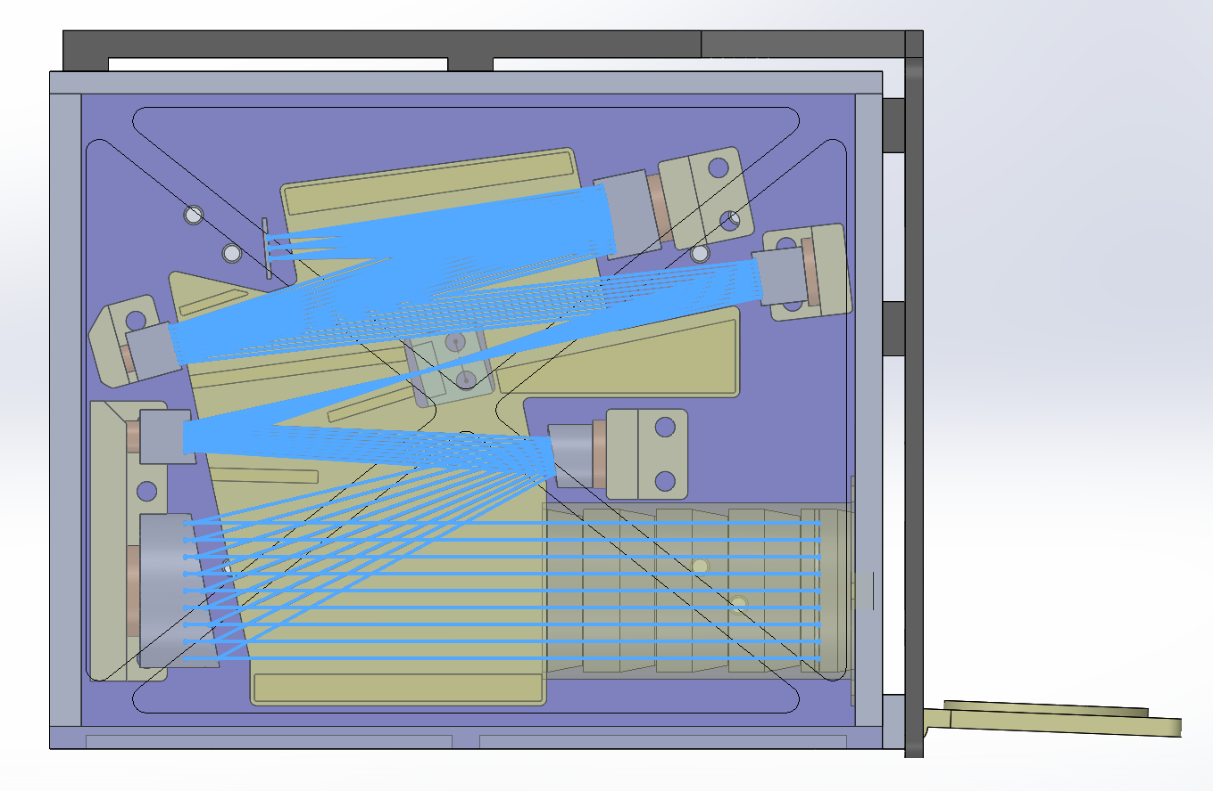
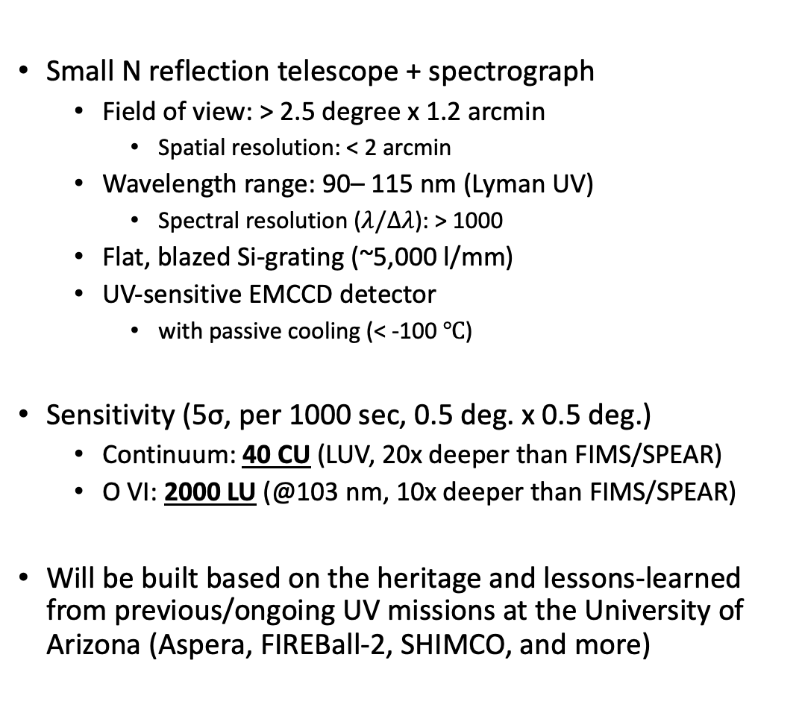
Payload: Lyman-UV Imaging Spectrograph
Small N reflection telescope + spectrograph
  Field of view: > 2.5 degree x 1.2 arcmin
    Spatial resolution: < 2 arcmin
  Wavelength range: 90– 115 nm (Lyman UV)
    Spectral resolution ($λ/Δλ$): > 1000
  Flat, blazed Si-grating (~5,000 l/mm)
  UV-sensitive EMCCD detector
    with passive cooling (< -100 $℃$)
Sensitivity (5σ, per 1000 sec, 0.5 deg. x 0.5 deg.)
  Continuum: 40 CU (LUV, 20x deeper than FIMS/SPEAR)
  O VI: 2000 LU (@103 nm, 10x deeper than FIMS/SPEAR)
Will be built based on the heritage and lessons-learned from previous/ongoing UV missions at the University of Arizona (Aspera, FIREBall-2, SHIMCO, and more)
Presenter: Haeun Chung

Slide 13
Summary
Nox: A SmallSat UV telescope mission concept to map the all-sky Far-UV background
  Lyman-UV background survey
  Milky-Way warm-hot CGM survey
Establish foundational baseline for all future UV missions
Lyman-UV imaging spectrograph
  State-of-art UV coating, grating, and detector
  Unprecedented continuum sensitivity at 90-115 nm
    Continuum Sensitivity: 40 CU
    O VI line sensitivity: 2000 LU
Questions?
Presenter: Haeun Chung

