Slide 1
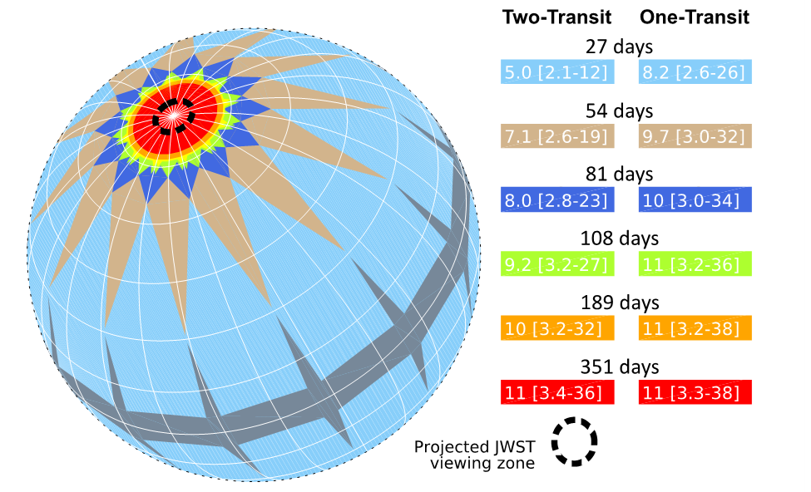
Empirical Predictions for the Period Distribution of Planets to be Discovered by the Transiting Exoplanet Survey Satellite Jonathan Jiang, Jet Propulsion Laboratory, Caltech
National Aeronautics and Space Administration
Jet Propulsion Laboratory
California Institute of Technology
Science Motivation: Launched in April 2018, NASA’s Transiting Exoplanet Survey Satellite (TESS) has been performing a wide-field survey for exoplanets orbiting bright stars with a goal to produce a database for follow-on studies using ground-based telescopes. Since the orbital periods of exoplanets detectable by TESS vary in different regions of the celestial sphere, due to different observation durations, a realistic estimation of these orbital periods is needed.
Data & Results: Our mathematical analysis finds that, for the two-transit criterion, the expected mean value of most frequent detected orbital period is 5.0 days with a most detected range of 2.1 to 12 days in the region with the observation of 27 days. Near the poles where the observational duration is 351 days, the expected mean orbital period is 11 days with a most detected range from 3.4 to 36 days. For one-transit, the most frequent detected orbital period is 8.2 days in the region with the observation of 27 days and 11 days near the poles. For the entire TESS mission containing several sectors, the mean value of orbital period is 8.5 days for two-transit and 10 days for one-transit, respectively. With such orbital periods, the majority of exoplanets detected by TESS will be closer to their host stars than Mercury to our Sun, whose orbital period is 88 days.
Significance: This study is very helpful to the exoplanet data analysis; It also provides critical information for understanding the formation and evolution of the star system that hosts the exoplanet detected by the TESS mission.
Figure: Duration of observations on the celestial sphere by TESS, distinguished by color. Mean orbital period and detection range of TESS’s most frequently detected orbital period of exoplanets for two-transit and one-transit criteria are listed by the text inside the color-bars.
Jiang, J.H. et al. Empirical Predictions for the Period Distribution of Planets to be Discovered by the Transiting Exoplanet Survey Satellite, The Astrophysical Journal, 158:96 (14pp), https://doi.org/10.3847/1538-3881/ab2a7a, 2019.
This work was supported by a Exoplanet Study Initiative at the Jet Propulsion Laboratory, California Institute of Technology
Notes:
1
You may add comments here to clarify the work or the results.

