Slide 1
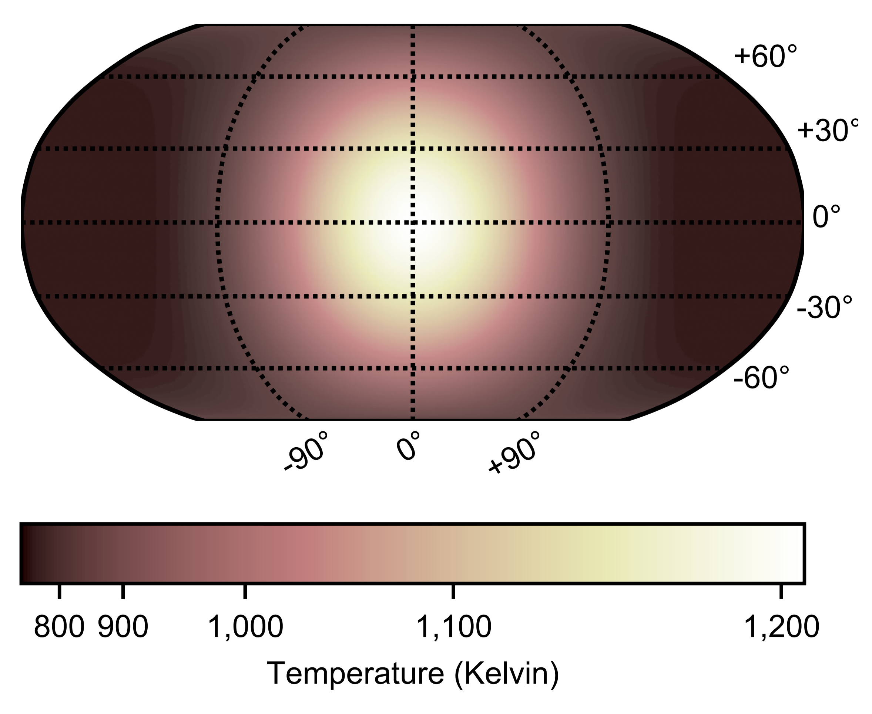
Rare Look at Rocky Exoplanet’s Surface JPL Press Release-Calla E. Cofield https://www.jpl.nasa.gov/news/news.php?feature=7479
National Aeronautics and Space Administration
Jet Propulsion Laboratory
California Institute of Technology
Science Question: Compared to Sun-like stars, M dwarfs emit high levels of ultraviolet light (though less light overall), which is harmful to life and can erode an exoplanet's atmosphere. Are the atmospheres of rocky planets around M dwarfs eroded away?
Data & Results: Scientists, using Spitzer Space Telescope infrared observations of the terrestrial exoplanet LHS 3844b, found that the peak brightness is at the exoplanet’s substellar point (point on surface where star is 90º above the horizon) and is symmetric about that point, with a dayside brightness temperature of 1,040 ± 40 Kelvin and a nightside temperature that could be as low as zero Kelvin.
Significance: A thick atmosphere would redistribute heat and smooth out the temperature distribution. The observations do not show evidence of heat transport, limiting the pressure to 10 bars or less; such low mass atmospheres are susceptible to erosion. These results support theoretical predictions that hot terrestrial planets orbiting close to small stars may not retain substantial atmospheres.
The temperature map which best predicts the brightnesses observed as LHS 3844b orbits its star. The substellar point is 1200 Kelvin. The data show no evidence for heat redistribution by atmospheric processes.
The figure is from Kreidberg, Koll, Morley, Hu, et al., Nature, 573, 87–90, 2019. Observations were with the Spitzer Space Telescope, sponsored by NASA.
Notes:
1
You may add comments here to clarify the work or the results.

Slide 2
National Aeronautics and Space Administration
Jet Propulsion Laboratory
California Institute of Technology
Contact:
Calla E. Cofield, 111-B80, Jet Propulsion Laboratory, Pasadena, CA 91109
calla.e.cofield@jpl.nasa.gov
Citation:
from Kreidberg, Koll, Morley, Hu, et al., Nature, 573, 87–90, 2019.
https://doi.org/10.1038/s41586-019-1497-4
Data Sources:
Spitzer Space Telescope
Technical Description of Figure:
The spherical harmonic temperature map used to model the variations of 4.5 micron flux with orbital phase of LHS 3844b about its star. The planet’s substellar point corresponds to the latitude and longitude (0º, 0º). The spherical harmonics model includes north-south temperature variation, but only east-west variation is constrained by the data.
Scientific significance, societal relevance, and relationships to future missions:
These results support theoretical predictions that hot terrestrial planets orbiting close to small stars may not retain substantial atmospheres. Future missions might be able to study the solid surfaces of exoplanets not having substantial atmospheres.

