Slide 1
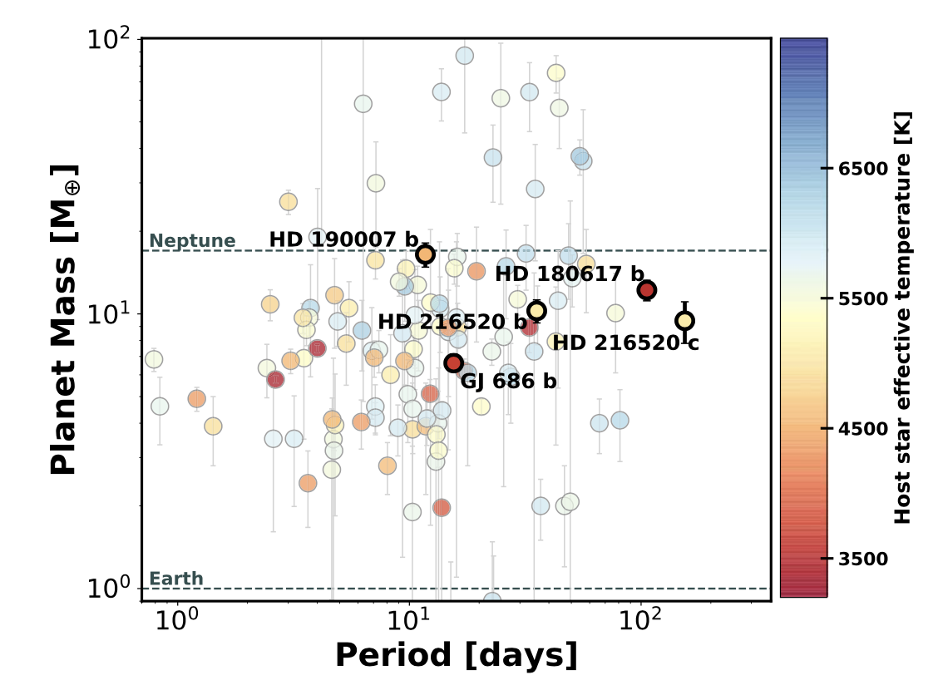
A Collage of Small Planets Jennifer Burt et al.
National Aeronautics and Space Administration
Jet Propulsion Laboratory
California Institute of Technology
Science Question: Is our Solar System a typical planetary system? How often do stars have planets not found here – super-Earths and sub-Neptunes with masses between that of Earth and Neptune?
Data & Results: Precision radial velocity measurements from Keck/HIRES and the Lick Automated Planet Finder are analyzed. Two planets are discovered around the star HD 216520 and an additional planet around HD 190007. New data is added for known planets around two other stars. All five planets are small, with mass estimates less than Neptune’s.
Significance: This new batch of planets expands on the existing sample of sub-Neptune-mass planets, an important type of planet not found in our Solar System. With orbits of >100 days, two of the planets are among the longest period orbits within the sample.
Reproduced with permission from AJ, © IOP
Three new planets are discovered and two planets are newly characterized (labeled points). All five planets have masses between Earth’s and Neptune’s – a type of planet not found in our Solar System.
Burt, Feng, Holden, et al. (2021), AJ 161, 10
https://doi.org/10.3847/1538-3881/abc2d0
This work was supported by NASA’s Exoplanet Exploration Program.
Notes:
1
You may add comments here to clarify the work or the results.

Slide 2
National Aeronautics and Space Administration
Jet Propulsion Laboratory
California Institute of Technology
Contact:
Dr. Jennifer Burt
JPL Postdoctoral Fellow
321-100, Jet Propulsion Laboratory, Pasadena, CA 91109
Jennifer.Burt@jpl.nasa.gov
https://orcid.org/0000-0002-0040-6815
Citation:
“A Collage of Small Planets from the Lick-Carnegie Exoplanet Survey:
Exploring the Super-Earth and Sub-Neptune Mass Regime”
Burt, J.A., Feng, F., Holden, B., et al. (2021), AJ 161, 10
https://doi.org/10.3847/1538-3881/abc2d0
Data Sources:
Lick Observatory/Automated Planet Finder (APF)
Keck/HIRES
Magellan/Planet Finder Spectrograph
Technical Description of Figure:
Based on radial velocity measurements from Keck/HIRES and Lick’s Automated Planet Finder,
three new planets are discovered (HD 190007 b and HD 216520 b,c) and two known planets
are updated with improved mass and orbit estimates (HD 180617 b and GJ 686 b).
All five planets have masses between Earth’s and Neptune’s – a range of planet masses not found in our Solar System.
Scientific significance, societal relevance, and relationships to future missions:
This new batch of planets expands on the existing sample of sub-Neptune-mass planets, an important type of planet not found in our Solar System. With orbits of 106 and 154 days, respectively, HD 180617 b and HD 216520 c are the longest period planets within the overall sample of sub-Neptune planets.

