Slide 1
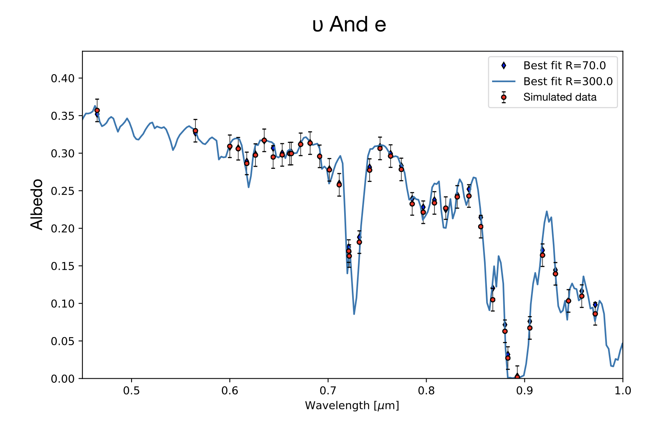
Exoplanetary Reflected Light Retrieval Mario Damiano & Renyu Hu
National Aeronautics and Space Administration
Jet Propulsion Laboratory
California Institute of Technology
Science Question: What information about the composition and cloud structure of cold gaseous planets can be extracted from their reflected spectra in optical wavelengths?
Methods & Results: A computational tool has been developed to retrieve atmospheric properties from an exoplanet’s optical, reflected-light spectrum. Three test cases are used to gauge the code performance – two known gas-giant exoplanets and Jupiter. It is found that spectral resolution ≳70 and signal-to-noise ≳15 are required to accurately measure the atmospheric composition and characterize the presence of clouds.
Significance: Future direct-imaging missions will measure the atmospheric abundances of cold gas giant exoplanets and characterize the clouds that are inevitably present in their atmospheres, should the missions meet the resolution and sensitivity requirements prescribed here.
Reproduced with permission from the Astronomical Journal, © AAS
The simulated optical spectrum of Upsilon Andromedae e, a known gas-giant exoplanet, (red points) is fit well by the model (blue line and points). The absorption features at 0.72 & 0.88 μm are due to methane in the atmosphere. Water abundance is also extracted from the spectrum, despite the presence of obscuring water clouds.
Damiano, M. & Hu, R. (2020), AJ 159, 175
https://doi.org/10.3847/1538-3881/ab79a5
This work was supported by NASA’s WFIRST Preparatory Science Program and WFIRST Science Investigation Team Program.
Notes:
1
You may add comments here to clarify the work or the results.

Slide 2
National Aeronautics and Space Administration
Jet Propulsion Laboratory
California Institute of Technology
Contact:
Mario Damiano
JPL Postdoctoral Scholar
169-237, Jet Propulsion Laboratory, Pasadena, CA 91109
Mario.Damiano@jpl.nasa.gov
https://orcid.org/0000-0002-1830-8260
Citation:
“ExoReL^{R}: A Bayesian Inverse Retrieval Framework for Exoplanetary Reflected Light Spectra”
Damiano, M. & Hu, R. (2020), AJ 159, 175
https://doi.org/10.3847/1538-3881/ab79a5
Technical Description of Figure:
A simulated optical (reflected light) spectrum for the planet ups And e is shown as red circles, with a spectral resolution R=70 and a signal-to-noise ratio S/N=20. The best-fit model is shown as blue diamonds (at the same spectral resolution) and as a blue line (at higher R=300 resolution). The strong absorption features at 0.72 & 0.88 μm are due to the presence of methane. Water vapor absorption occurs over most of the wavelength range, in particular above ~0.9 μm. Ammonia abundance information can not be extracted from the spectrum as the spectral resolution (R=70) is too low to resolve the small absorption feature at ~0.63 μm.
Scientific significance, societal relevance, and relationships to future missions:
Future missions to directly image exoplanets – such as the Roman Space Telescope (Roman), Habitable Exoplanet Imaging Mission (HabEx), the Large Ultra-Violet/Optical/ InfraRed Surveyor (LUVOIR); and the Starshade Rendezvous Probe (SRP) – will observe cold exoplanet atmospheres via their reflected starlight.
The models presented here are needed to interpret these observations. The framework can measure atmospheric abundances and characterize the clouds of cold gaseous exoplanets, potentially providing key constraints on how they formed.

