Slide 1
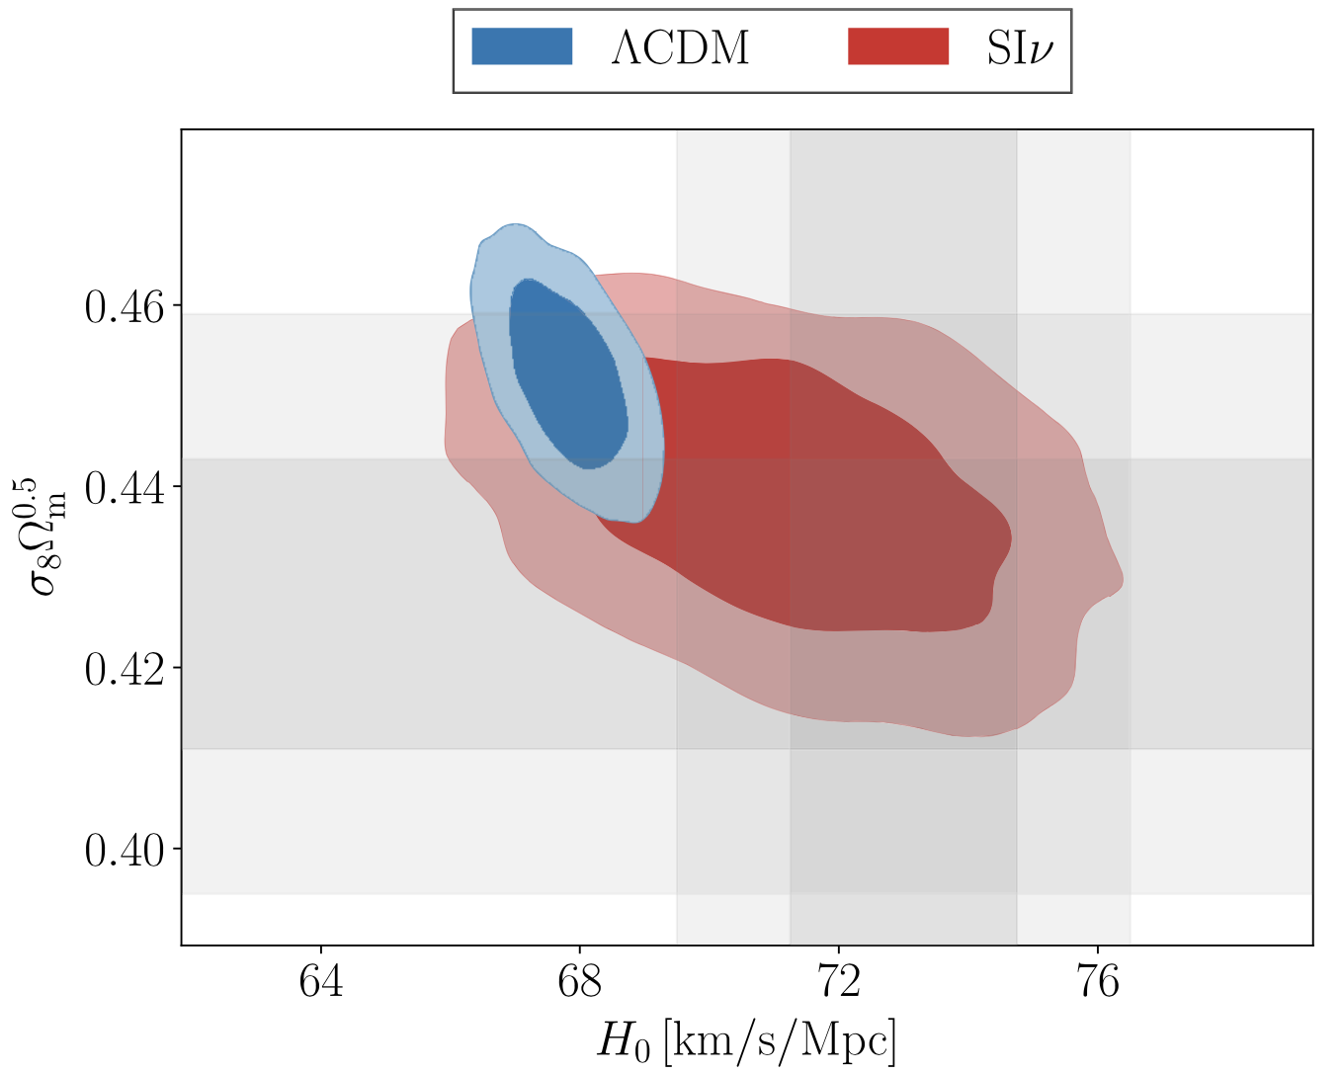
Neutrino Solution to a Cosmological Puzzle Kreisch, Cyr-Racine, & Doré
National Aeronautics and Space Administration
Jet Propulsion Laboratory
California Institute of Technology
Science Questions: How does the Universe evolve – from the initial Big Bang to its ongoing expansion? What are the fundamental forces driving this expansion?
Methods & Results: A new cosmological model is considered that includes new physics for neutrinos – ultra-low-mass particles that only weakly interact with other matter. The inclusion of massive neutrino self-interactions can reconcile discrepant measurements for basic cosmological parameters such as H₀, the local expansion rate of the Universe, and 𝛔_{8,} a measure of galaxy clustering.
Significance: The results demonstrate that a minor extension to the particle content of the Universe can not only provide an excellent fit to existing data, but can also resolve the existing tension between cosmic microwave background based and supernovae based measurements. This model can be verified with future high-resolution observations of the cosmic microwave background and large scale structure of the Universe.
Reproduced with permission from Physical Reviews, © APS
Current estimates of two fundamental cosmological parameters – H₀ and 𝛔₈ – are inconsistent between local measurements of the expansion rate using supernovae (grey bars) and Planck cosmic microwave background measurements (blue contours). A new model with strongly-interacting neutrinos (SI𝛎; red contours) is able to match the H₀ and 𝛔₈ measurements.
C. Kreisch, F. Cyr-Racine, & O. Doré (2020), Phys. Rev. D 101, 123505
https://doi.org/10.1103/PhysRevD.101.123505 (Editor’s selection)
This work was supported by NASA’s Astrophysics Theory Program.
Notes:
1
You may add comments here to clarify the work or the results.

Slide 2
National Aeronautics and Space Administration
Jet Propulsion Laboratory
California Institute of Technology
Contact:
Dr. Olivier Doré
Principal Research Scientist; Project Scientist for SPHEREx
169-506, Jet Propulsion Laboratory, Pasadena, CA 91109
Olivier.P.Dore@jpl.nasa.gov
https://orcid.org/0000-0002-5009-7563
Citation:
“Neutrino puzzle: Anomalies, interactions, and cosmological tensions”
Christina Kreisch, Francis-Yan Cyr-Racine, and Olivier Doré (2020), Physical Review D 101, 123505 (Editor’s selection)
https://doi.org/10.1103/PhysRevD.101.123505
Data Sources:
Planck, a European Space Agency (ESA) satellite with NASA contributions
Technical Description of Figure:
Current estimates of two fundamental cosmological parameters – H₀ and 𝛔₈ – are inconsistent between measurements from the local expansion rate measured with supernovae (grey bars) and the cosmic microwave background measurements from Planck (𝛬CDM; blue contours). H₀ is the local expansion rate of the Universe; 𝛔₈ is a measure of clustering between galaxies.
A minimal extension of the standard 𝛬CDM model that includes strongly-interacting neutrinos (SI𝛎; red contours) is consistent with the H₀ and 𝛔₈ measurements from both experiments.
Scientific significance, societal relevance, and relationships to future missions:
The results demonstrate that a minimal extension to the standard cosmological model can not only provide an excellent fit to existing data, but can also resolve the existing conflict between measurements performed at high redshift (cosmic microwave background) and low redshift (supernovae). Future observations from observatories such as ACT, SPT, or SPHEREx can verify this new model via its impact on the matter power spectrum.

