Slide 1
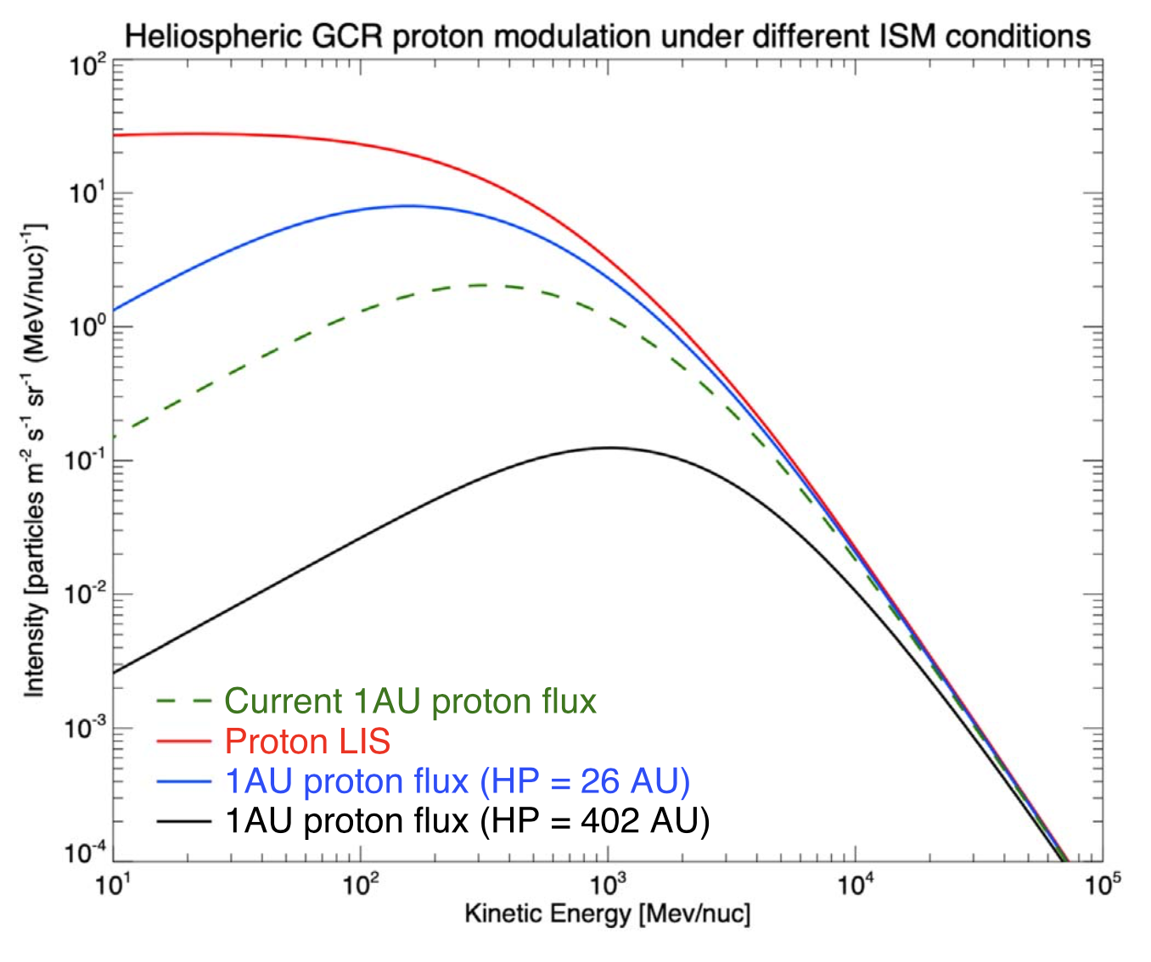
Galactic Cosmic Ray Impact on Exoplanets Jasinski, Nordheim, Hasegawa, & Murphy
National Aeronautics and Space Administration
Jet Propulsion Laboratory
California Institute of Technology
Science Questions: How do Galactic cosmic rays – highly energetic particles that can affect the habitability of Earth-like planets – vary between planetary systems? Are some Galactic environments more likely to produce intense Galactic cosmic ray intensities for exoplanets?
Data & Results: Differences in the local interstellar medium (ISM) are found to have a significant impact on the cosmic ray flux reaching planets around other stars. More dense ISM compresses the stellar astrosphere, resulting in a higher rate of cosmic rays reaching the planet surface.
Significance: While it was already known that Galactic cosmic rays have an impact on planetary atmospheres, previous studies of exoplanets assumed conditions similar to the current Solar System’s. It is important to consider an exoplanet’s local interstellar medium when investigating the Galactic cosmic ray impact on any exoplanet.
Particle flux
Particle energy
Reproduced with permission from the Astrophysical Journal, © AAS
Energetic particles approaching the Solar System (red line) are partly blocked by the Sun’s heliosphere (green line). This shielding depends on the surrounding interstellar medium (ISM). If the ISM is less dense, the heliosphere expands and the Earth becomes more shielded from the cosmic rays (black line). If the ISM is more dense, the heliosphere is compressed and more cosmic rays penetrate the heliosphere to reach Earth (blue line).
Jasinski, Nordheim, Hasegawa, & Murphy (2020), ApJL 899, L18
https://doi.org/10.3847/2041-8213/aba7c8
This work was supported by NASA’s Postdoctoral Fellowship Program.
Notes:
1
You may add comments here to clarify the work or the results.

Slide 2
National Aeronautics and Space Administration
Jet Propulsion Laboratory
California Institute of Technology
Contact:
Jamie Jasinski
Research Scientist
169-506, Jet Propulsion Laboratory, Pasadena, CA 91109
jamie.m.jasinski@jpl.nasa.gov
https://orcid.org/0000-0001-9969-2884
Citation:
“The Importance of Local Interstellar Conditions on the Galactic Cosmic-Ray Spectrum at Exoplanets”
Jasinski, J.M., Nordheim, T.A., Hasegawa, Y., & Murphy, N. (2020), ApJL 899, L18
https://doi.org/10.3847/2041-8213/aba7c8
Data Sources:
Data from Voyager’s Cosmic-Ray-Subsystem (CRS) is compared against a cosmic ray propagation model. This model is then used to investigate the modulation of cosmic rays for the exoplanets Kepler-20f and Kepler-88c (where the local interstellar medium conditions have been estimated).
Technical Description of Figure:
The Galactic cosmic ray (GCR) local interstellar spectrum (LIS) for protons is shown in red, based on Voyager measurements. This spectrum is modulated as the GCRs propagate into and through the heliosphere (the reduced flux at 1 AU is shown in green). If the Sun resided in different interstellar medium (ISM) conditions – more/less dense – then the heliosphere would contract/expand, and less/more modulation of the GCRs would occur (blue/black). Modelling the propagation of GCRs for known exoplanets Kepler-20f and Kepler-88c (using estimations of the local ISM properties from observations for these two systems), the paper shows that the local ISM is important in determining the intensity of GCRs at exoplanets.
Scientific significance, societal relevance, and relationships to future missions:
Previous investigations of GCRs at exoplanets have assumed Earth-like GCR intensity (found at 1 AU in the Solar System). The paper shows that this is often incorrect, and that GCRs can vary widely at different exoplanetary systems. Variations in the local interstellar medium can have important implications for the habitability of planets in other systems and must be taken into account when modeling the astrospheres around planet-bearing host stars.

