Slide 1
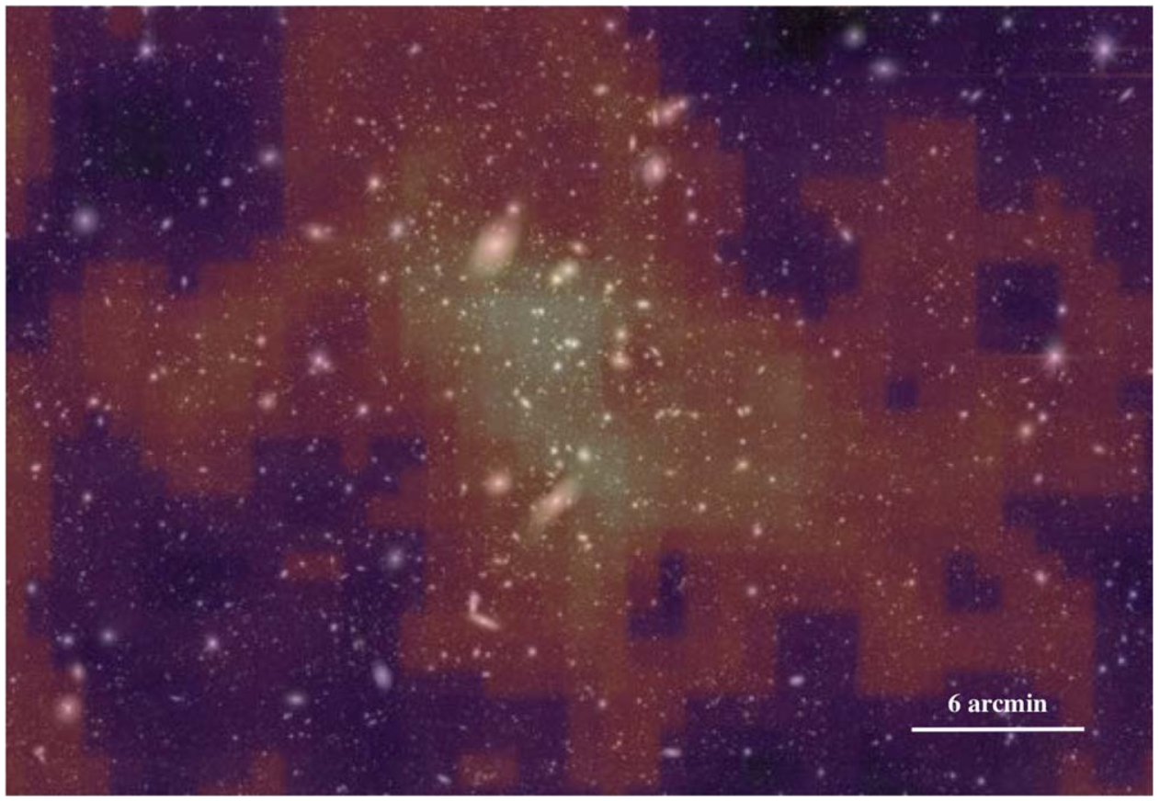
Dark Matter in Four Galaxy Clusters McCleary, dell’Antonio, von der Linden
National Aeronautics and Space Administration
Jet Propulsion Laboratory
California Institute of Technology
Science Question: How is dark matter distributed throughout the universe, and what are its properties?
Data & Results: Large fields surrounding four low-redshift (z<0.1, equivalent to <1.3 billion years old) galaxy clusters (containing thousands of galaxies) were observed in visible light. Weak gravitational lensing signal is recovered for all four clusters, and is used to infer the distribution of dark matter and masses of the clusters.
Significance: Weak lensing provides a measurement of the dark matter content of galaxy clusters without assumptions about the state of their baryons. Improved understanding of the baryon-to-dark matter relationship in these nearby clusters places strong limits on potential dark matter models.
Reproduced with permission from the Astrophysical Journal, © AAS
This large field surrounding a nearby galaxy cluster contains thousands of background galaxies that are weakly lensed by the cluster. Based on this observed lensing, the cluster’s dark matter distribution is inferred (color scale). This map of dark matter is derived completely independently of the cluster’s member galaxies.
McCleary, dell’Antonio, & von der Linden (2020), ApJ 893, 8
https://doi.org/10.3847/1538-4357/ab7c58
This work was supported by JPL internal funding.
Notes:
1
You may add comments here to clarify the work or the results.

Slide 2
National Aeronautics and Space Administration
Jet Propulsion Laboratory
California Institute of Technology
Contact:
Jacqueline McCleary
JPL Postdoctoral Fellow
169-237, Jet Propulsion Laboratory, Pasadena, CA 91109
Jacqueline.E.McCleary@jpl.nasa.gov
https://orcid.org/0000-0002-9883-7460
Citation:
“Dark Matter Distribution of Four Low-z Clusters of Galaxies”
McCleary, J., dell’Antonio, I., & von der Linden, A. (2020), ApJ 893, 8
https://doi.org/10.3847/1538-4357/ab7c58
Data Sources:
Dark Energy Camera (DECam) at the Cerro Tololo Inter-American Observatory (CTIO)
Technical Description of Figure:
The derived dark matter map for cluster A85 (color scale) is overlaid with the visible-light images of the cluster (white).
The dark matter map and visible light images are clearly correlated with each other, though the map is derived completely independently from the visible cluster light. Similar maps are obtained for the A2029, A2457, and A1606 clusters.
Scientific significance, societal relevance, and relationships to future missions:
Weak gravitational lensing provides a measurement of the dark matter content of galaxy clusters without assumptions about the state of their baryons. This study contains the first weak lensing maps and masses of clusters A2457 and A1606 in the literature, and prepares for a large census of low-redshift (z<0.1, equivalent to <1.3 billion years old) cluster studies. Weak lensing maps like the ones presented in this study will robustly calibrate the relation between mass and observable (e.g., X-ray emissivity) at low redshift – a crucial component of galaxy cluster-based dark energy studies. In addition, improved understanding of the baryon-to-dark matter relationship in these nearby clusters places strong limits on potential dark matter models.

