Slide 1
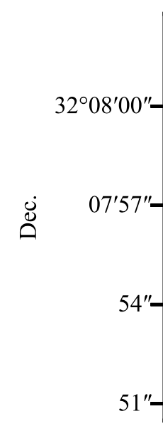
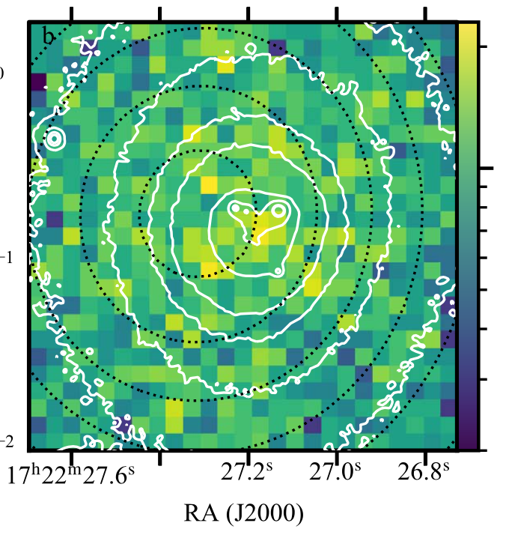
A Missing Super-Massive Black Hole K. Gültekin et al.
National Aeronautics and Space Administration
Jet Propulsion Laboratory
California Institute of Technology
Science Question: Do all large galaxies host central supermassive black holes? Can a central supermassive black hole be ejected from a galaxy, possibly due to an encounter with another supermassive black hole?
Data & Results: Based on comparison with similarly sized galaxies, the galaxy A2261-BCG is expected to have a central supermassive black hole with ten billion times the mass of the Sun, which could result in an X-ray emitting peak. New deep Chandra X-ray images fail to find any sign of accretion onto a supermassive black hole within the galaxy’s core.
Significance: There is no evidence for a supermassive black hole in the center of A2261-BCG or ejected outward within its core. Unlike other similar massive galaxies, the core of A2261-BCG either has no supermassive black hole or the black hole is dormant, accreting material at an extremely low level.
Reproduced with permission from ApJ, © IOP
Hubble Space Telescope images of galaxy A2261-BCG (white contours) reveal four knots of emission near the galaxy’s center. These knots could be the location of a supermassive black hole ejected from the center. Chandra X-ray observations (color scale), however, do not detect any emission from an accreting black hole.
Gültekin, K., et al. (2021), ApJ 906, 48
https://doi.org/10.3847/1538-4357/abc483
This work was supported by an award from
NASA’s Chandra X-Ray Observatory Center.
Notes:
1
You may add comments here to clarify the work or the results.

Slide 2
National Aeronautics and Space Administration
Jet Propulsion Laboratory
California Institute of Technology
Contact:
Dr. Leonidas Moustakas
Astrophysics Section Manager
169-506, Jet Propulsion Laboratory, Pasadena, CA 91109
leonidas@jpl.nasa.gov
https://orcid.org/0000-0003-3030-2360
Citation:
“Chandra Observations of Abell 2261 Brightest Cluster Galaxy, a Candidate Host to a Recoiling Black Hole”
Gültekin, K., et al. (2021), ApJ 906, 48
https://doi.org/10.3847/1538-4357/abc483
Press Coverage:
https://www.nytimes.com/2021/01/19/science/astronomy-black-hole-abell.html
Data Sources:
Chandra X-Ray Observatory
Hubble Space Telescope
Subaru Telescope
Herschel Space Observatory
Very Large Array (VLA)
Technical Description of Figure:
Optical images of cluster Abell 2261’s brightest galaxy, A2261-BCG, (white contours) reveal four knots of emission near the galaxy’s center. These knots could be the location of a black hole ejected from the center. However, deep Chandra X-ray observations (color scale), do not detect emission from any point sources in the galactic core, as would be expected from an accreting black hole.
Scientific significance, societal relevance, and relationships to future missions:
There is no evidence for a supermassive black hole in the center of A2261-BCG or one that was ejected outward within its core. Unlike similar massive galaxies, A2261-BCG either does not have a super-massive (10 billion Solar mass) black hole or the black hole is dormant, accreting material at an extremely low level (less than one-millionth of the maximum rate).

