Slide 1
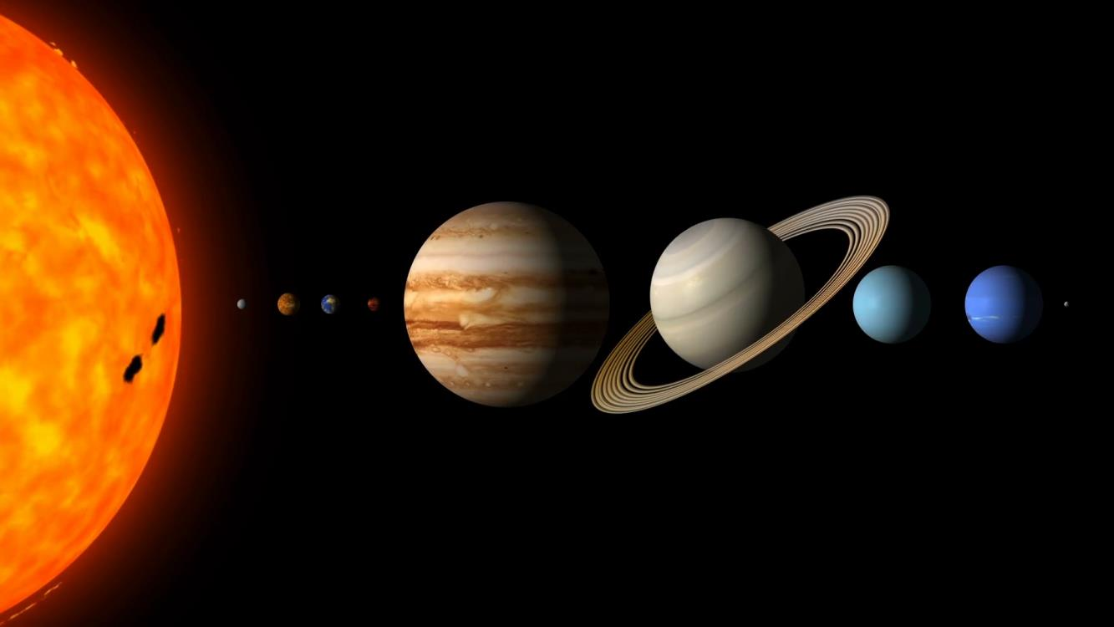
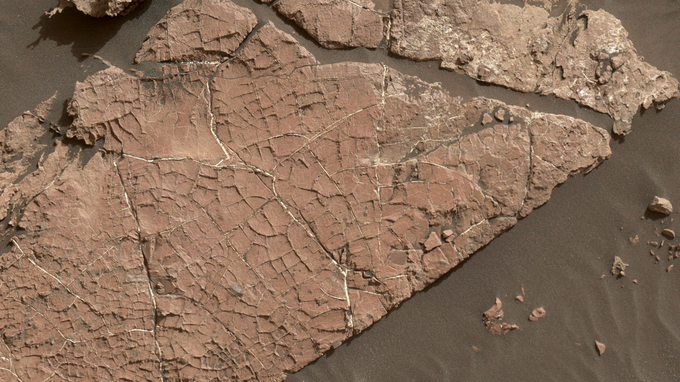
NASA’s Curiosity Rover Finds an Ancient Oasis on Mars William Rapin
National Aeronautics and Space Administration
Jet Propulsion Laboratory
California Institute of Technology
Imagine 3.5 billion years ago, ponds dotting the floor of Gale Crater, the 100-mile-wide (150-kilometer-wide) ancient basin that Curiosity is exploring. Streams might have laced the crater's walls, running toward its base. Watch history in fast forward, and you'd see these waterways overflow then dry up, a cycle that probably repeated itself numerous times over millions of years.
Significance: Mud cracks would be evidence of a time when dry intervals interrupted wetter periods that supported lakes in the area. Curiosity has found evidence of ancient lakes in older, lower-lying rock layers and also in younger mudstone that is above Old Soaker.
Sutton Island's salt-enriched rocks are just one clue among several the rover team is using to piece together how the Martian climate changed. Looking across the entirety of Curiosity's journey, which began in 2012, the science team sees a cycle of wet to dry across long timescales on Mars.
The network of cracks in this Martian rock slab called "Old Soaker" may have formed from the drying of a mud layer more than 3 billion years ago. The view spans about 3 feet (90 centimeters) left-to-right and combines three images taken by the MAHLI camera on the arm of NASA's Curiosity Mars rover. Credit: NASA/JPL-Caltech/MSSS
https://www.jpl.nasa.gov/news/news.php?feature=7514
Notes:
1
You may add comments here to clarify the work or the results.

