Slide 1
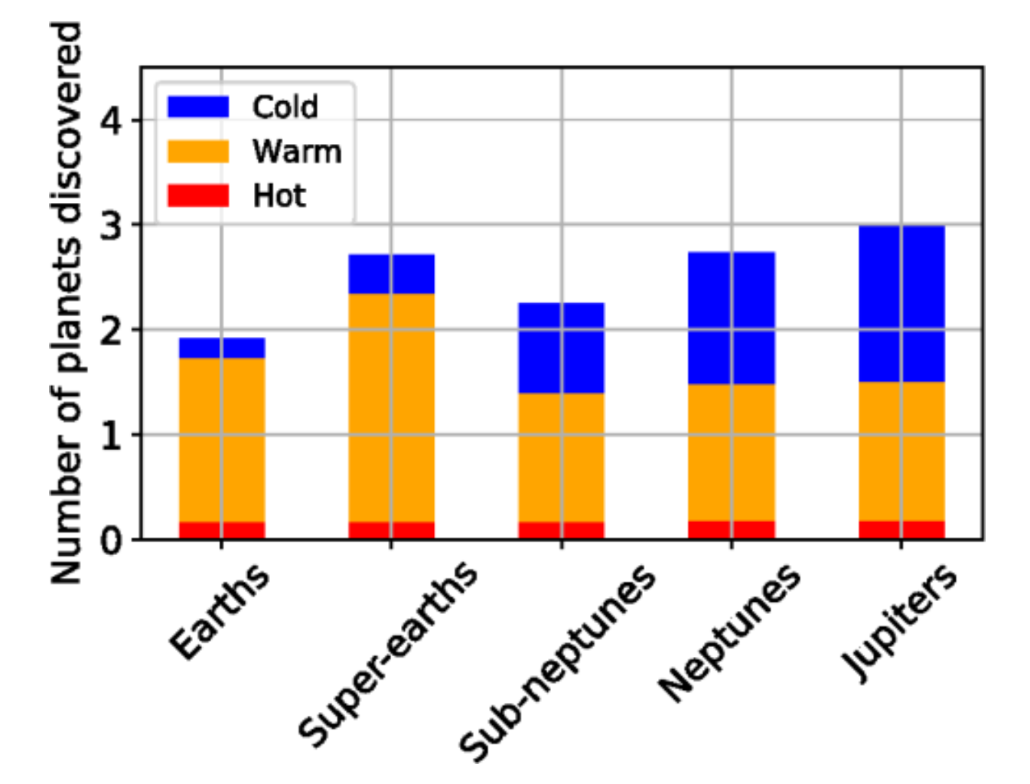
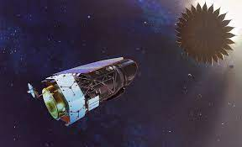
Exoplanet Detection with a Starshade Romero-Wolf, Bryden, Seager, Kasdin, et al.
National Aeronautics and Space Administration
Jet Propulsion Laboratory
California Institute of Technology
Science Question: Are there Earth-like planets orbiting around stars in the Solar neighboring stars? What is the best method to determine if a planet has the right surface and atmospheric conditions to harbor life?
Data & Results: Adding a starshade – a 26-m diameter free-flying occulter – to the Roman Space Telescope allows it to detect planets closer to their parent stars, with higher signal-to-noise. Based on observations of 16 nearby stars, a starshade mission could detect an Earth-mass planet, trace its orbit, and characterize its atmospheric composition.
Significance: A starshade combined with the Roman Space Telescope is arguably the most promising method to detect and characterize an Earth-size, habitable-zone planet within the next decade.
Reproduced with permission from JATIS, © SPIE
The Starshade Rendezvous Probe –
a proposed mission combining the Roman Space Telescope with an external starshade – can directly image planets in the habitable zones of nearby stars. While the detected planets would cover a range of masses and temperatures (above histogram), the mission would most importantly have the capability to detect and characterize an Earth-like planet.
Romero-Wolf, Bryden, Seager, Kasdin, et al. (2021), JATIS 7(2), 021210
https://doi.org/10.1117/1.JATIS.7.2.021210
This work was supported by JPL internal funding.
Notes:
1
You may add comments here to clarify the work or the results.

Slide 2
National Aeronautics and Space Administration
Jet Propulsion Laboratory
California Institute of Technology
Contact:
Dr. Andres Romero-Wolf
Technologist; JPL Science Lead for the Starshade Rendezvous Probe mission concept
67-201, Jet Propulsion Laboratory, Pasadena, CA 91109
Andrew.Romero-Wolf@jpl.nasa.gov
https://orcid.org/0000-0002-4992-4162
Citation:
“Starshade rendezvous: exoplanet sensitivity and observing strategy”
Romero-Wolf, A., Bryden, G., Seager, S., Kasdin, J., et al. (2021),
Journal of Astronomical Telescopes, Instruments, and Systems 7(2), 021210
https://doi.org/10.1117/1.JATIS.7.2.021210
Data Sources:
NASA Exoplanet Archive
Technical Description of Figure:
Adding a starshade – a 26-m diameter free-flying occulter – to the Roman Space Telescope allows it to detect planets closer to their parent stars, with higher signal-to-noise. Based on observations of a 16 nearby stars, a starshade mission would detect about a dozen planets over a mass range from Earth’s to Jupiter’s. One or two Earth-mass planets would be detected in their habitable zones (the region where temperatures allow liquid water). The orbits of these Earth-like planets would be traced over multiple imaging epochs. Should they be observed at a favorable phase angle, the Earth-like planets would have their atmospheric composition characterized via long-exposure spectroscopy.
Scientific significance, societal relevance, and relationships to future missions:
NASA’s Astrophysics Decadal Survey is considering two mission concept studies to detect Earth-like planets –
the Habitable Exoplanet Observatory (HabEx) and the Large Ultraviolet Optical Infrared Surveyor (LUVOIR).
While the yield is not as high as for these dedicated flagship missions, a starshade combined with the
Roman Space Telescope – the Starshade Rendezvous Probe – is arguably the most promising method
to detect and characterize an Earth-like planet within the next decade.

