Slide 1
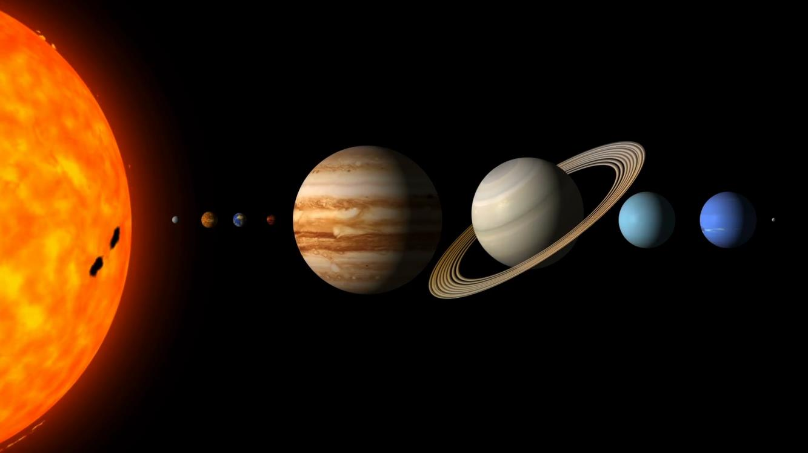
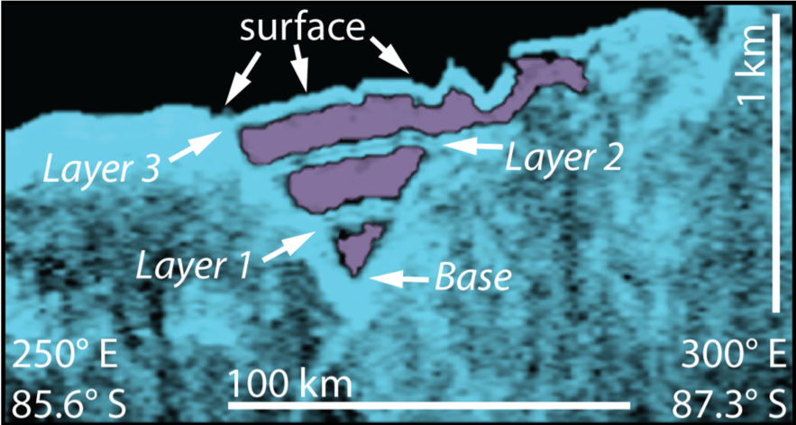
Coevolution of Mars’ Atmosphere and Massive CO₂ Ice Deposit
Dr. Peter Buhler
H₂O
CO₂
Mars has a massive CO₂ ice deposit buried in its south polar cap that, if released, could significantly change Mars’ climate. Its existence has remained a mystery since its discovery nearly ten years ago.
We developed a new model to track CO₂ exchange between Mars’ atmosphere and CO₂ ice deposit as Mars’ orbit evolves on hundred-thousand year timescales. The model closely reproduces the alternating layers of CO₂ and water ice in the buried CO₂ ice observed with NASA’s Shallow Radar instrument.
The results provide the first observational support for a half-century-old theory for climate change on Mars, in which orbital variations cause Mars’ atmospheric pressure to vary by more than a factor of ten. We calculate the history of these pressure variations, which control the stability of near-surface liquid water and potentially habitable environments near Mars’ surface.
Colorized radargram of CO₂ ice buried within the water ice of Mars’ south polar cap. Note alternating layers of water ice (light blue) and CO₂ ice (purple).
Buhler, P.B., Ingersoll, A.P., Piqueux, S., Ehlmann, B.L., Hayne, P.O. Coevolution of Mars’s atmosphere and massive south polar CO2 ice deposit. Nature Astronomy (2019). https://doi.org/10.1038/s41550-019-0976-8
This work was supported by an award to Peter Buhler under the NASA Postdoctoral Program
© 2020 California Institute of Technology. Government sponsorship acknowledged.
Notes:
1
You may add comments here to clarify the work or the results.

