Slide 1
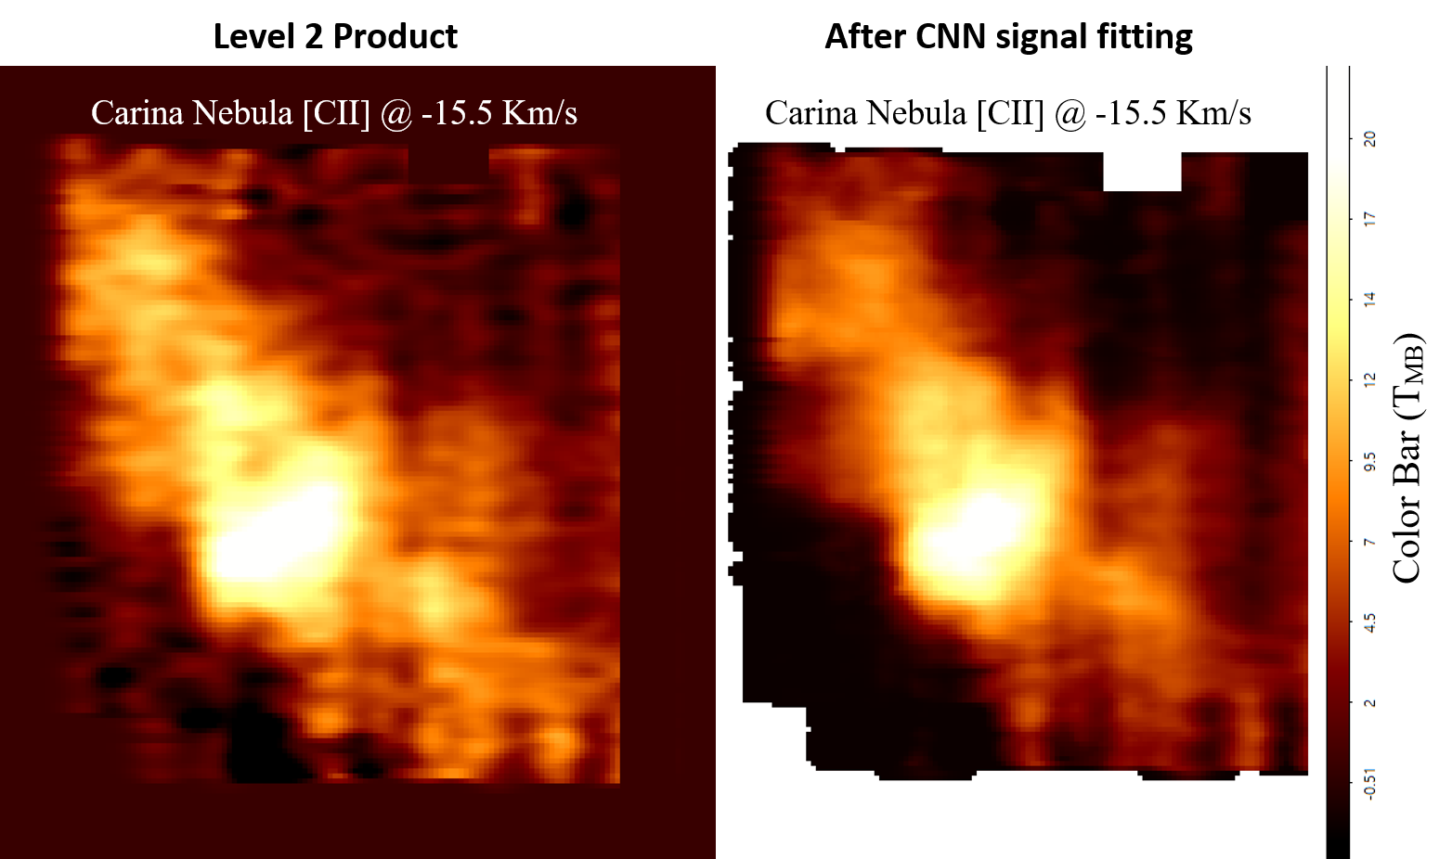
Machine Learning Analysis of Far-IR Spectra Youngmin Seo et al.
National Aeronautics and Space Administration
Jet Propulsion Laboratory
California Institute of Technology
Science Questions: How does the interstellar medium (ISM) condense into stars? How do stellar feedback processes affect the ISM and drive the evolution of our Galaxy?
Data & Results: The entire library of spectra from the Stratospheric Terahertz Observatory 2 (STO2) balloon-borne mission has been reprocessed with state-of-the-art machine learning techniques. These algorithms are able to reduce instrumental artifacts within the data, significantly improving the overall data quality.
Significance: The new data analysis detects much fainter spectral features, enabling a greater science yield from STO2’s library of star-forming region observations. For the Carina nebula, for example, mapping the evaporation of the star-forming cloud enabled an estimate of its lifetime. Similar analysis techniques can potentially be applied to future missions such as the balloon-borne GUSTO and ASTHROS.
The original map of the Carina star-forming region (left panel) shows vertical striping and substantial background noise throughout. The newly created map (right) uses a machine learning algorithm to remove most of the instrumental striping and to greatly reduce the background noise. The resulting high-quality map reveals that [CII] emission comes from the surfaces of dense clouds, tracing the ionization front of the evaporating star-forming region.
Seo, Goldsmith, Tolls, et al. (2020), Astron. Instrumentation 9, 3
https://doi.org/10.1142/S2251171720500117
This work was supported by NASA’s Astrophysics and Data Analysis Program (ADAP).
Notes:
1
You may add comments here to clarify the work or the results.

Slide 2
National Aeronautics and Space Administration
Jet Propulsion Laboratory
California Institute of Technology
Contact:
Dr. Youngmin Seo
Research Scientist
169-506, Jet Propulsion Laboratory, Pasadena, CA 91109
youngmin.seo@jpl.nasa.gov
https://orcid.org/0000-0003-2122-2617
Citation:
“Applications of Machine Learning Algorithms in Processing Terahertz Spectroscopic Data”
Seo, Y., Goldsmith, P., Tolls, V., et al. (2020), Journal of Astronomical Instrumentation 9, 3
https://doi.org/10.1142/S2251171720500117
Data Sources:
Stratospheric Terahertz Observatory 2 (STO2)
Technical Description of Figure:
Analysis of the original map of the Carina star-forming region (left panel) is limited by the poor data quality –
instrumental vertical striping and substantial background noise throughout. The newly created map (right) uses a convolutional neural network (CNN) to clean the data, removing most of the vertical striping and greatly reducing the background noise. Spectral fringes have been reduced by more than an order of magnitude, with baseline amplitude of just a few K. With this improved map, the [CII] emission is found to trace the surfaces of the dense molecular cloud.
Scientific significance, societal relevance, and relationships to future missions:
The balloon-borne STO2 observatory produced a large library of spectra of star-forming regions throughout the Galaxy. While conventional data reduction software can detect prominent features within the spectra, the new machine learning approach presented here detects much fainter features, enabling a greater science yield from the mission.
For the Carina nebula, for example, the [CII] emission is found to originate along the ionization front that is evaporating the star-forming cloud; based on this analysis, the authors estimate that the region will last an additional 20–30 million years.
The new data products, as well as the software used to create them, are publicly available.
Similar analysis techniques can potentially be applied to future NASA missions such as GUSTO and ASTHROS.

