Slide 1
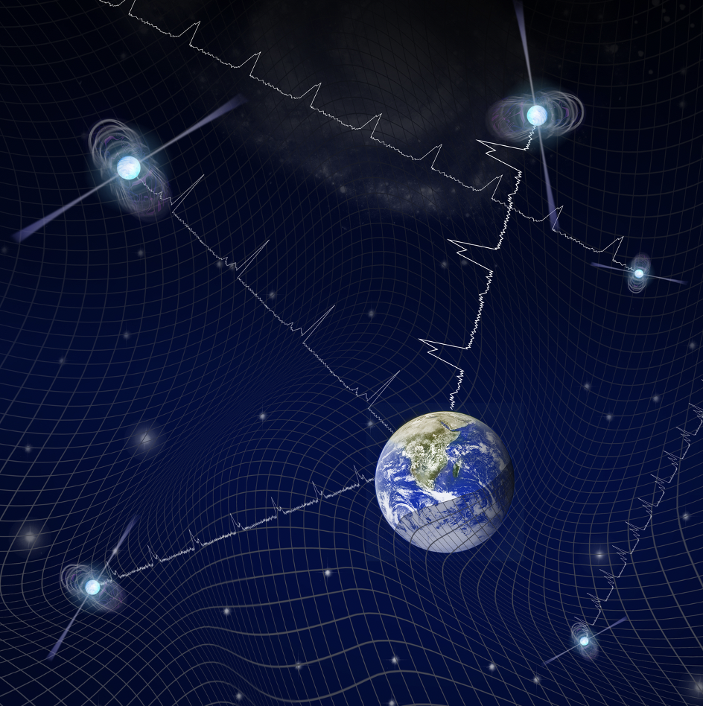
Signal from the Gravitational Wave Background Joseph Simon et al.
National Aeronautics and Space Administration
Jet Propulsion Laboratory
California Institute of Technology
Science Question: What is the population of gravitational wave-emitting supermassive black hole (SMBH) binaries resulting from mergers of galaxies?
Data & Results: Over 12.5 years, 47 millisecond radio pulsars were observed. The precise arrival times of the radio pulses were analyzed for contributions from gravitational wave signals produced by SMBH binaries with ~1 year orbital periods. The analysis found strong evidence for a common signal in all pulse arrival times, consistent with a population of SMBH binaries emitting gravitational waves.
Significance:
The observations are consistent with, though not yet conclusive for, the expected signal from a population of SMBH binaries. Additional data already exist to confirm this result, which will then constrain SMBH interactions and merger time scales.
Reproduced with permission from NANOGrav/T. Klein
Millisecond pulsars emit radio pulses with a stability that allows pulse arrival times to be predicted over decadal time scales.
A set of precisely timed millisecond pulsars is a gravitational wave detector, with ‘‘arms” formed from Earth-pulsar lines of sight. Orbiting supermassive black holes produce gravitational waves that are detected by their distortions in the Earth-pulsar detector arms.
Arzoumanion, et al. (2020), ApJL 905, L34
https://doi.org/10.3847/2041-8213/abd401
This work was supported by JPL’s internal funding.
Notes:
1
You may add comments here to clarify the work or the results.

Slide 2
National Aeronautics and Space Administration
Jet Propulsion Laboratory
California Institute of Technology
Corresponding author: Secondary Contact:
Dr. Joseph Simon Dr. Joseph Lazio
University of Colorado, Boulder Chief Scientist for the Interplanetary Network Directorate
200 Colorado Ave., Boulder, CO 80309 Jet Propulsion Laboratory
https://orcid.org/0000-0003-1407-6607 M/S 67-201, 4800 Oak Grove Dr., Pasadena, CA 91109
joe.simon@nanograv.org Joseph.Lazio@jpl.nasa.gov
Citation:
“The NANOGrav 12.5-year Data Set: Search for an Isotropic Stochastic Gravitational-wave Background”
Arzoumanion, Z., Baker, P.T., Blumer, H., et al. (2020), ApJL 905, L34
https://doi.org/10.3847/2041-8213/abd401
also see:
https://www.jpl.nasa.gov/news/gravitational-wave-search-finds-tantalizing-new-clue
Data Sources:
NANOGrav – the North American Nanohertz Observatory for Gravitational Waves
Arecibo Observatory
Green Bank Observatory (GBT)
National Radio Astronomy Observatory (NRAO)
Technical Description of Figure:
Millisecond pulsars emit radio pulses with a stability that allows pulse arrival times to be predicted over decadal time scales.
A set of precisely timed millisecond pulsars is a gravitational wave detector, with ”arms” formed from Earth-pulsar lines of sight. Orbiting supermassive black holes (SMBH) produce nanohertz gravitational waves that are detected by their distortions in the Earth-pulsar detector arms.
Scientific significance, societal relevance, and relationships to future missions:
The observations are consistent with, though not yet conclusive for, the expected signal from a population of SMBH binaries. Additional data already exist to confirm this result, which will then constrain SMBH interactions and merger time scales.
Much of this work was led by a JPL postdoctoral researcher and built upon a foundation developed by previous Einstein Fellows.
Historical Note:
The first such “pulsar timing array” was constructed by JPL researchers, but prior to the discovery of millisecond pulsars, so it was not sensitive enough to detect gravitational waves from supermassive black hole binaries.

