Slide 1
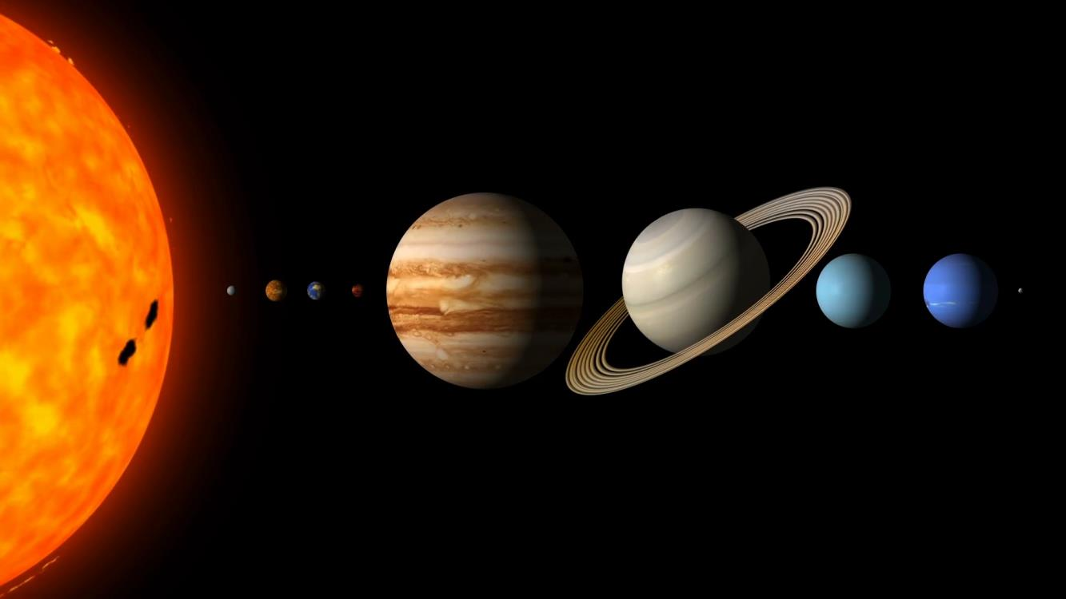
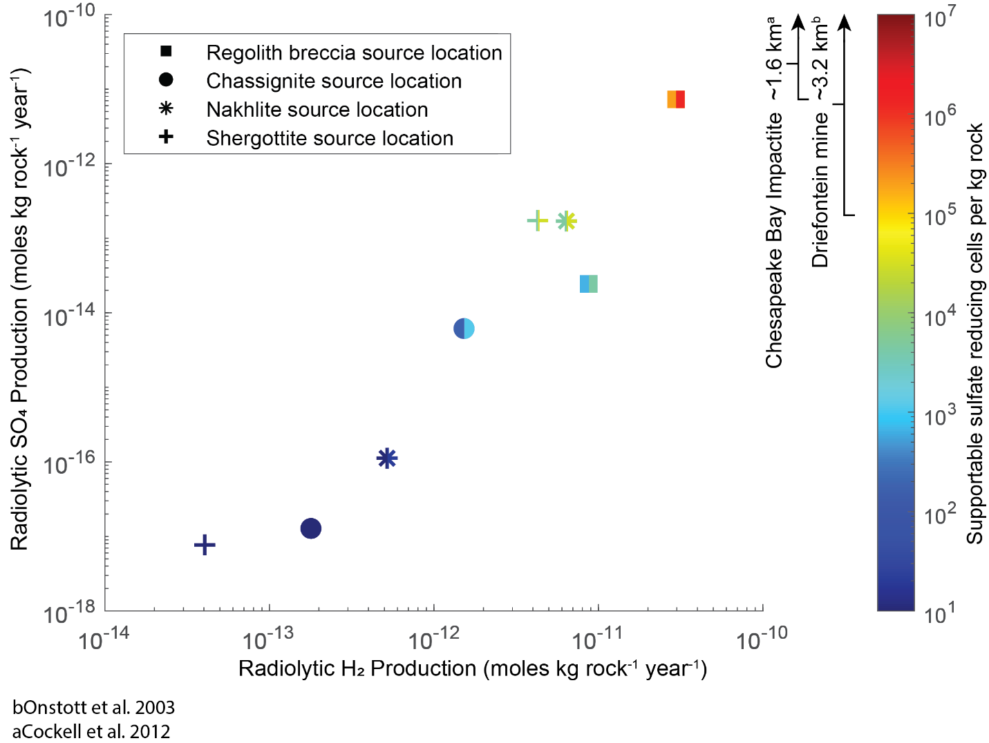
Earth-like habitable environments in the subsurface of Mars Jesse Tarnas
National Aeronautics and Space Administration
Jet Propulsion Laboratory
California Institute of Technology
In Earth’s deep continental subsurface, where groundwaters are often isolated for >10⁶-10⁹ years, energy released by radionuclides within rock produces oxidants and reductants that drive metabolisms of non-photosynthetic microorganisms. Similar processes could support past and present life in the martian subsurface. Sulfate-reducing microorganisms are common in Earth’s deep subsurface, often using hydrogen derived directly from radiolysis of pore water and sulfate derived from oxidation of rock-matrix-hosted sulfides by radiolytically-derived oxidants.
Data & Results: We used data from martian meteorites, orbital gravimetry, and Witwatersrand Basin microbial communities for our calculations. We found that the source localities for many martian meteorites are capable of producing sufficient redox nutrients to sustain up to millions of sulfate-reducing microbial cells per kg rock via radiolysis alone.
Significance: Our results demonstrate that martian subsurface groundwaters, where present, would largely be habitable from a redox energy perspective via radiolysis alone. This provides motivation to explore the subsurface and search for groundwater on Mars.
If groundwater was present in the martian meteorite source regions, radiolysis would produce sufficient redox energy to sustain cell concentrations similar to those observed in Earth’s deep subsurface.
Tarnas et al. (2021) Earth-like habitable environments in the subsurface of Mars, Astrobiology doi.org/10.1089/ast.2020.2386
This work was supported by a Canadian Institute for Advanced Research (CIFAR) and partly by a NASA Postdoctoral Fellowship to Jesse Tarnas.
Notes:
Link to paper: https://www.liebertpub.com/doi/10.1089/ast.2020.2386

