Slide 1
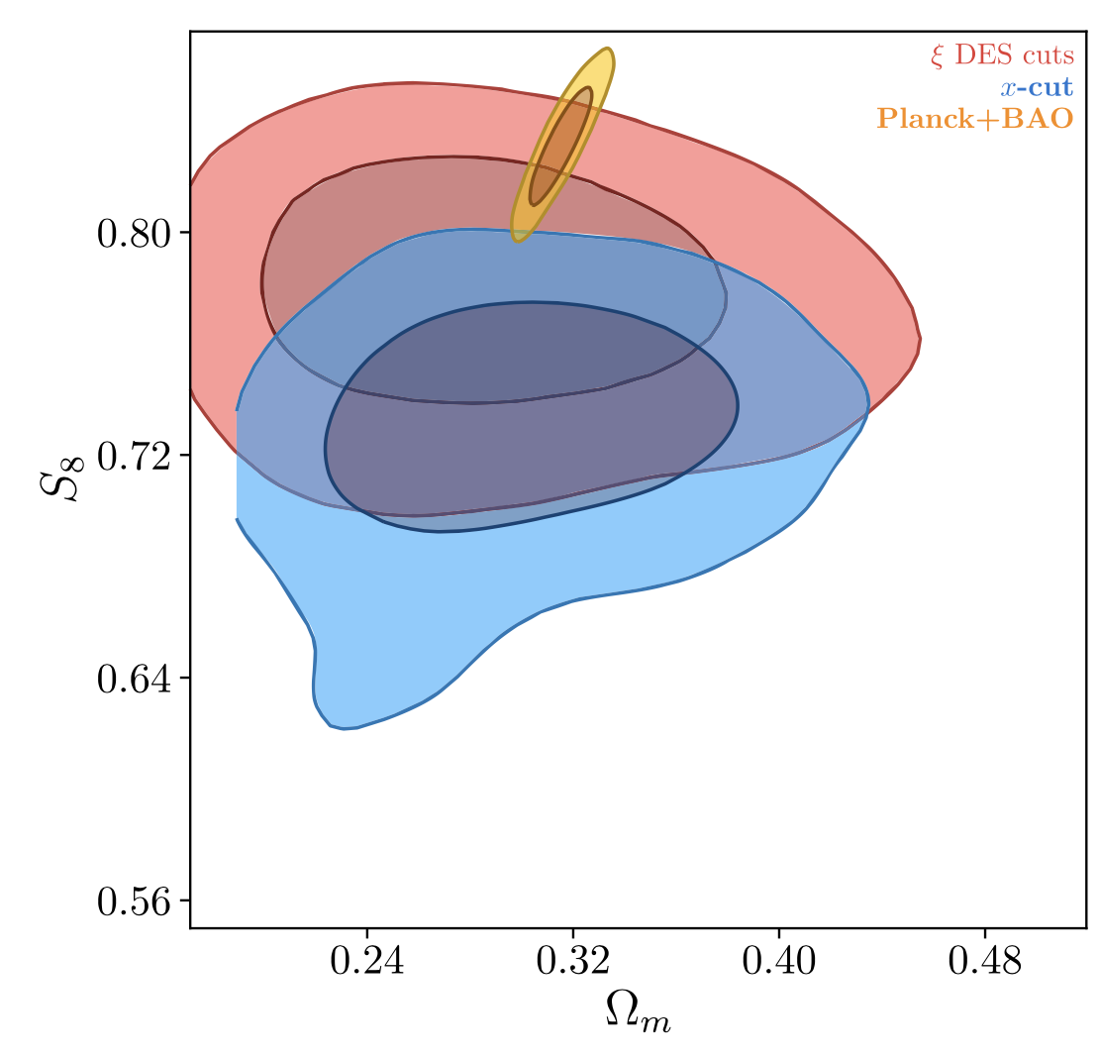
Improved Observations of Cosmic Shear Taylor, Bernardeau, and Huff
National Aeronautics and Space Administration
Jet Propulsion Laboratory
California Institute of Technology
Science Question: How can we use observations of large-scale structure to understand the formation and evolution of the Universe?
Data & Results: A new method is developed to quantify the cosmic shear in surveys of large-scale structure. Re-analysis of data from the first year of the Dark Energy Survey is able to significantly reduce the uncertainty on S₈ – a key cosmological parameter measuring the clustering of matter on large scales.
Significance: The newly developed method for interpreting cosmic shear has already produced an important measurement of large-scale structure, in tension with Planck’s observations of the cosmic microwave background. Future application to upcoming surveys – e.g. the Roman Space Telescope’s – should similarly improve their precision and robustness.
Reproduced with permission from Phys Rev D, © APS
Dark Energy Survey (DES) observations of cosmic shear constrain basic cosmological parameters such as 𝛺_{m}, the total matter density (baryonic plus dark matter) and S₈, the clustering of matter on large scales (red). A new analysis method (blue) reduces the uncertainty on S₈ by 32%. The new result is inconsistent with Planck’s observations of the cosmic microwave background (yellow).
P. Taylor, F. Bernardeau, and E. Huff (2021), Phys Rev D 103, 043531
https://doi.org/10.1103/PhysRevD.103.043531
This work was supported by NASA’s Postdoctoral Program.
Notes:
1
You may add comments here to clarify the work or the results.

Slide 2
National Aeronautics and Space Administration
Jet Propulsion Laboratory
California Institute of Technology
Contact:
Dr. Peter L. Taylor
NASA Postdoctoral Fellow
169-237, Jet Propulsion Laboratory, Pasadena, CA 91109
peter.taylor@jpl.nasa.gov
Citation:
“x-cut Cosmic shear: Optimally removing sensitivity to baryonic and nonlinear physics
with an application to the Dark Energy Survey year 1 shear data”
Peter L. Taylor, Francis Bernardeau, and Eric Huff (2021), Physical Review D 103, 043531
https://doi.org/10.1103/PhysRevD.103.043531
Data Sources:
Dark Energy Survey Year 1 (DESY1) shear data
Technical Description of Figure:
Dark Energy Survey (DES) observations of cosmic shear constrain basic cosmological parameters such as 𝛺_{m},
the total matter density (baryonic plus dark matter) and S₈, the clustering of matter on large scales (red contours).
The new analysis method developed in this paper reduces the uncertainty on S₈ by 32% (blue contours).
This new result is inconsistent with Planck’s observations of the cosmic microwave background (yellow contours),
at a 2.6-sigma significance level.
Scientific significance, societal relevance, and relationships to future missions:
The newly developed method for interpreting cosmic shear has already produced an important measurement of large-scale structure, in tension with Planck’s observations of the cosmic microwave background (at a 2.6-sigma level). Future application to upcoming surveys of large-scale structure – e.g. the Roman Space Telescope’s survey of cosmic shear – should similarly improve their precision and robustness.

