Slide 1
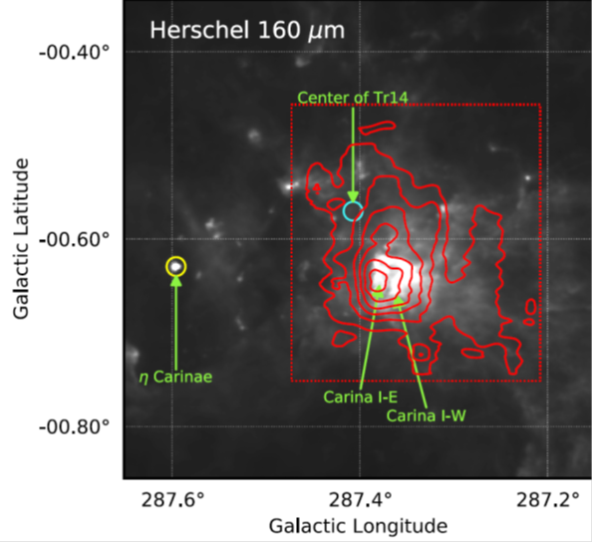
Probing Carina using STO2 Youngmin Seo
National Aeronautics and Space Administration
Jet Propulsion Laboratory
California Institute of Technology
Science Question: How stellar feedback regulates star formation is a critical question in star formation and galactic evolution. The Carina Nebula Complex (CNC) is an extremely active star-forming region in our Galaxy and is a prominent site to test theories of star formation and feedback from young stars.
Data and Results: We observed the Tr 14/Carina I region in the [CII] 158 micron transition using STO2. We find that the HII regions of the CNC are well-described as HII regions with one side freely expanding towards us. The dispersal of the Giant Molecular Cloud in this region is dominated by EUV photoevaporation; the dispersal timescale is 20-30 million years.
Significance: STO2 successfully demonstrated deployment of a balloon-borne telescope for high resolution spectroscopy and provided invaluable data for future long-duration balloon missions. The scientific findings using STO2 revealed the impact of star formation on the interstellar medium.
STO-2
Successful observation of [CII] emission (red contours, left) in Tr 14/Carina I made using Stratospheric Terahertz Observatory 2 (STO2). STO2 included an 80 cm telescope & a heterodyne spectrometer on a balloon platform, which flew at 40 km altitude above Antarctica.
Seo et al. 2019, Astrophysical Journal, Vol. 878, Page 120, 10.3847/1538-4357/ab2043
STO2 is a multi-institutional effort funded by the National Aeronautics and Space Administration (NASA) through the ROSES-2012 program under grant NNX14AD58G. (Eric Tollestrup, Michael Garcia)
Notes:
1
You may add comments here to clarify the work or the results.

Slide 2
National Aeronautics and Space Administration
Jet Propulsion Laboratory
California Institute of Technology
Contact:
Youngmin Seo, 169-537A, Jet Propulsion Laboratory, Pasadena, CA 91109
youngmin.seo@jpl.nasa.gov
Citation:
Seo et al., “Probing ISM Structure in Trumpler 14 & Carina I Using The Stratospheric Terahertz Observatory 2”, 2019, Astrophysical Journal, Vol. 878, Page 120, 10.3847/1538-4357/ab2043
Data Sources:
Stratospheric Terahertz Telescope - 2 (ftp site: http://soral.as.arizona.edu/STO2/)
Technical Description of Figure:
Successful observation of [CII] emission (red contours, left) in Tr 14/Carina I using Stratospheric Terahertz Observatory 2 (STO2). The grayscale background in the left panel shows the dust continuum at 160 µm, which traces warm dust in the interstellar cloud. The photos in the right panel show STO2 in flight in December 2016 in Antarctica.
Scientific significance, societal relevance, and relationships to future missions:
STO2 is the first balloon-borne Terahertz telescope for astronomy with a high-resolution spectrometer. Through achieving scientific findings, STO2 has proved to be a new, useful platform to observe infrared light from the Universe, which is invaluable in understanding star formation. With the success of STO2, the Galactic/Extragalactic ULDB Spectroscopic Terahertz Observatory (GUSTO) was approved and is the next generation mission for submillimeter astronomical spectroscopy. GUSTO is to be launched in December 2021.

