Slide 1
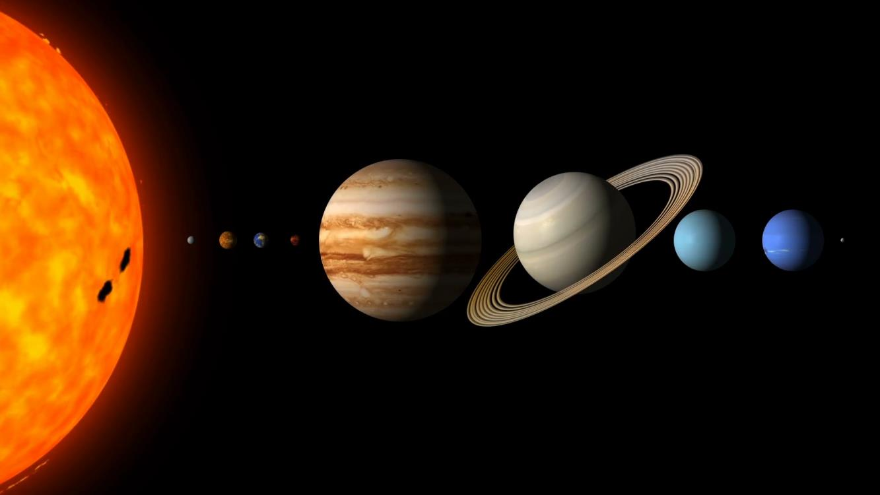
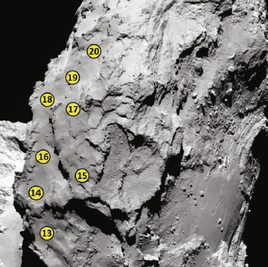
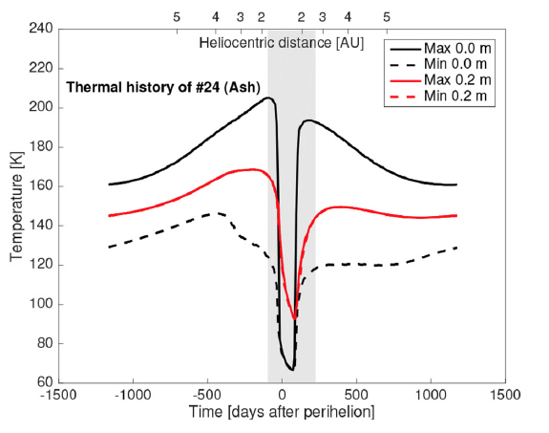
Airfall on Comet 67P Prepared by Björn J. R. Davidsson (3224)
National Aeronautics and Space Administration
Jet Propulsion Laboratory
California Institute of Technology
Comet 67P/Churyumov-Gerasimenko ejects particles from its southern hemisphere, of which some land on its northern hemisphere as “airfall”. The CAESAR mission, proposed to NASA’s New Frontier 4 program, would collect airfall material and return it to Earth.
Data & Results: We used computer models to calculate the amount of particles produced in the south, tracked their orbits in the gravity field of the comet nucleus, and estimated how much airfall that would land at each potential CAESAR landing site in the north. We found that a 0.9 meter thick layer is deposited on average each comet orbit. We also calculated the amount of solar heating at the sites, to identify locations where water ice may survive for long periods of time.
Significance: In order to make an informed choice of the spacecraft landing site, this research told us where we would have the largest chance of finding plenty of fresh ice.
We calculated the amount of airfall at potential landing sites of the CAESAR mission (left) and the temperature of the sites throughout the comet orbit (right) to understand how much ice that would be available for sampling by the spacecraft.
Davidsson et al. (2021). Airfall on Comet 67P/Churyumov-Gerasimenko.
Icarus 354, 114004.
DOI: https://doi.org/10.1016/j.icarus.2020.114004
This work was supported by an award to B. J. R. Davidsson from the
Planetary Science Directorate (4X) at the Jet Propulsion Laboratory / California Institute of Technology
© 2022 California Institute of Technology. Government sponsorship acknowledged.
Notes:
1
You may add comments here to clarify the work or the results.

