Slide 1
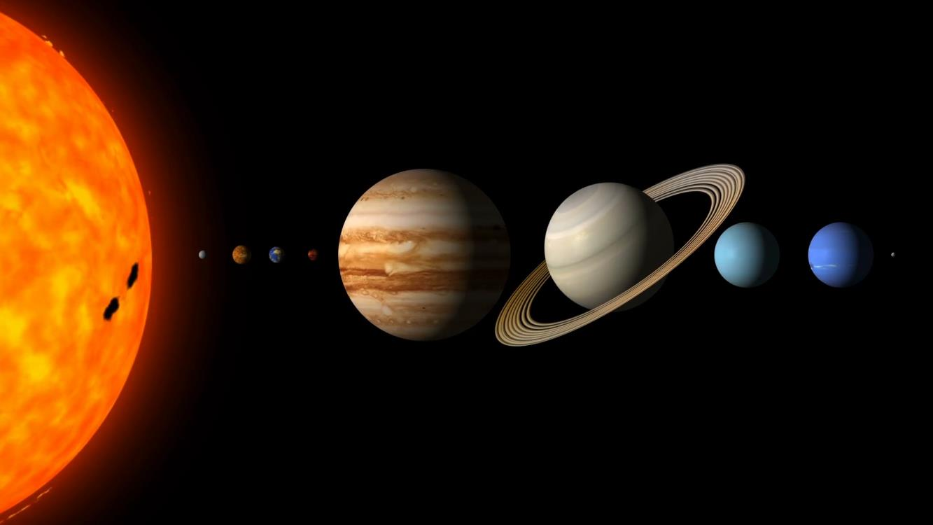
Water on the Rough Lunar Surface Björn J. R. Davidsson & Sona Hosseini (3224)
National Aeronautics and Space Administration
Jet Propulsion Laboratory
California Institute of Technology
Spacecraft observations have revealed small amounts of water on the lunar day-time surface. But is it strongly bound within the rock, or free to move around?
Data & Results: We present a new thermal model of the lunar surface, reporting water may not be trapped within impact glass, as previously assumed. Instead, frost can persist on the surface due to low temperatures caused by shadowing. The molecules are released when sunlight illuminates the shadows, thus feeding the exosphere.
Significance: This research adds to an ongoing debate on how water is produced or released, transported, and stored on the Moon. It helps us understand how the Moon works as a natural body, and also what resources are available for human lunar exploration.
Caption to graphic, use action words e.g. note hot spot over Asia caused by xyz.
Davidsson, B. J. R., and Hosseini, S. (2021). Implications of surface roughness in models of water desorption on the Moon. Mon. Not. R. Astron. Soc. 506, 3421-3429. DOI: https://doi.org/10.1093/mnras/stab1360
This work was supported by funding from the Space Technology Office at
the Jet Propulsion Laboratory, California Institute of Technology
NASA press release:
https://www.jpl.nasa.gov/news/nasa-study-highlights-importance-of-surface-shadows-in-moon-water-puzzle
© 2022 California Institute of Technology. Government sponsorship acknowledged.
Notes:
1
You may add comments here to clarify the work or the results.

