Slide 1
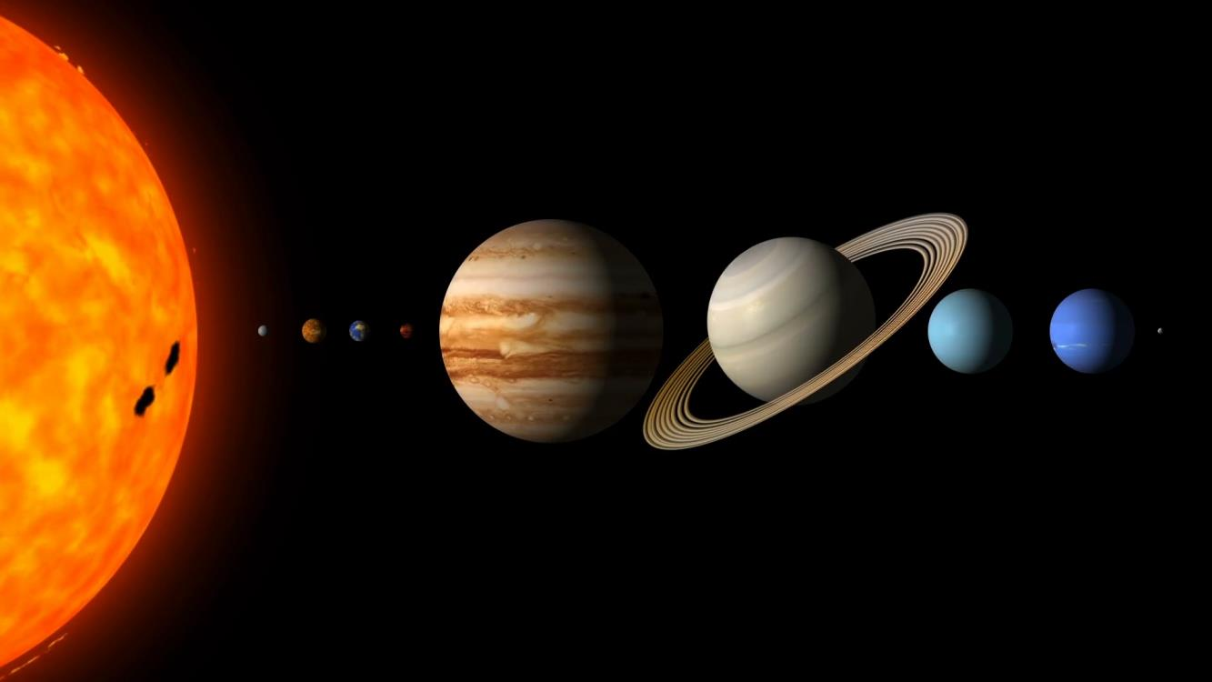
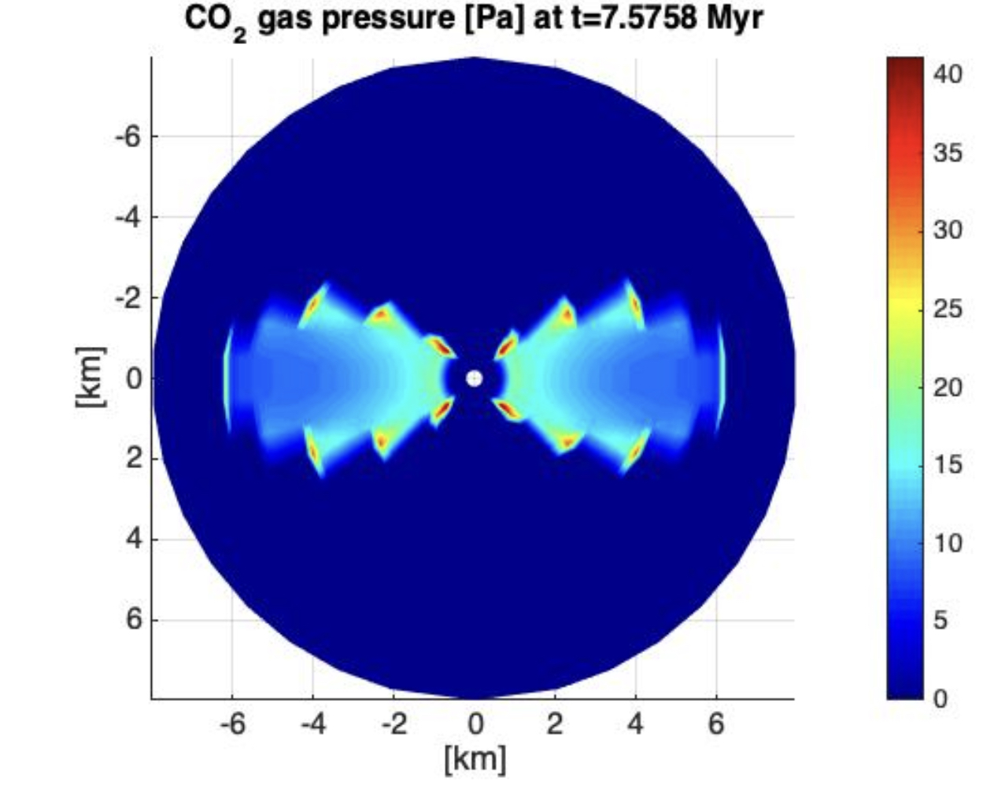
Heating of icy bodies in catastrophic collisions Björn J. R. Davidsson (3224)
National Aeronautics and Space Administration
Jet Propulsion Laboratory
California Institute of Technology
Violent collisions between small icy bodies in the outer Solar System lead to heating. The heating triggers loss of highly volatile carbon monoxide (CO) ice to space, and relocates less volatile carbon dioxide (CO₂) ice from the body centers to their surfaces. But comet nuclei, supposedly being the remaining km-sized fragments after collisional activity, are CO-rich. The question is therefore how energetic collisions the comet’s ancestors possibly could have endured?
Data & Results: The thermophysics modeling tool NIMBUS was used to calculate compositional changes within icy bodies, as the result of global collisional heating. It was found that the comet nucleus ancestors may have been at most 20-60 km in diameter. If larger bodies were grinded down to form comets, the CO loss would have been too large.
Significance: Scientists debate the age and size of the `Primordial Disk’ – the structure where comets formed, and that was dispersed when the giant planets migrated to their current orbits. The current research supports a short collision era and helps constraining the epoch of planetary migration to the first 10-70 million years of Solar System history.
Here, impact heating has triggered crystallization of amorphous water ice, a process that releases even more energy, enough to vaporize CO₂ ice. The picture shows a snapshot map of the CO₂ vapor gas pressure within the largest surviving fragment after the collision that destroyed the parent body.
Davidsson, B. J. R. (2023). Collisional heating of icy planetesimals – I. Catastrophic collisions. Mon. Not. R. Astron. Soc. 521, 2484-2503. DOI: https://doi.org/10.1093/mnras/stad679
This work was supported by an award to the author under the ROSES 2018 Emerging Worlds Program (Dr. Kathleen Vander Kaaden)
© 2023 California Institute of Technology. Government sponsorship acknowledged.
Notes:
1
You may add comments here to clarify the work or the results.

