Slide 1
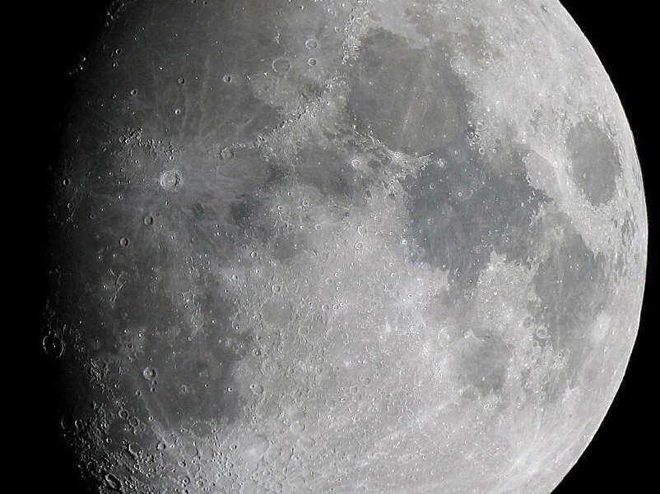
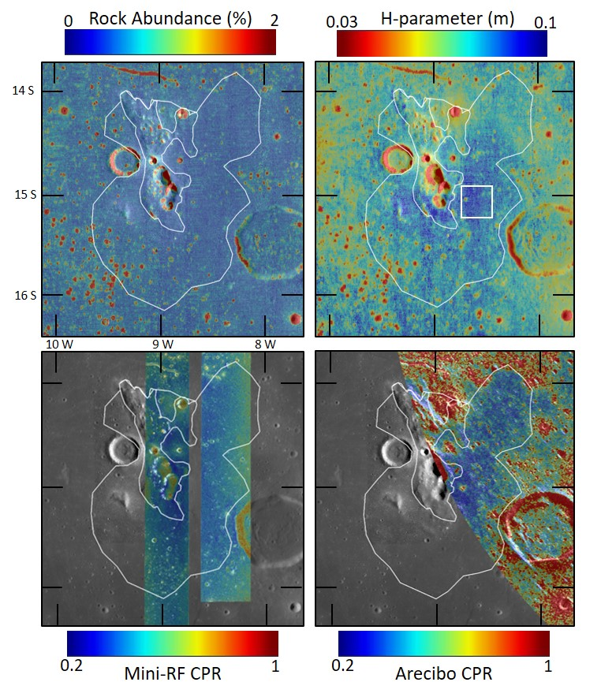
Evidence for Fine-Grained Material at Lunar Red Spots
Ben Byron
Thermal inertia
Lunar Red Spots are volcanic features on the Moon that appear to be the product of silicic volcanism. Their formation mechanism is unclear, as the Moon lacks the water and plate tectonics needed to enable the silicic volcanism we see on Earth. In this work, we investigate the material properties of lunar red spots to provide context for their formation.
Data & Results: Using thermal infrared data and radar datasets from lunar orbital and Earth-based instruments, we found that the red spots were generally rock-poor and displayed low thermal inertia. This suggests that the regolith at certain locations within the red spots is relatively finer-grained and contains fewer rocks than typical regolith.
Significance: In some cases, the fine-grained regolith is likely related to the presence of volcanic deposits (e.g., Lassell Massif). In others, it could be related to the unique physical properties of the rocks that make up the red spots, and how those properties affect the way the rocks break down over time due to space weathering. Red spots are compositionally unique features on the Moon, and their material properties indicate that they are different from the maria surrounding them.
A number of lunar red spots such as Lassell Massif (above) have low rock abundance, thermal inertia, and radar return, indicating an abundance of rock-poor, fine-grained regolith
Byron, B. D., et al., (2023). Evidence for Fine-Grained Material at Lunar Red Spots: Insights from Thermal Infrared and Radar Data Sets. The Planetary Science Journal, Vol. 4, No. 9. 10.3847/PSJ/acf134
This work was supported by the Lunar Reconnaissance Orbiter Diviner Lunar Radiometer Experiment
© 2023 California Institute of Technology. Government sponsorship acknowledged.
Notes:
1
You may add comments here to clarify the work or the results.

