Slide 1
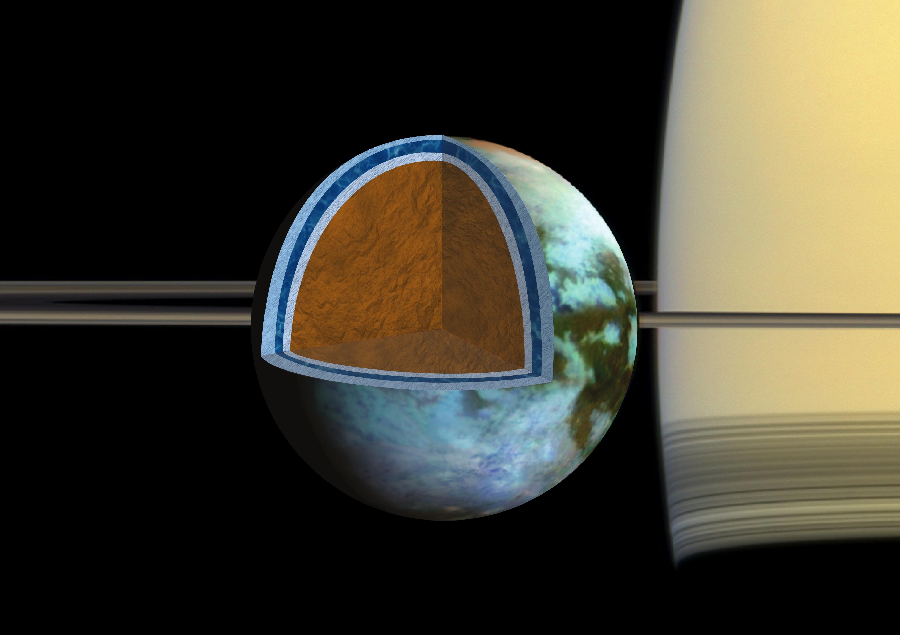
Dynamics of Clathrates in Ocean Worlds
Evan Carnahan, Steven D. Vance , Marc A. Hesse,
Baptiste Journaux, and Christophe Sotin
We show clathrates—gases trapped in water ice—accumulating at the base of the ice shell are entrained throughout the shell. This entrainment slows convection and thickens the conductive lid across a range of ocean worlds, potentially preserving sub-ice oceans but limiting avenues for material transport into them.
Data & Results: We used computer models and recently available physical data for ices and clathrates to improve available theory regarding solid state convection based on constraints from the Cassini and New Horizons missions.
Significance: The pronounced effect of clathrates on heat transport has the potential to preserve sub-ice oceans, while simultaneously limiting transport of materials across the ice.
Caption to graphic, use action words e.g. note hot spot over Asia caused by xyz.
Carnahan, E., Vance, S. D., Hesse, M. A., Journaux, B., & Sotin, C. (2022). Dynamics of mixed clathrate-ice shells on ocean worlds. Geophysical Research Letters, 49, e2021GL097602.
This work was supported by an award to E. Carnahan, S. Vance, B. Journaux, and C. Sotin under the NASA Astrobiology Institute CAN17 (P. Boston)
Background Image: NASA/JPL/SSI/Univ. of Arizona/G. Mitri/University of Nantes
© 2022 California Institute of Technology. Government sponsorship acknowledged.
Notes:
1
You may add comments here to clarify the work or the results.

