Slide 1
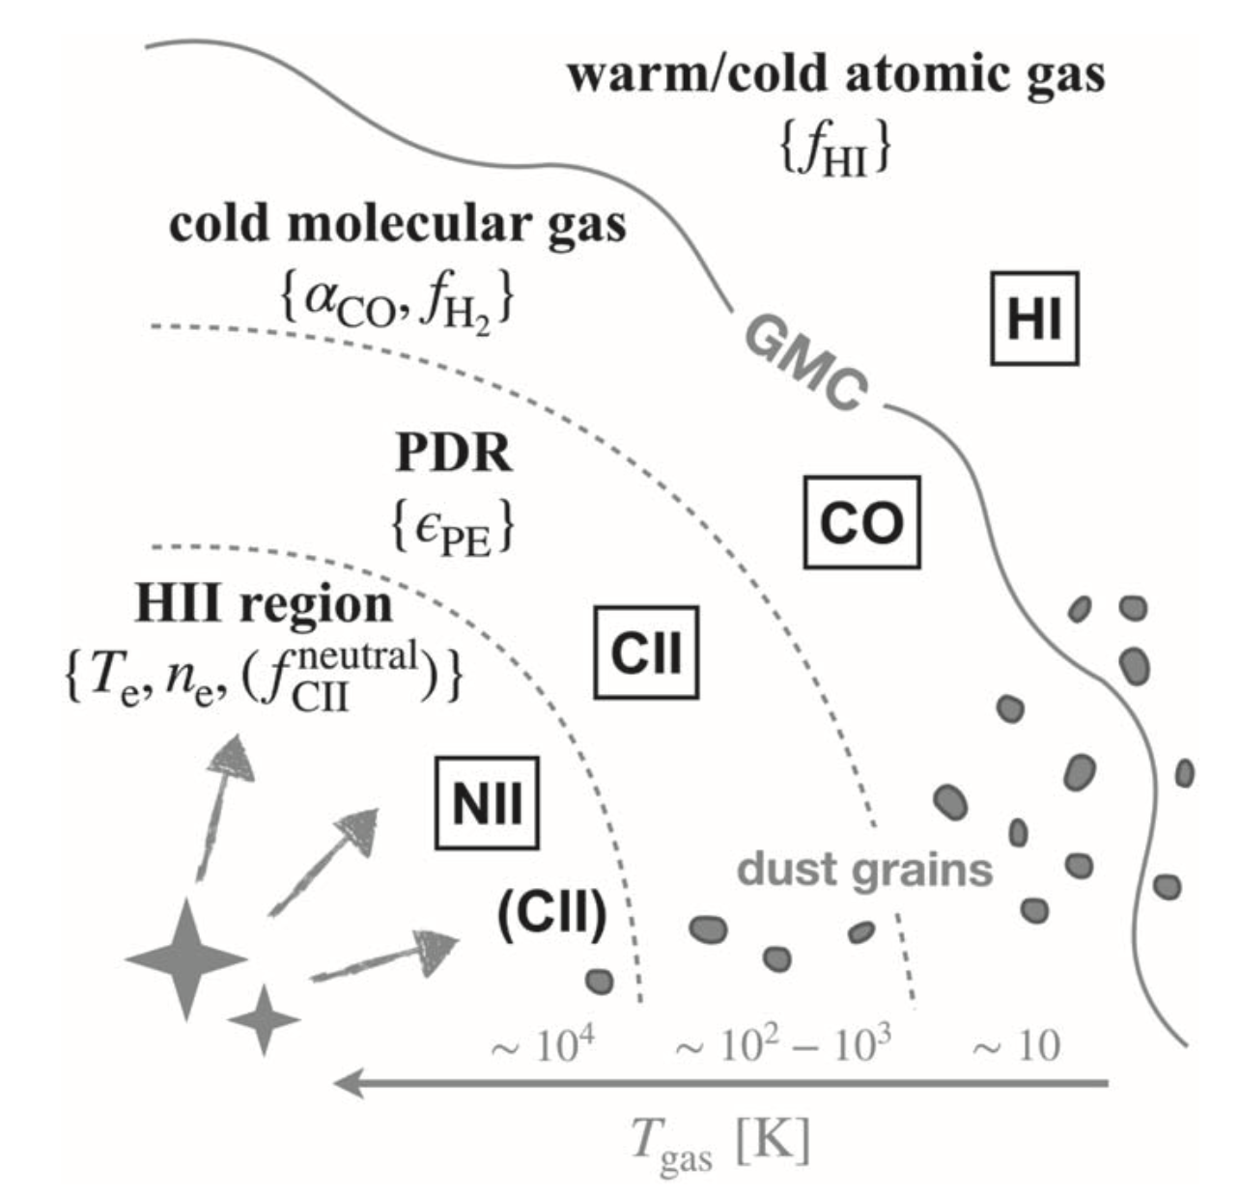
Modeling Line Intensity Mapping G. Sun, B. Hensley, T.C. Chang, O. Doré, P. Serra
National Aeronautics and Space Administration
Jet Propulsion Laboratory
California Institute of Technology
Science Question: How does the interstellar medium (ISM) evolve throughout the history of the universe? What does this evolution tell us about star formation in the early universe?
Methods & Results: Line intensity mapping (LIM) is a technique for probing star formation history that focuses not on individual targets, but rather on a whole population of galaxies. By studying the overall emission, it is possible to probe the conditions of interstellar gas and dust back in time. Based on a detailed model of line emission, the potential of LIM for tracing the evolution of the interstellar medium is rigorously quantified.
Significance: This is the first time it’s been demonstrated that with cosmological large-scale, statistical measurements of multiple line intensity fluctuations, we can trace and extract the small-scale ISM physical parameters in different phases out to high redshifts.
Reproduced with permission from the Astrophysical Journal, © AAS
The line intensity model includes observations of several lines, including HI, CO, CII, and NII. These lines probe different interstellar environments, from cold atomic gas to hot ionized-hydrogen regions. With line intensity mapping, it is possible to use these lines to probe back toward the universe’s first bursts of star formation.
Sun, G., et al. (2019), ApJ 887, 142
https://doi.org/10.3847/1538-4357/ab55df
This work was supported by JPL internal funds.
Notes:
1
You may add comments here to clarify the work or the results.

Slide 2
National Aeronautics and Space Administration
Jet Propulsion Laboratory
California Institute of Technology
Contact:
Tzu-Ching Chang
Research Scientist
169-237, Jet Propulsion Laboratory, Pasadena, CA 91109
Tzu-Ching.Chang@jpl.nasa.gov
https://orcid.org/0000-0001-5929-4187
Citation:
“A Self-Consistent Framework for Multiline Modeling in Line Intensity Mapping Experiments”
Sun, G., Hensley, B. S., Chang, T. C., Dore, O., and Serra, P. (2019), ApJ 887, 142
https://doi.org/10.3847/1538-4357/ab55df
Technical Description of Figure:
Cartoon illustration of how physical parameters describing different ISM phases in the line intensity model are mapped to the emission lines considered - HI 21 cm, CO (1-0), CII 158 𝛍m, and NII 122 & 205 𝛍m. These lines probe different interstellar environments, from cold (10 K) atomic and molecular gas to hot (1000 K) ionized-hydrogen regions. With line intensity mapping, it is possible to use these lines to probe back toward the universe’s first bursts of star formation.
Scientific significance, societal relevance, and relationships to future missions:
This is the first time that a self-consistent model of large-scale spectral line intensity fluctuations is derived through modeling of the small-scale physical conditions of different phases of the interstellar medium (ISM). It is demonstrated that with cosmological large-scale, statistical measurements of multiple line intensity mapping (LIM) signals, one can trace and extract the small-scale ISM physical parameters in different phases out to high redshifts. This could potentially shed light on galaxy formation and evolution, especially at high redshifts. The results are relevant for future missions such as the Cosmic Dawn Intensity Mapper (CDIM) and the Galaxy Evolution Probe (GEP) probe mission concepts.

