Slide 1
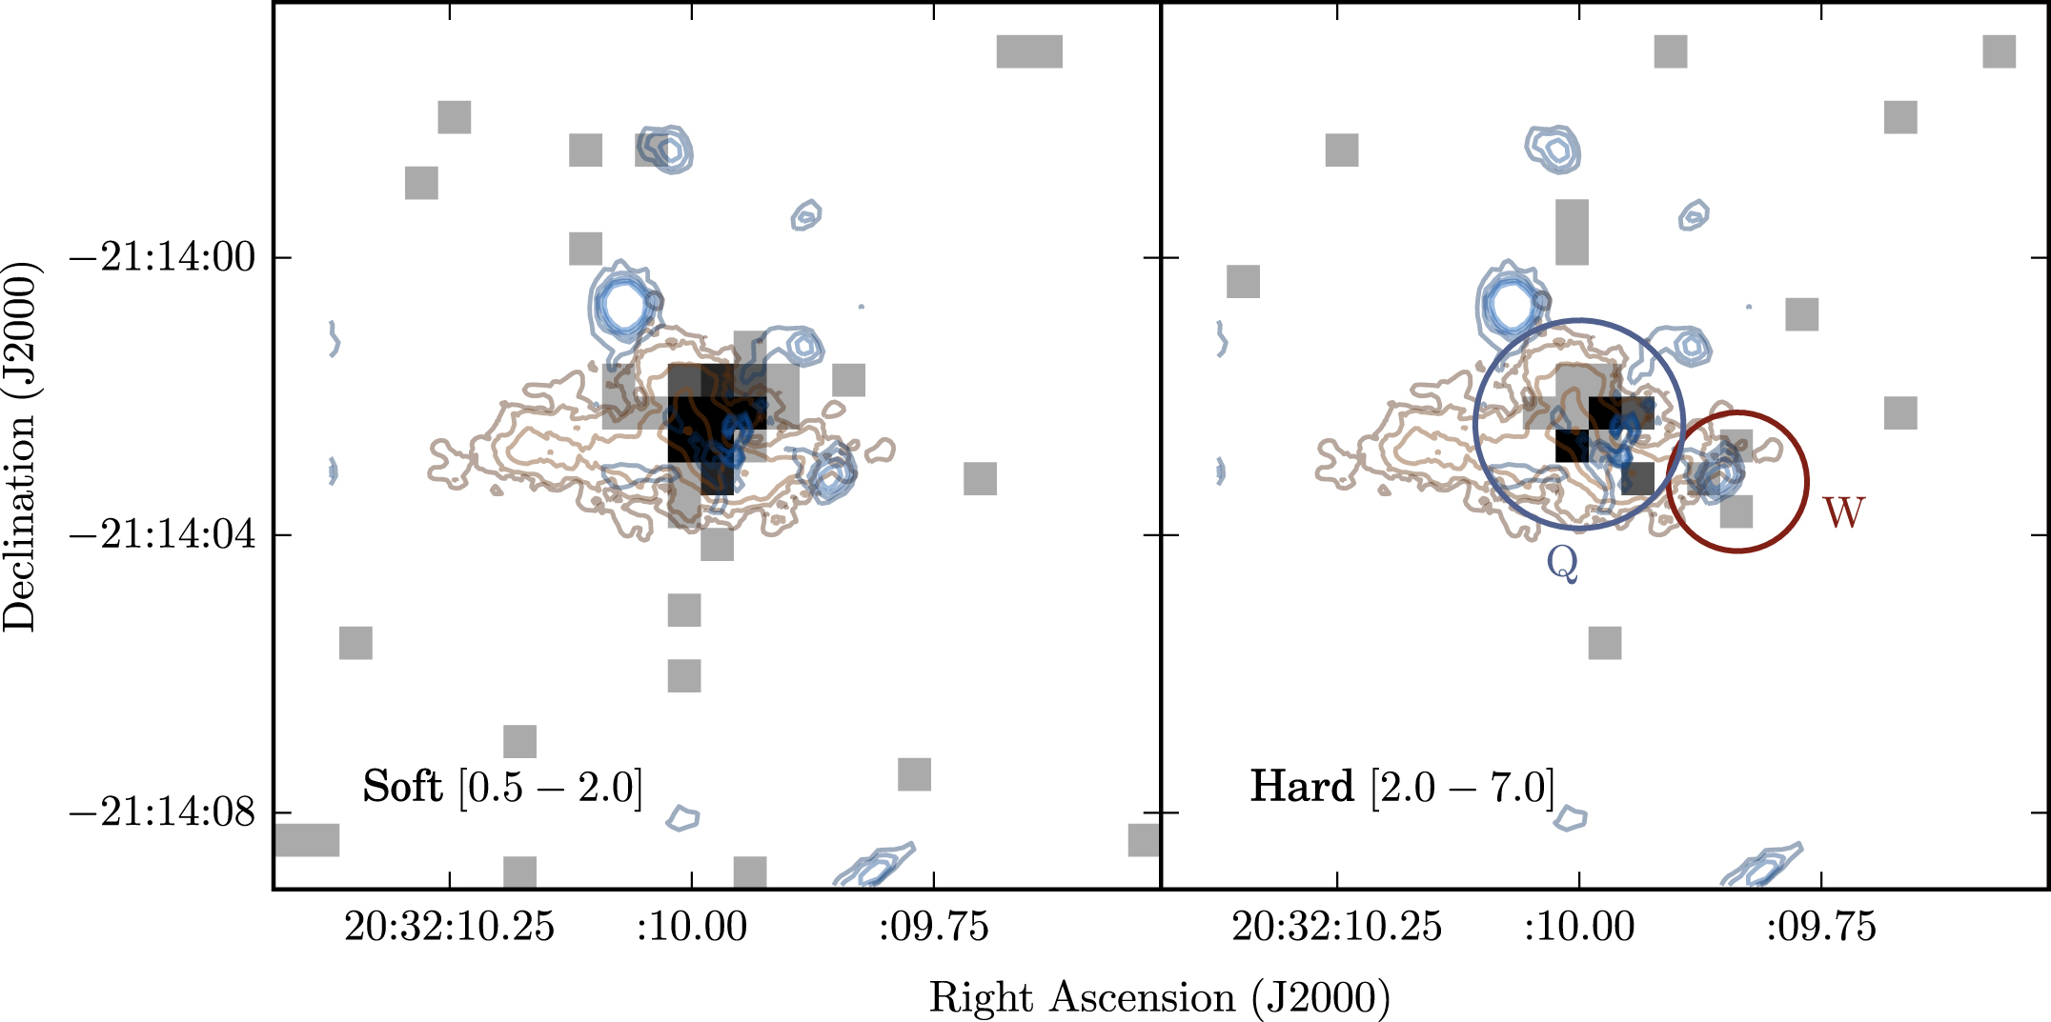
A Quasar/Galaxy Merger at z=6.2 Thomas Connor
National Aeronautics and Space Administration
Jet Propulsion Laboratory
California Institute of Technology
Science Question: How do galaxies form and evolve? Do their central central black holes merge together during galactic collisions?
Data & Results: Chandra observations of PSO J308.0416−21.2339 – a distant quasar seen in the first billion years of the universe – reveal two X-ray sources. The emission likely comes from the active nuclei of two young galaxies merging in the early universe.
Significance: This is the first time that X-ray emission has been detected from neighboring galaxies at high redshift, providing evidence for a pair of young merging galaxies that both have massive black holes in their centers.
Reproduced with permission from the Astrophysical Journal, © AAS
NASA’s Chandra X-Ray Observatory detects X-ray emission from two galaxies merging in the early universe. The companion to the right of the central target, however, is only detected at higher energies (right panel), suggesting that the emitting source is highly obscured by dust.
Connor, T., Bañados, E., Stern, D., et al. (2019), ApJ 887, 171
https://doi.org/10.3847/1538-4357/ab5585
This work was supported by STScI/NASA award HST-GO-15198.
Use of data from the Chandra X-Ray Observatory and the Hubble Space Telescope is acknowledged.
Notes:
1
You may add comments here to clarify the work or the results.

Slide 2
National Aeronautics and Space Administration
Jet Propulsion Laboratory
California Institute of Technology
Contact:
Thomas Connor
NASA Postdoctoral Fellow
169-327, Jet Propulsion Laboratory, Pasadena, CA 91109
Thomas.P.Connor@jpl.nasa.gov
Citation:
“X-Ray Observations of a z ~ 6.2 Quasar/Galaxy Merger”
Connor, T., Bañados, E., Stern, D., et al. (2019), ApJ 887, 171
https://doi.org/10.3847/1538-4357/ab5585
Data Sources:
Chandra X-Ray Observatory, Hubble Space Telescope (HST), Atacama Large Millimeter Array (ALMA)
HST and ALMA images originally published by Decarli, R., et al. (2019), ApJ 880, 157
Technical Description of Figure:
Chandra X-ray observations of PSO J308.0416−21.2339 (black squares) are overlaid on top of a Hubble ultraviolet (UV) image (blue contours) and ALMA radio image (brown contours). A faint X-ray source is seen to the right of the quasar, coincident with a previously reported UV knot. This X-ray emission to the right of the central source is only detected with harder X-rays (right panel), suggesting that the emission is highly obscured by dust.
Scientific significance, societal relevance, and relationships to future missions:
This is the first time that X-ray emission has been detected from neighboring galaxies at high redshift, providing evidence for young merging galaxies that both have massive black holes in their centers. More than 40 hours of Chandra time were required to make this detection; future missions with greater collecting area and/or resolution (e.g. Lynx or Athena) are needed to further advance our understanding of the earliest quasars.

