Slide 1
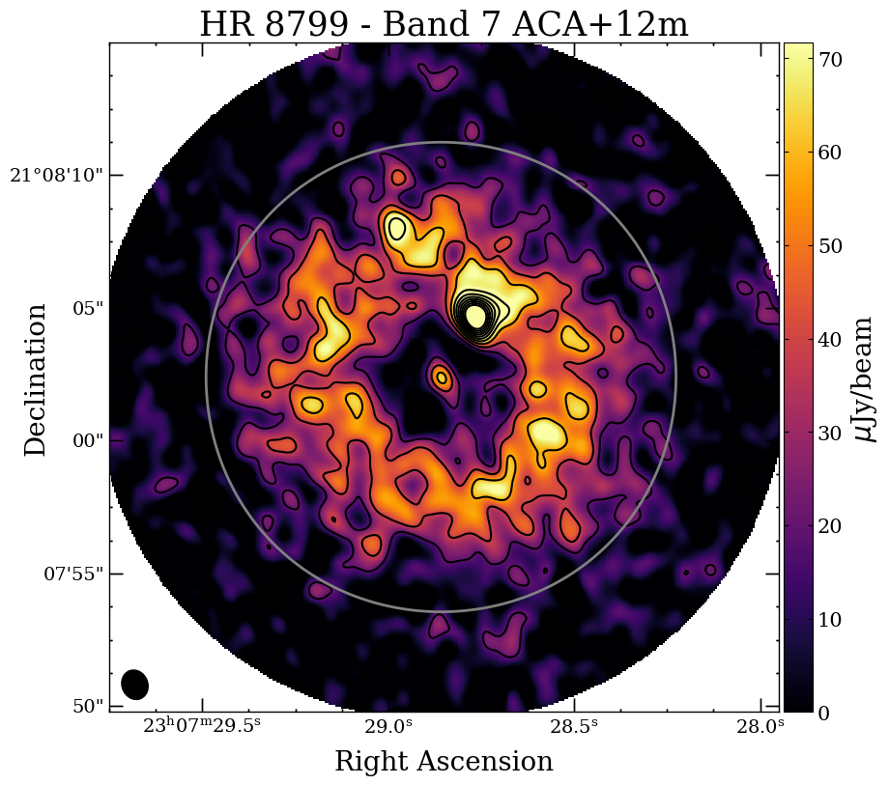
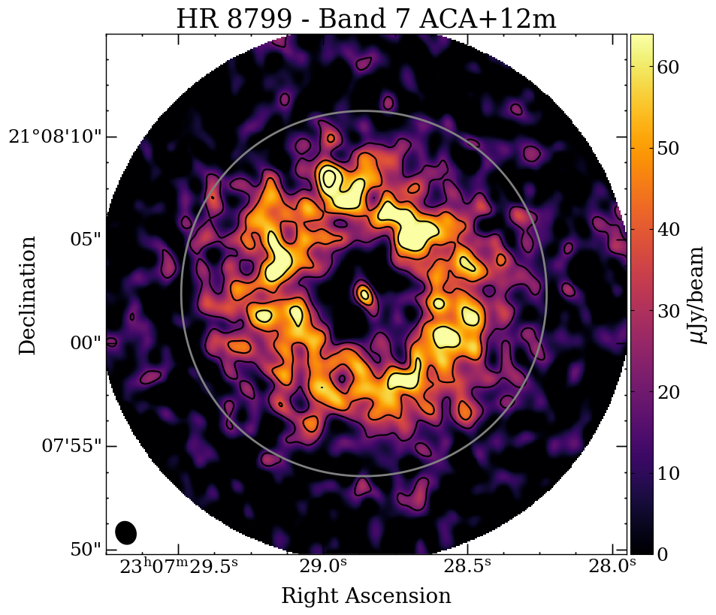
A Detailed View of HR 8799’s Debris Disk Virginie Faramaz et al.
National Aeronautics and Space Administration
Jet Propulsion Laboratory
California Institute of Technology
Science Question: How do planets interact with their surrounding disks of asteroidal and cometary material? Do debris disk structures indicate the presence of unseen shepherding planets?
Data & Results: Before the discovery of its directly imaged planets, the HR 8799 system was already known to host a prominent debris disk – remnant material analogous to the Solar System’s asteroid and Kuiper belts. New observations with the ALMA radio array at 0.88 mm map the disk architecture with an unprecedented level of sensitivity and resolution.
Significance: Though the planets are not seen in this high-resolution image, the distribution of dusty debris provides insight into the underlying planetary system. Specifically, 1) the disk orientation (29º from face-on) matches estimates for the planet’s orbital inclinations, suggesting co-planarity and 2) the location and shape of the disk inner edge are consistent with sculpting from the outermost planet.
Reproduced with permission from AJ, © AAS
The debris disk surrounding HR 8799 has two components – an inner asteroidal belt close to the parent star and a cold outer belt stretching from ~100 to 300 AU.
Four known planets reside in the gap, with projected separations from 15 to 68 AU.
The nearly face-on outer belt is easily resolved by the ALMA radio array, enabling detailed measurement of its radial profile.
Faramaz, V., Marino, S., Booth, M., et al. (2021), AJ 161, 271
https://doi.org/10.3847/1538-3881/abf4e0
This work was supported by JPL internal funding.
Notes:
1
You may add comments here to clarify the work or the results.

Slide 2
National Aeronautics and Space Administration
Jet Propulsion Laboratory
California Institute of Technology
Contact:
Dr. Virginie Faramaz
JPL Postdoctoral Fellow
169-506, Jet Propulsion Laboratory, Pasadena, CA 91109
virginie.c.faramaz@jpl.nasa.gov
https://orcid.org/0000-0001-6403-841X
Citation:
“A Detailed Characterization of HR 8799ʼs Debris Disk with ALMA in Band 7”
Faramaz, V., Marino, S., Booth, M., et al. (2021), AJ 161, 271
https://doi.org/10.3847/1538-3881/abf4e0
Data Sources:
Atacama Large (sub)Millimeter Array (ALMA) – Bands 6 and 7 (1.3 and 0.88 mm wavelength)
Technical Description of Figure:
The debris disk surrounding HR 8799 has two components – an inner asteroidal belt close to the parent star and a cold outer belt stretching from ~100 to 300 AU. Four known planets reside in the gap, with projected separations from 15 to 68 AU.
The central emission peak seen here is from both the star and the inner asteroid belt.
The nearly face-on outer belt is easily resolved by the ALMA radio array, enabling detailed measurement of its radial profile.
Scientific significance, societal relevance, and relationships to future missions:
Though the planets are not seen in this high-resolution image, the distribution of dusty debris provides insight into the underlying planetary system. Specifically, 1) the disk orientation (inclined 29º from face-on) is close to estimates for the planet’s orbital inclinations, suggesting that the disk and planets are nearly co-planar and 2) the location and shape of the disk inner edge are consistent with sculpting from the outermost planet. The presence of additional planets remains an open question. Future observations of resonant clumps hold the potential to determine whether the inner edge has been shaped solely by the known planets or also by a new unseen planet.

