Slide 1
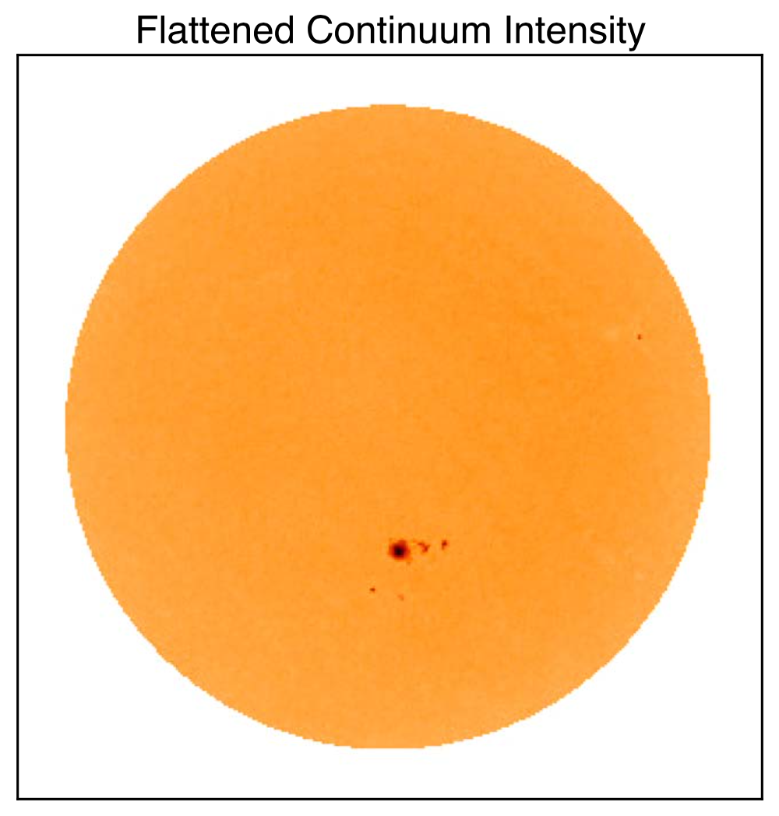
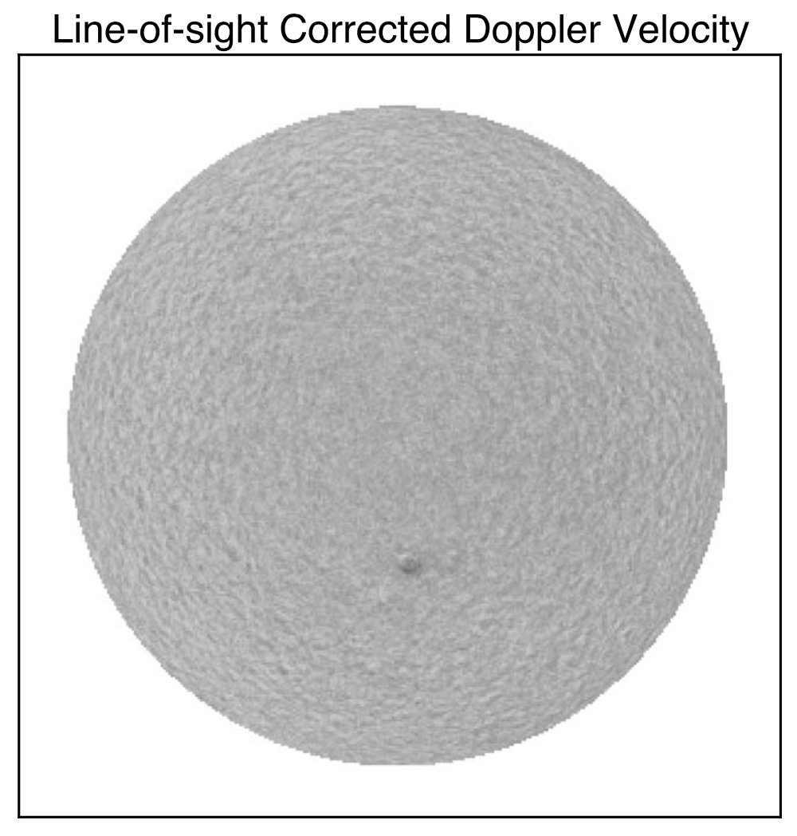

Stellar Activity Signatures in Radial Velocity Data Ervin, Halverson, Burrows, et al.
National Aeronautics and Space Administration
Jet Propulsion Laboratory
California Institute of Technology
Science Questions: How can the Sun be used to better understand stellar activity, which is currently limiting our ability to detect Earth-like planets using the radial velocity (RV) technique? Do high-resolution images of the Sun offer an opportunity to better recognize and thereby mitigate specific effects of stellar activity?
Data & Results: Solar Dynamics Observatory (SDO) images were compared against spectra from the ground-based NEID instrument. An automated analysis pipeline was developed to quantify Solar activity over time using SDO images, allowing for a comparison of various activity metrics against ground-based RVs. Using a basic detrending with magnetic field variability improved the NEID RV scatter by 20%.
Significance: The developed software to compare SDO images with ground-based RVs is now publicly available, providing a valuable community tool for improving our understanding of stellar activity in Sun-like stars. While the basic detrending method demonstrated here reduced the variations in radial velocity by ~20%, additional improvement is still needed to detect Earth-like planets around Sun-like stars.
Reproduced with permission from AAS, ©CC
Unlike more distant stars, the disk of the Sun is easily resolved both in continuum light (left) and with spectra, which provide a map of radial velocity variations across the surface (right). Integrating the light allows for a direct comparison with point-like stellar observations, providing insight into patterns of stellar activity, e.g. those driven by the sunspot group seen above.
Ervin, Halverson, Burrows, et al. (2022), AJ 163, 272
https://doi.org/10.3847/1538-3881/ac67e6
Notes:
1
You may add comments here to clarify the work or the results.

Slide 2
National Aeronautics and Space Administration
Jet Propulsion Laboratory
California Institute of Technology
Contact:
Dr. Samuel Halverson
Optical Engineer
321-123, Jet Propulsion Laboratory, Pasadena, CA 91109
Samuel.Halverson@jpl.nasa.gov
https://orcid.org/0000-0003-1312-9391
Citation:
“Leveraging Space-based Data from the Nearest Solar-type Star
to Better Understand Stellar Activity Signatures in Radial Velocity Data”
Ervin, T., Halverson, S., Burrows, A., Murphy, N., et al. (2022), Astronomical Journal 163, 272
https://doi.org/10.3847/1538-3881/ac67e6
Data Sources:
NN-explore Exoplanet Investigation with Doppler spectroscopy (NEID) on the WIYN 3.5m telescope
Helioseismic and Magnetic Images (HMI) on the Solar Dynamics Observatory (SDO)
Kitt Peak National Observatory
National Optical Astronomy Observatory (NOAO)
Technical Description of Figure:
SDO/HMI image of the Sun in continuum (left panel) and in radial velocity (right panel), with both showing a sunspot group in the southern hemisphere. Additional images of magnetic flux (not shown) are correlated against the radial velocity signal.
Scientific significance, societal relevance, and relationships to future missions:
A fully-automated, openly-distributed Solar analysis pipeline (solaster) was produced to derive complimentary data products for ground-based radial velocity measurements of the Sun. Ongoing efforts with the NEID instrument will further improve the modeling methodology and improve our overall understanding of how stellar activity affects ground-based radial velocity measurements.
While the detrending method developed here was able to reduce the variations in radial velocity down to ~60 cm/s,
additional improvement is still needed to detect Earth-like planets around Sun-like stars (~10 cm/s).

