Slide 1
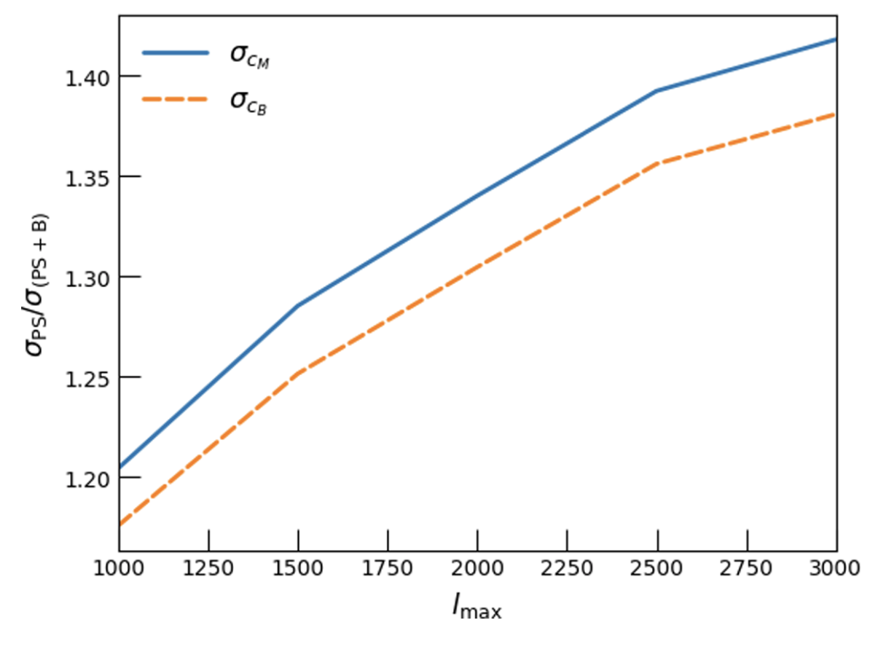
Cosmological Constraints from Bispectra Chen Heinrich and Olivier Doré
National Aeronautics and Space Administration
Jet Propulsion Laboratory
California Institute of Technology
Science Questions: How well does standard general relativity predict the observed structure of the universe? What new observations can test theories of alternate gravity?
Results: The analysis of galaxy clustering via gravitational lensing is extended from a traditional two-point statistic (power spectrum) to a three-point cross-correlation (bispectrum), focusing on simulated surveys by the upcoming Roman Space Telescope. This new methodology provides improved constraints on deviations from standard general relativity, with modified-gravity parameters measured at least 20% better or more if smaller spatial scales are included in the analysis.
Significance: Future surveys of large scale structure will improve our understanding of how the universe evolves. The new analysis techniques developed here will optimize the scientific yield from these surveys, improving their ability to detect deviations from general relativity.
Reproduced with permission from the Physical Reviews, © APS
Future surveys of the Universe’s large-scale structure will place limits on any deviations from standard gravitational theory. Cross-correlating different cosmology probes over various redshift bins with a three-point statistic (bispectrum) can improve the constraints on modified gravity parameters such as 𝛔_{CM} and 𝛔_{CB} by factors of 1.2 to 1.4, depending on the survey resolution.
Heinrich, C. and Dore, O. (2020) Physical Review D 102, 123549
https://doi.org/10.1103/PhysRevD.102.123549
This work was supported by JPL internal funds.
Notes:
1
You may add comments here to clarify the work or the results.

Slide 2
National Aeronautics and Space Administration
Jet Propulsion Laboratory
California Institute of Technology
Contact:
Dr. Chen Heinrich
CalTech Postdoctoral Fellow
169-237, Jet Propulsion Laboratory, Pasadena, CA 91109
Chen.H.Heinrich@jpl.nasa.gov
https://orcid.org/0000-0003-0426-1948
Citation:
“Cross-bispectra constraints on modified gravity theories from the Nancy Grace Roman Space Telescope
and the Rubin Observatory Legacy Survey of Space and Time”
Chen Heinrich and Olivier Doré (2020) Physical Review D 102, 123549
https://doi.org/10.1103/PhysRevD.102.123549
Data Sources:
Simulations from the Nancy Grace Roman Space Telescope
Technical Description of Figure:
Future surveys of the Universe’s large-scale structure will not only constrain basic cosmological parameters such as
𝛺_{m}, the total matter density, but will also quantify any deviations from non-standard gravity such as c_{M}, the running of the
Planck mass, and c_{B}, the braiding parameter. Extending the analysis of galaxy lensing from two-point (power spectrum)
to three-point (bispectrum) statistics improves the constraints on these two parameters. The improvement depends on l_{max},
the cutoff for spatial scales included in the analysis. A conservative cutoff improves the parameter constraints by a factor
of 1.2, while including smaller scales achieves factors up to 1.4.
Scientific significance, societal relevance, and relationships to future missions:
Future surveys of large scale structure (e.g. by the Roman Space Telescope) will improve our understanding of how
the universe evolves. The new analysis techniques developed here will optimize the scientific yield from these surveys, significantly improving their ability to detect non-standard gravitational effects.

