Slide 1
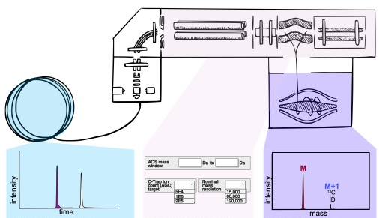
Methods and limitations of stable isotope measurements via direct
elution of chromatographic peaks using gas chromatography-
Orbitrap mass spectrometry Sarah S. Zeichner, Amy E. Hofmann, and Co-Authors
National Aeronautics and Space Administration
Jet Propulsion Laboratory
California Institute of Technology
Background: The Eiler group at Caltech is pioneering the use of Orbitrap mass spectrometry to determine the H, C, O, N, and S isotopic compositions of cosmochemically relevant organic and inorganic compounds. Several sample-introduction methods have been developed. We asked: can we make simultaneous singly, multiply, and/or site-substituted isotope ratio measurements on GC-separated analytes within a single acquisition?
Results: The method is appropriate for systems with large position-specific,
molecular, or multiply-substituted isotopic anomalies (e.g., isotopically labelled or extraterrestrial compounds), and for compounds that produce strong molecular ions.
Significance:
Orbitrap mass spectrometry is poised at the cutting edge of isotope geochemistry. Its ultra-high precision and accuracy far outweigh other mass spectrometric techniques for analyses of organic molecules, particularly cosmochemically relevant species.
This is the first publication containing pilot study data from A. Hofmann’s Emerging Worlds grant: clumped carbon-isotope measurements on PAHs from the Murchison meteorite.
This analytical method and data analysis software have since been used in comparable clumped-isotope analyses of other extraterrestrial PAHs.
Direct Injection & Elution + Optimization → Isotopologue Separation
The multiply-substituted and site-specific isotopic compositions of organic molecules with large isotopic anomalies (e.g., isotopically labeled or extraterrestrial organics) can be measured to high-precision via this method.
Zeichner, SS, Wilkes EB, Hofmann AE, Chimiak L, Sessions AL, Makarov A, & Eiler JM. (2022) Methods and limitations of stable isotope measurements via direct elution of chromatographic peaks using gas chromatography-Orbitrap mass spectrometry. International Journal of Mass Spectrometry 477: 116848; https://doi.org/10.1016/j.ijms.2022.116848
(Underlined names are of Caltech graduate student authors.)
This work was partially supported by an Emerging Worlds grant (18-EW18_2-0084) to A.E. Hofmann.
© 2022 California Institute of Technology. U.S. Government sponsorship acknowledged.

