Slide 1
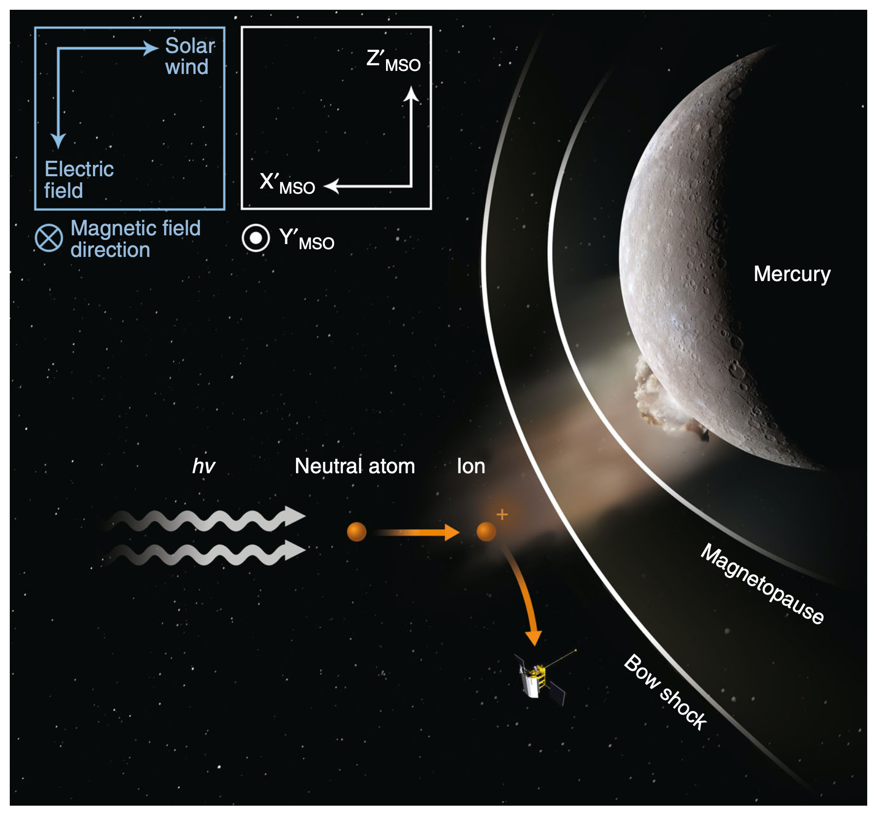
A Transient Event in Mercury’s Exosphere Jamie Jasinski et al.
National Aeronautics and Space Administration
Jet Propulsion Laboratory
California Institute of Technology
Science Questions: What is the origin of Mercury’s exosphere – a tenuous collision-less atmosphere that is closely bound to the planetary surface? Why does the exosphere fluctuate?
Data & Results: The Fast-Imaging Plasma Spectrograph (FIPS) on NASA’s MESSENGER spacecraft detected an enhanced density of recently ionized particles at high altitude (~5000 km) above Mercury. These particles were most likely created by a meteoroid impact on planet’s surface, which enhanced the exosphere.
Significance: Meteoroid impacts act as an important source of material for Mercury’s exosphere and contribute to its variability. Future observations with the Bepi-Colombo mission will further improve our understanding of these impacts and their role in creating Mercury’s exosphere.
Reproduced with permission from Nature Comm., © AAAS
A meteoroid impact on Mercury ejects a plume of neutral atoms into space. As solar photons (“h𝜈”) ionize these atoms from Mercury’s surface, they are picked up by the solar wind and gyrate around the interplanetary magnetic field where they are detected by NASA’s MESSENGER spacecraft.
Jasinski, Regoli, Cassidy, et al. (2020), Nature Comm. 11:4350
https://doi.org/10.1038/s41467-020-18220-2
This work was supported by NASA’s Postdoctoral Fellowship Program.
Notes:
You may add comments here to clarify the work or the results.

Slide 2
National Aeronautics and Space Administration
Jet Propulsion Laboratory
California Institute of Technology
Contact:
Jamie Jasinski
Research Scientist
169-506, Jet Propulsion Laboratory, Pasadena, CA 91109
jamie.m.jasinski@jpl.nasa.gov
https://orcid.org/0000-0001-9969-2884
Citation:
“A transient enhancement of Mercury’s exosphere at extremely high altitudes inferred from pickup ions”
Jasinski, J.M., Regoli, L.H., Cassidy, T.A., et al. (2020), Nature Communications 11:4350
https://doi.org/10.1038/s41467-020-18220-2
Data Sources:
Fast-Imaging Plasma Spectrometer (FIPS) onboard NASA’s MESSENGER spacecraft
Technical Description of Figure:
A meteoroid impact causes vaporization of surface particles on Mercury. This causes a plume of neutral atoms to be
ejected out to high altitudes in space. As solar photons (“h𝜈”) ionize these atoms, they are picked up by the solar wind.
These “pickup” ions are accelerated by the solar wind’s motional electric field and gyrate around the interplanetary magnetic field (i.e. outside Mercury’s magnetospheric boundary layers of the bow shock and magnetopause) where they are detected by the MESSENGER spacecraft. The FIPS instrument measures the detected ions’ velocity distribution as well as mass-per-charge.
The pickup ions were observed to be non-gyrotropic which shows that the particles were recently photoionized.
The composition was estimated to be Na⁺ and Si⁺ (Na⁺ is the most common constituent of Mercury’s exosphere).
The impact was most likely caused by a ~1m sized meteoroid. Large meteoroids such as this are expected
to originate from the main asteroid belt, ejected into the inner solar system by secular resonances.
The boxes at the top show the directions of the solar wind velocity and electric field, as well a description of the
Mercury-Solar-Orbital (MSO) coordinate system.
Scientific significance, societal relevance, and relationships to future missions:
Meteoroid impacts are an important source of material for Mercury’s exosphere. However, large impacts are
expected to contribute more to its variability. Future observations with the Bepi-Colombo mission will further improve
our understanding of these impacts and their role in creating Mercury’s tenuous atmosphere.

