Slide 1
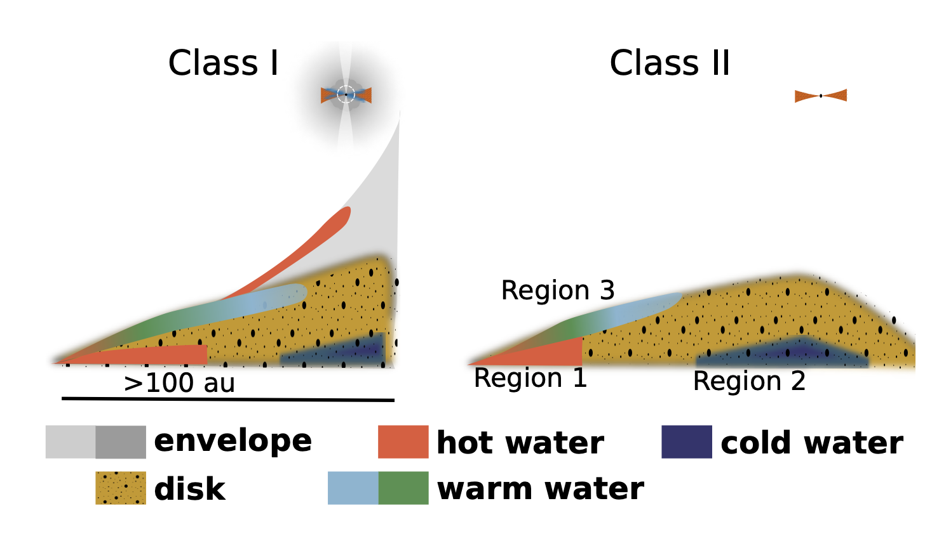
Water in Star-Forming Regions Ewine van Dishoeck et al.
National Aeronautics and Space Administration
Jet Propulsion Laboratory
California Institute of Technology
Science Question: How is water transported from interstellar clouds to forming planetary systems?
Data & Results: Herschel Space Observatory far-infrared spectra are used to trace cold gaseous water across multiple stages of star formation – from molecular clouds to young protoplanetary disks. Weaker water vapor emission than expected is observed in disks, suggesting that water is mostly locked up in pebbles that settle to the disk mid-plane and drift inward.
Significance: Water is a unique diagnostic of the physical and chemical conditions in star-forming regions. When a cloud collapses to form new stars and planets, water is largely preserved and quickly sequestered in pebble-sized dust particles. Enough water to fill several thousand oceans can be supplied through this process to the regions where planets form.
Reproduced with permission from AA, © ESO
Planet-forming disks exhibit a wide range of physical and chemical conditions, depending on the location (inner vs outer disk; surface vs midplane) and evolutionary state (Class I vs Class II). Far-infrared spectra from the Herschel Space Observatory measure the quantity of gaseous water over these different environments.
van Dishoeck et al. (2021), AA 648, A24
https://doi.org/10.1051/0004-6361/202039084
This work was supported by a Strategic RTD Initiative from the Planetary Science Directorate at JPL.
Observations from Herschel Space Observatory, an ESA mission with NASA contributions, are acknowledged.
Notes:
1
You may add comments here to clarify the work or the results.

Slide 2
National Aeronautics and Space Administration
Jet Propulsion Laboratory
California Institute of Technology
Contact:
Dr. Dariusz Lis
Scientist
169-327, Jet Propulsion Laboratory, Pasadena, CA 91109
Dariusz.C.Lis@jpl.nasa.gov
https://orcid.org/0000-0002-0500-4700
Citation:
“Water in star-forming regions: physics and chemistry from clouds to disks as probed by Herschel spectroscopy”
van Dishoeck, E.F., Kristensen, L.E., Mottram, J.C., et al. (2021), AA 648, A24
https://doi.org/10.1051/0004-6361/202039084
Press Coverage:
https://www.herschel.caltech.edu/news/nhsc2021-001
Data Sources:
Herschel Space Observatory, an ESA mission with NASA contributions.
Technical Description of Figure:
Planet-forming disks exhibit a wide range of physical and chemical conditions, depending on the location (inner vs outer disk; surface vs midplane) and evolutionary state (a Class I source with an infalling envelope vs a more isolated Class II source).
Herschel far-infrared spectra measure the quantity, temperature, and density of gaseous water over these different environments.
Scientific significance, societal relevance, and relationships to future missions:
Water is a unique diagnostic for the physical and chemical conditions in star-forming regions, enabling a comprehensive comparison over a range of evolutionary states. Most water flows into protoplanetary disks as ice, with many oceans of water likely to be present in the regions where planets form.
Herschel has done trailblazing work aimed at understanding the trail of water during the process of star formation. This pioneering work will continue using future space facilities – James Webb Space Telescope (JWST), SPHEREx, and possibly the proposed Origins Space Telescope – to fully understand the development of conditions of habitability in forming planetary systems.

