Slide 1
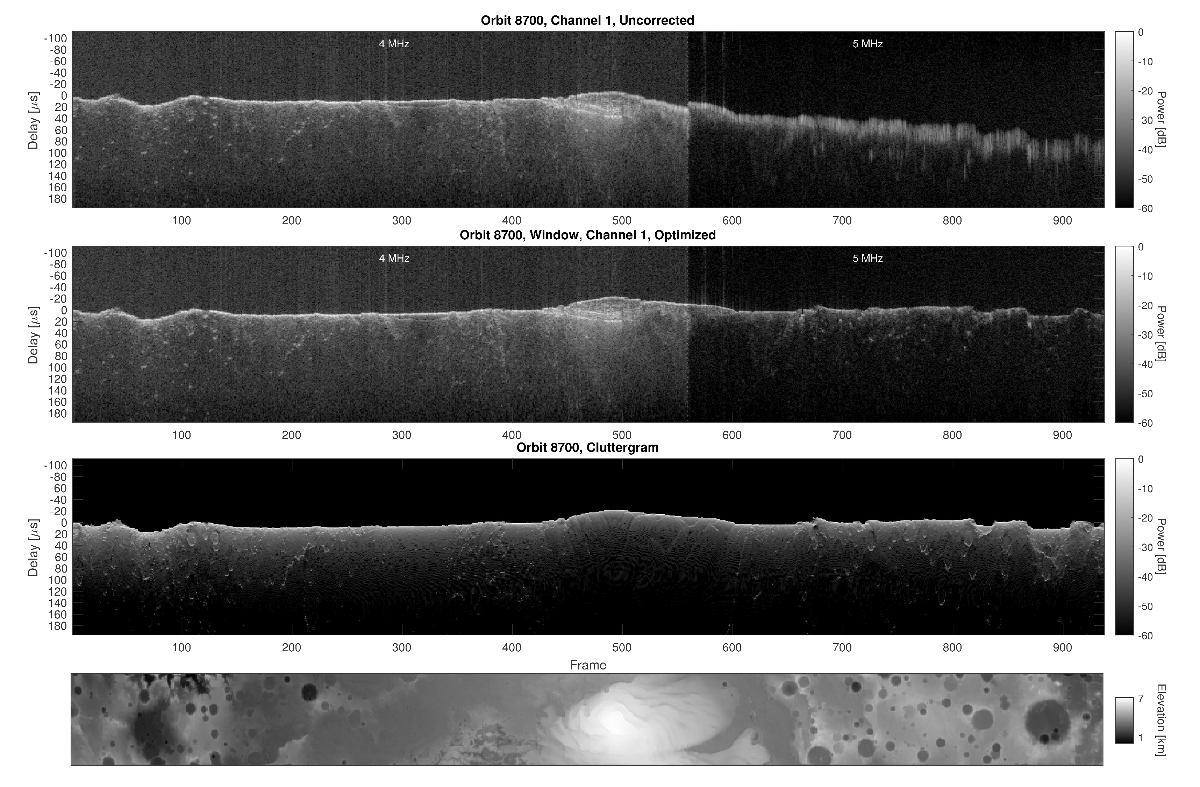
MARSIS Subsurface Radar Sounding Data:
High-Level Optimized Archive now on the PDS
The entire 17-year data set from the Mars Express MARSIS Radar Sounder has been reprocessed to correct for geometric distortions caused by the ionosphere. For all MARSIS radargram images, the corrected data along with simulated cluttergrams and MOLA ground track maps are provided.
Radargram processed with no ionospheric correction.
Optimized radargram. Note the sharpness of the image on the right side.
Simulated cluttergram portrays the effect of surface topography.
MOLA topo map of ground track, in the south polar region.
Depth to the top of the water ice table derived from Mars Reconnaissance Orbiter Mars Climate Sounder data.
Background is a topographic shaded relief. Low thermal inertia regions unsuitable for landing are masked out.
Plaut, J.J., 2023. Optimized MARSIS Radargram Data (U.S.) PDS Archive User’s Guide. NASA Planetary Data System Geosciences Node. Draft doi: 10.17189/wrxv-m053

