Slide 1
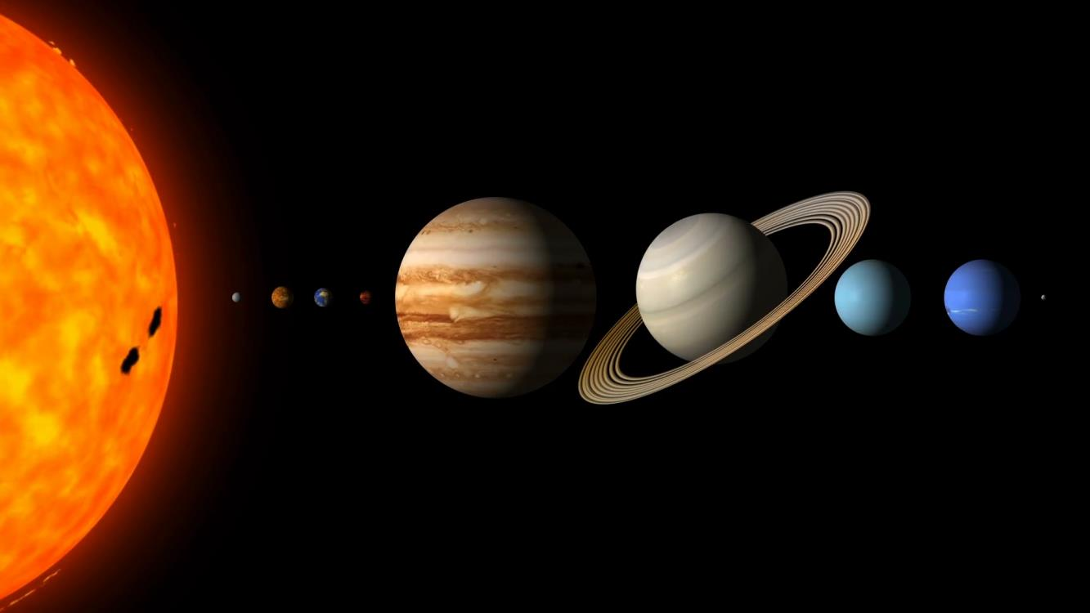
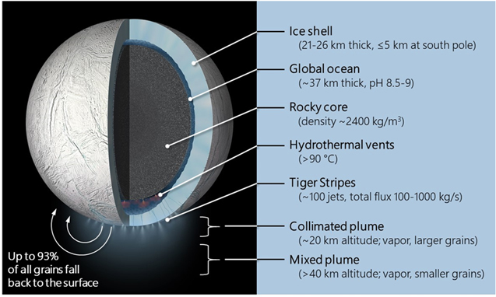
The Science Case for a Return to Enceladus Morgan L. Cable and Co-Authors
Background: The plume of Enceladus is unique in the solar system in providing direct access to fresh material from an extraterrestrial subsurface ocean. Meeting the criteria of "extended regions of liquid water, conditions favorable for the assembly of complex organic molecules, and energy source(s) to sustain metabolism," the ocean of Enceladus can therefore be considered habitable. It is also the only confirmed place beyond the Earth where we can easily sample fresh material from a demonstrably habitable environment without the complications of digging or drilling. The next step is to investigate whether Enceladus' ocean is actually inhabited.
Significance: This paper initially started out as a white paper for the Planetary Science and Astrobiology Decadal Survey. It was significantly expanded in depth and scope to be suitable for publication in the PSJ special issue Ocean Worlds: Motivations for a Multi-Decadal Exploration Program.
Discoveries of the Cassini Mission reveal Enceladus to have a global subsurface ocean that contains organic molecules and hosts hydrothermal activity at the underlying sea floor that sustains redox disequilibria. Material from the ocean is expressed into space via the plume, emanating from about 100 jets in the Tiger Stripes of the South Polar Terrain.
Cable M. L., C. Porco, C. R. Glein, C. R. German, S. M. MacKenzie, M. Neveu, T. M. Hoehler, A. E. Hofmann, A. R. Hendrix, J. Eigenbrode et al. (2021) The Science Case for a Return To Enceladus. The Planetary Science Journal, 2, 132.
https://iopscience.iop.org/article/10.3847/PSJ/abfb7a
© 2021 California Institute of Technology. Government sponsorship acknowledged.
Notes:
You may add comments here to clarify the work or the results.

