Slide 1
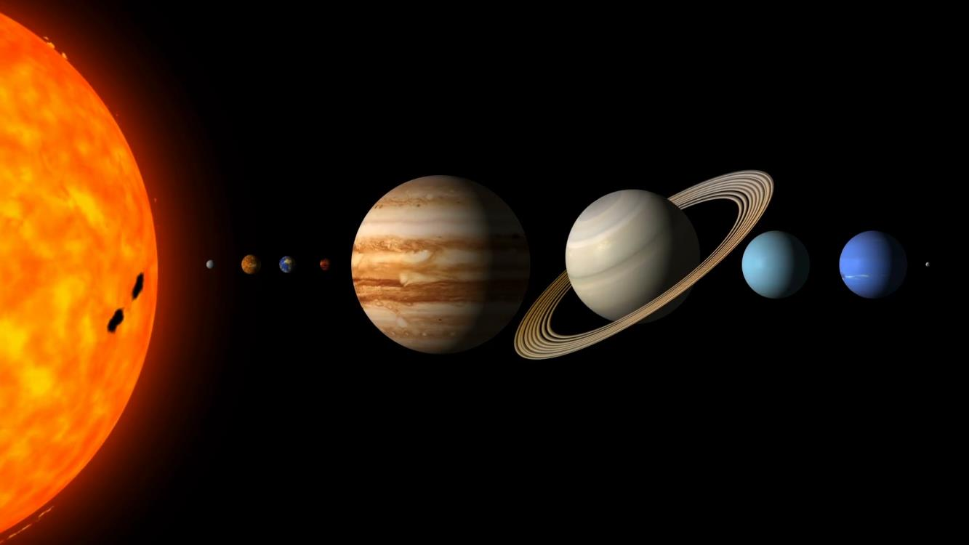
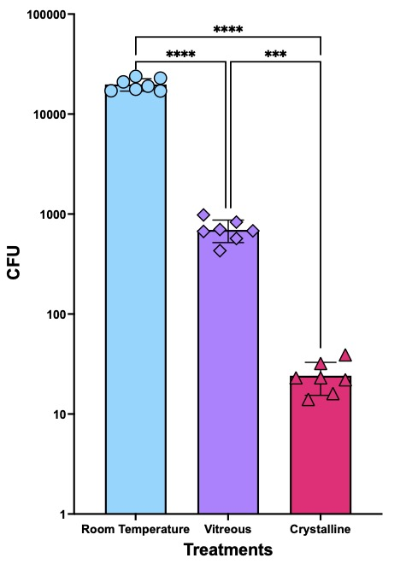
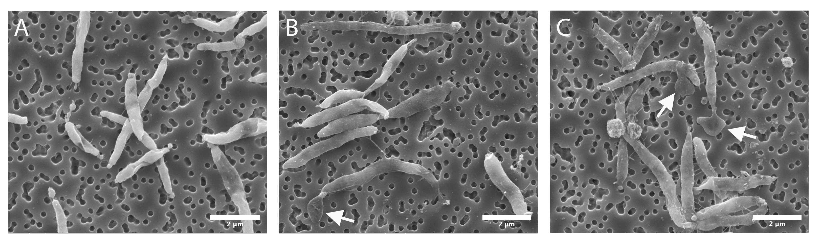
Viability of Microbes in Vitreous Salt Hydrates on Ocean Worlds
Paul Johnson
Background: Recent work has shown that vitreous salt hydrates (non-crystalline solids produced by rapid cooling of brines) form readily and are kinetically stable under conditions relevant to ocean worlds, suggesting that they are likely to be present on the surface of Europa and within Enceladus plume particles.
Data & Results: The bacterium Pseudoalteromonas haloplanktis is found to demonstrate enhanced viability after freezing to 100 K in brines containing vitreous MgSO₄ hydrate compared to fully crystalline samples. This might be due at least in part to being entrained in vitreous pockets, thus avoiding physical damage caused by crystallization.
Significance: Together, this suggests that vitreous salt hydrates may represent habitable environments at the (sub-)surface of icy ocean worlds.
SEM images after samples were frozen and then thawed. (A)-room temp control: the cells are bright and ‘inflated’ with prominent curvature, indicating that the majority of these cells retained intact cellular membranes. (B) Vitreous treatment includes intact bright/ ‘inflated’ cells mixed with grey flattened/ ‘deflated’ cells; evidence of cytoplasmic release (white arrow). (C) Crystalline treatement nearly all cells appear deflated with numerous examples of cytoplasmic release (white arrows) indicating widespread cell lysing.
The figure shows the results of CFU screening of three samples in 0.1M MgSO4: room temperature control, vitreous treatment, and a crystalline treatment. After recovery of the thawed samples, cultivation and CFU screening showed significantly more viable organisms in the vitreous samples over the crystalline samples.
Citation Ceth W. Parker et al 2023 Planet. Sci. J. 4 178 DOI 10.3847/PSJ/aceefa
This work was supported by an award to Paul Johnson under the JPL R&TD program.
© 2023 California Institute of Technology. Government sponsorship acknowledged.
Notes:
1
You may add comments here to clarify the work or the results.

