Slide 1
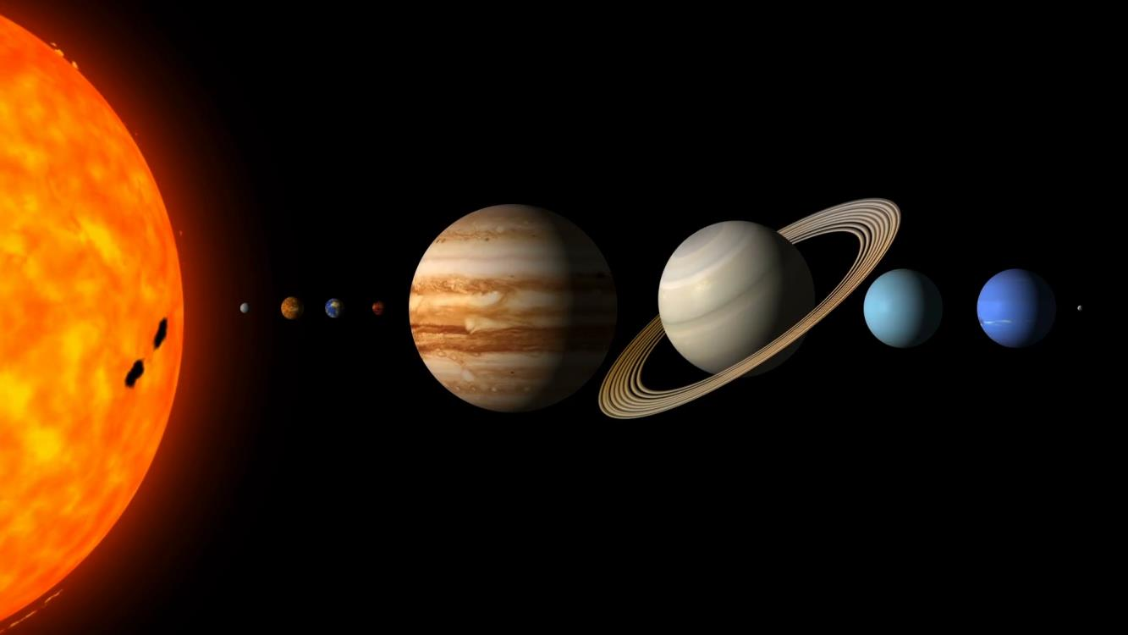
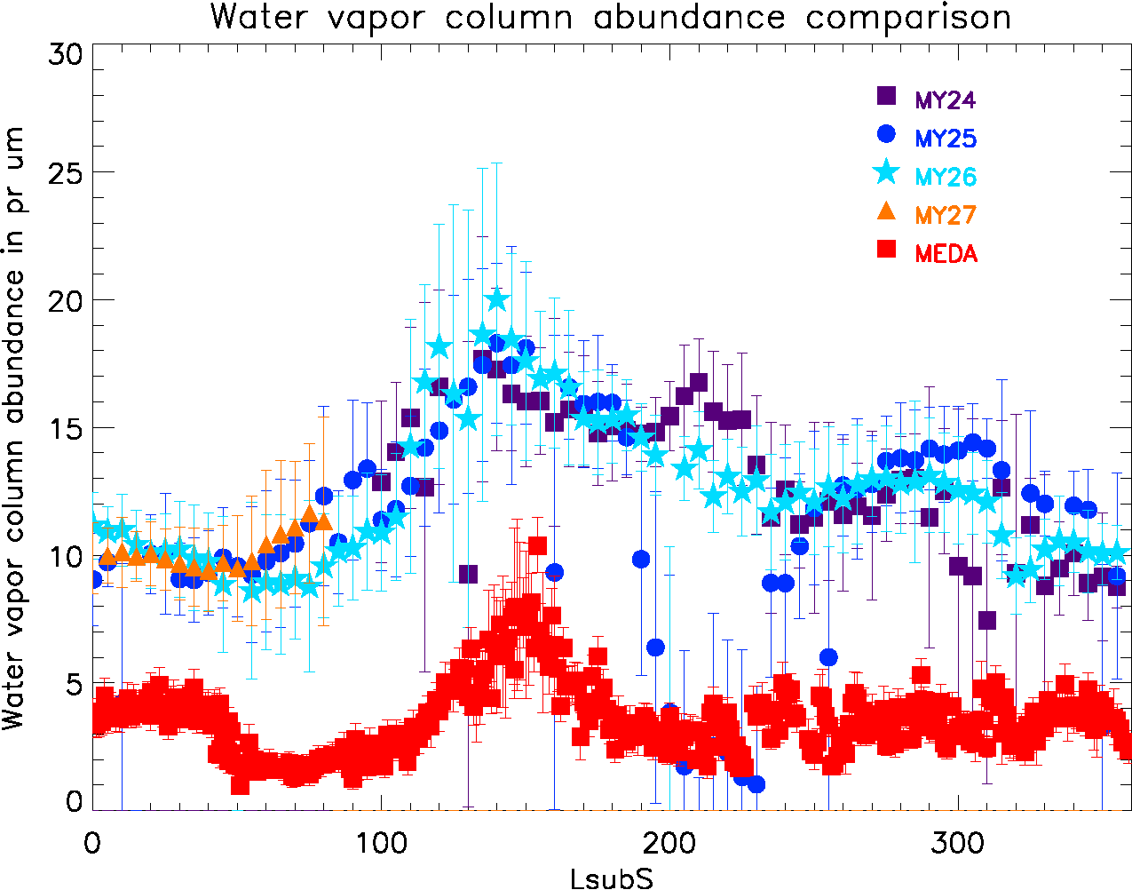
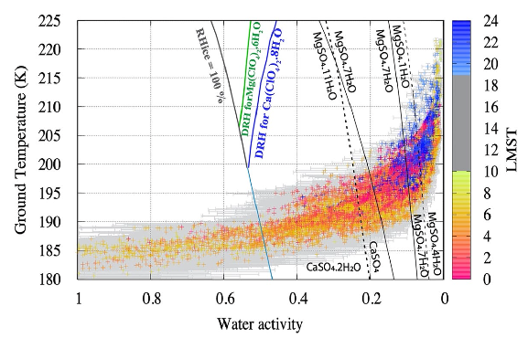
Thermal and water activity for Perseverance’s first depot of samples
Leslie Tamppari
Comparison of daytime water vapor column abundances (upper lines) to nighttime vapor abundances (red). The difference shows the upper limit (~10g/m²) of diurnal uptake of water to surface.
Colored points indicate measured water activity, which does not allow formation of brines in present day, but does allow for frost formation and hydration/dehydration of suggested salts.
Background: Understanding the habitability of Mars today is of high interest. Water activity above 0.5 along with temperature above 245K are thought to be required for cell replication. The water activity for the samples that have been deposited at Three Forks have been determined.
Data & Results: Perseverance weather station (MEDA) data and Mars Global Surveyor Thermal Emission Spectrometer data were used. The findings include that 0.5-10g/m2 water could be exchanged with the surface diurnally, that brine formation is not likely, but frost and salt hydration/dehydration could occur, and that temperature and humidity environment at Jezero crater today is incompatible with the currently understood requirements for cell replication.
Significance: It is unlikely that there is currently thriving microorganisms in the samples that are waiting on Mars at the Three Forks location for return to Earth.
Paper by M.-P. Zorzano et al., 2024: https://doi.org/10.1038/s41598-024-57458-4
This work was supported by Perseverance MEDA funding (M. Thornblom and G. Tahu, HQ program executives)
© 2024 California Institute of Technology. Government sponsorship acknowledged.
Notes:
1
You may add comments here to clarify the work or the results.

