Slide 1
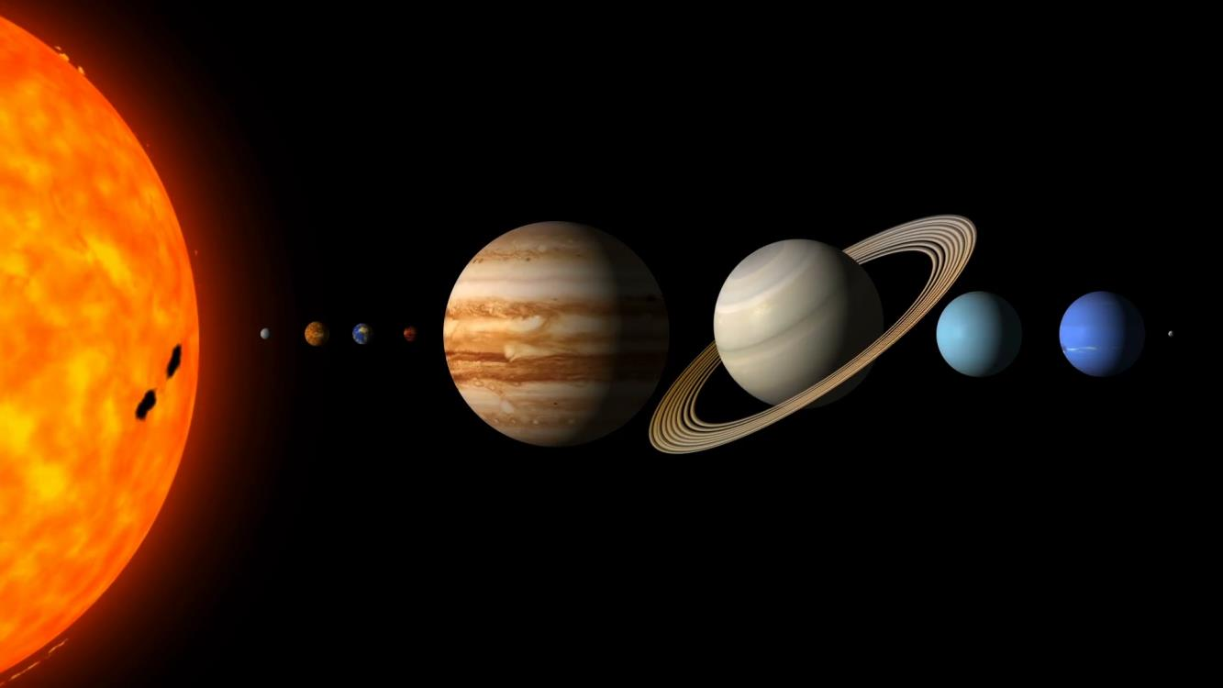
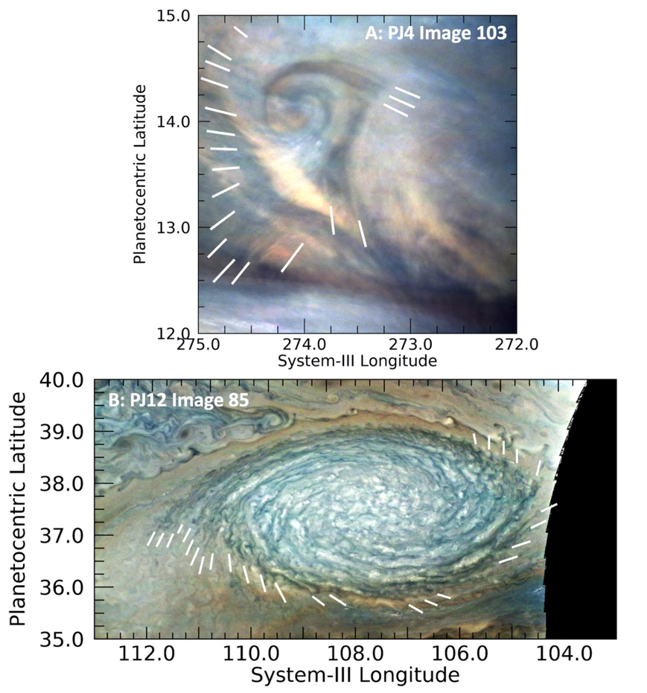
A JunoCam Survey of Small-Scale Waves on Jupiter
Glenn Orton
Partially differentiated interior
Background: During the first 20 orbits of the Juno mission, over 150 waves and wave-like features have been detected by the JunoCam instrument.
Data & Results:. A wide variety of wave morphologies were detected over a wide latitude range, but the overwhelming majority were found near Jupiter’s equator.
Significance: JunoCam has detected waves as small as 30 km, shorter than ever measured before. The lack of motion associated with waves at the equator suggests that they are like ripples in a pond but in a rotating fluid, a phenomenon known as inertia-gravity waves.
Wave-like features detected near vortices. Top panel shows a very compact cyclonic feature with a set of extended radial wavefronts in the North Equatorial Belt (NEB). Bottom panel shows a regular set of dark lines emerging from the ends of the internal spiral structures in an anticyclonic white oval.
Orton, G. S., Tabataba-Vakili, F., Eichstadt, G., Rogers, J., Hansen, C., Momary, T.W., et al. (2020), A Survey of Small-Scale Waves and Wave-Like Phenomena in Jupiter’s Atmosphere Detected by JunoCam, J. Geophys. Res., in press, doi:10.1029/2019JE006369.
This work was funded by NASA through the Juno Project (HQ manager: K.C. Hansen)
© 2020 California Institute of Technology. Government sponsorship acknowledged.
Notes:
1
You may add comments here to clarify the work or the results.

