Slide 1
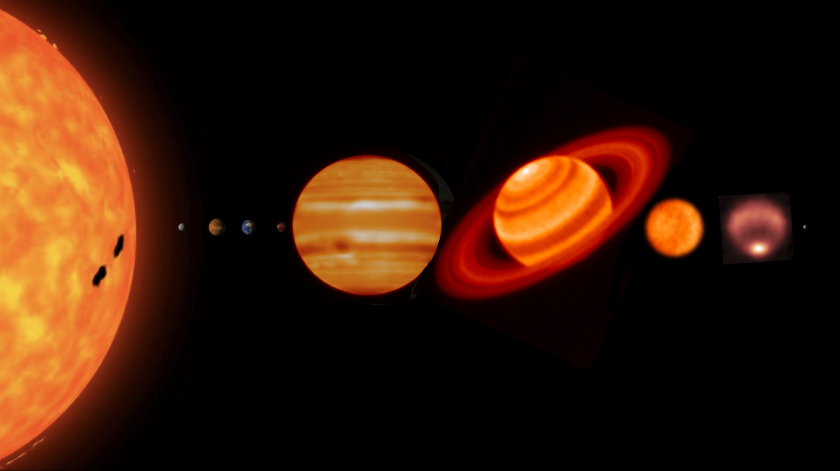
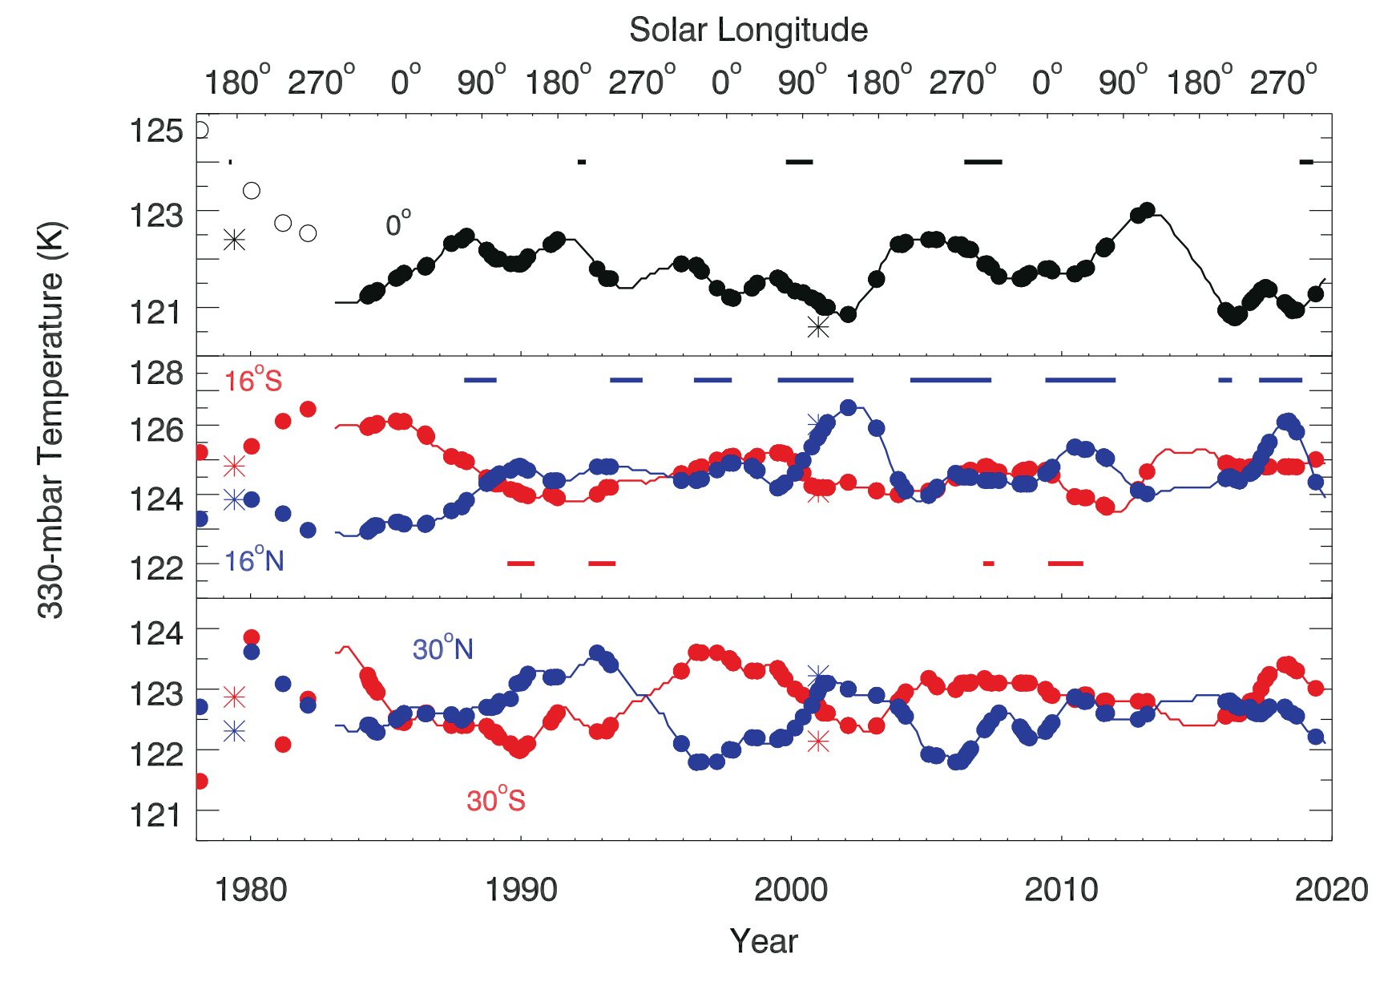
Unexpected Long-Term Variability in Jupiter’s Tropospheric Temperatures
Glenn Orton
Background: Temperature and its variability constitute an essential element of the climatology of a planetary atmosphere, inextricably linked to dynamics and chemistry. Previous studies of Jupiter have hinted at periodic non-seasonal behavior, but they spanned timeframes much shorter than Jupiter’s orbit, or were too sparsely sampled.
Data & Results: Infrared observations of Jupiter obtained over 40 years - several Jupiter orbits - with the NASA/IRTF, Subaru Telescope, and Very Large Telescope, show long-term variations of upper-tropospheric temperatures with different periodicities. Anticorrelations of variability in opposite hemispheres were striking at 16º, 22º and 30º from the equator. Equatorial temperature variations are also anticorrelated with those 60-70 km above.
Significance: The data suggest that stratospheric dynamics higher up have a direct bearing on equatorial tropospheric temperatures. In general, the long-term variations of temperature can be disconnected from any seasonal changes in solar heating. Future global climate models must address the origins of these variations in order for them to be extended to a wider array of gas-giant exoplanets.
Variability of zonal-mean temperatures at 330 mbar in the northern and southern hemispheres. A: Equator, B: 16° from the Equator. C: 30°S from the Equator.
Orton, G.S., Antuñano, A., Fletcher, L.N. et al. Unexpected long-term variability in Jupiter’s tropospheric temperatures. Nat Astron (2022). https://doi.org/10.1038/s41550-022-01839-0
This work was supported by an award to the Jet Propulsion Laboratory under the NASA SSO program (Dr. David Smith)
© 2022 California Institute of Technology. Government sponsorship acknowledged.
Notes:
1
You may add comments here to clarify the work or the results.

