Slide 1

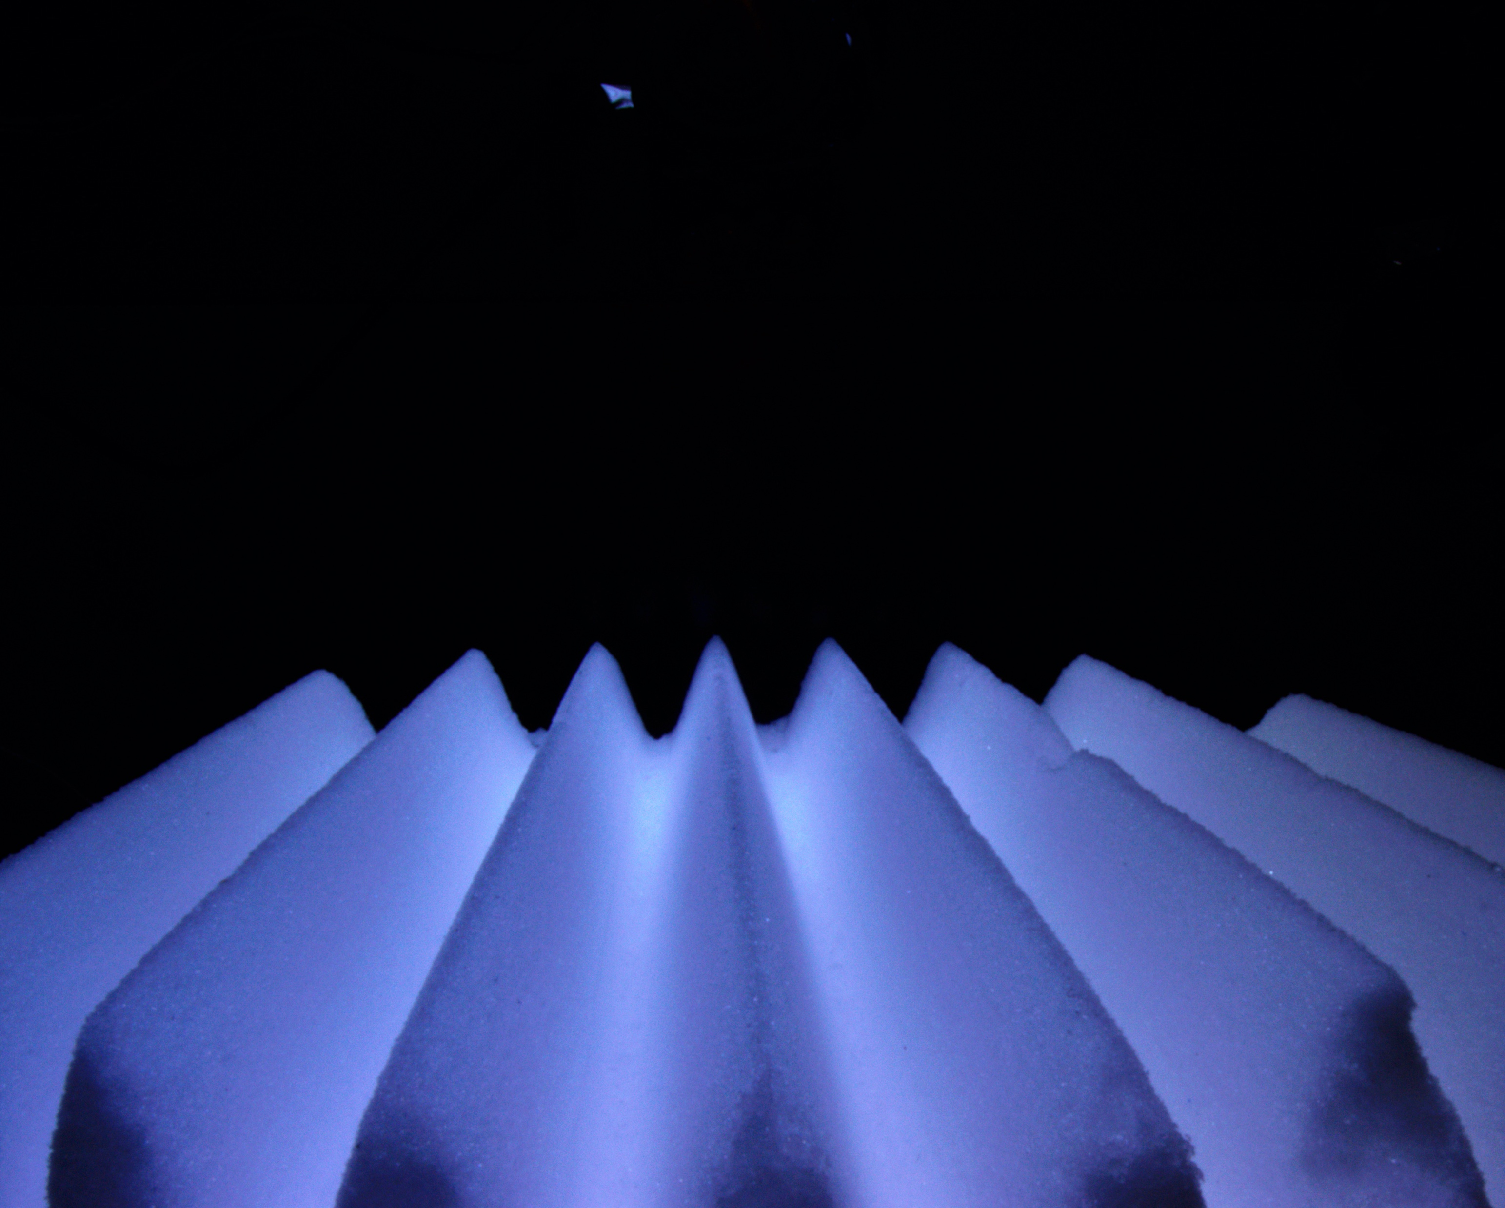
Penitente Erosion on Ocean Worlds
Jeffrey T Foster
The submeter-scale surface morphology of ice-covered worlds is poorly constrained by observations, but is important for understanding their physics and chemistry.
Data & Results: 2-D sinusoidal penitente-like ridges, 2.5 cm tall with 1.25 cm spacing. Over 1 month at 165–175 K, and 10−4 Pa, the ridges decreased in height by 20% and became more triangular and less sinusoidal, evolving toward a more flat surface.
Significance: These experiments suggest that penitentes are unlikely to be stable on airless worlds with free-molecular flow conditions, which is significant for understanding the spectral and thermal properties of these worlds, and for understanding risks for future landed spacecraft.
Laboratory produced H2O snow molded into an artificial penitente field inside “Ark” environmental chamber under ocean world surface conditions.
Berisford, D. F., Foster, J. T., Kosberg, J. A., Furst, B. I., Poston, M. J., Daimaru, T., et al. (2021). Erosion of penitentes under experimental conditions relevant to ice-covered airless worlds. Journal
of Geophysical Research: Planets, 126, e2021JE006955. https://doi. org/10.1029/2021JE006955
This research was carried out at the
Jet Propulsion Laboratory, California Institute of Technology, under a contract with the National Aeronautics and Space Administration (80NM0018D0004).
© 2021 California Institute of Technology. Government sponsorship acknowledged.
Notes:
1
You may add comments here to clarify the work or the results.

