Slide 1
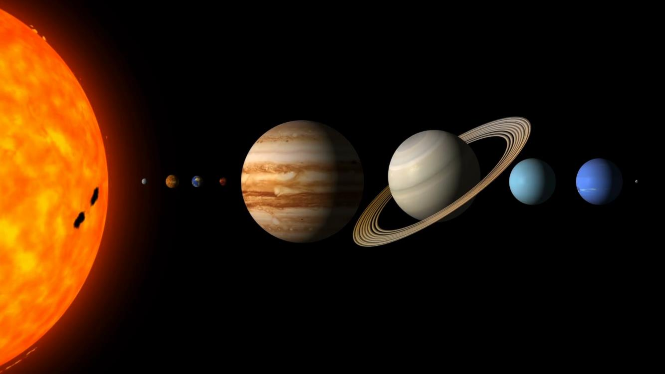
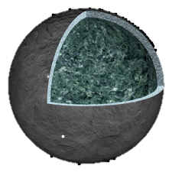
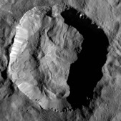

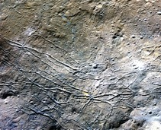
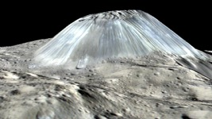
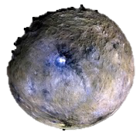

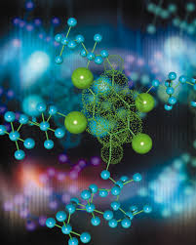
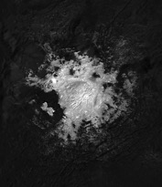
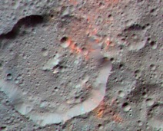
Ceres as an Astrobiological Target
Julie Castillo-Rogez
Glacier
Background, Science question, hypothesis and why it is important. Dwarf planet Ceres is the most water rich body in the inner solar system after Earth. When the Dawn mission was selected in 2001, Ceres was believed to be a cold an unevolved relic of the early solar system. A few years before Dawn’s arrival at Ceres, models showed that the dwarf planet likely followed an evolutionary path similar to large icy moons and could preserve a deep ocean until present.
Data & Results: This paper synthesizes the analyses of the extensive dataset returned by the Dawn mission at Ceres to unveil an object of astrobiological significance and a potential ocean world that could host conditions favorable to prebiotic chemistry.
Significance: These results expand the realm of candidate ocean worlds to ~1000km-sized bodies with limited heat budget, such as other dwarf planets and some icy moons. This work highlights the role of salts in preserving liquid environments in these objects, in which rich organic chemistry could develop.
One Graphic
explaining finding, two if absolutely necessary
Partially differentiated interior
5 km
Salts associated with fractures
Water
Volcanic dome
5 km
10 km
Volcanic dome
Organics in Ernutet crater
CHNOPS
Energy
20 km
10 km
Observations returned by NASA’s Dawn mission confirm that dwarf planet Ceres presents all of the features found at astrobiological targets: differentiated interior, abundant salts ice, and organic matter, and recent volcanic activity.
Castillo-Rogez, J. C., Neveu, M., Scully, J. E.C., House, C. H., Quick, L. C., Bouquet, A., Miller, K., Bland, M., De Sanctis, M. C., Ermakov, A., Hendrix, A. R., Prettyman, T. H., Raymond, C. A., Russell, C. T., Sherwood, B. E., Young, E., Ceres: Astrobiological Target and Possible Ocean World, Astrobiology. Feb 2020. 269-291. http://doi.org/10.1089/ast.2018.1999
This work was supported by the Dawn Project (HQ manager: Anthony Carro)
© 2020 California Institute of Technology. Government sponsorship acknowledged.
Notes:
1
You may add comments here to clarify the work or the results.

