Slide 1
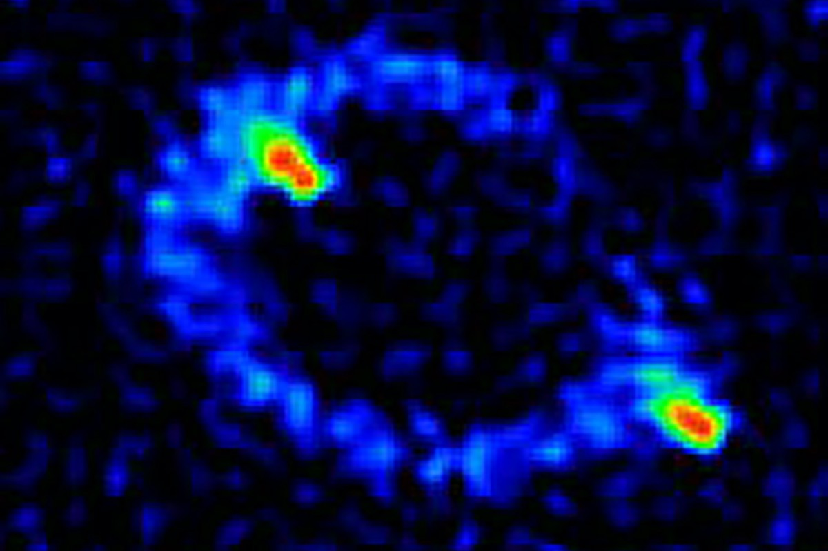
A Redshift for the First Einstein Ring Daniel Stern & Dominic Walton
National Aeronautics and Space Administration
Jet Propulsion Laboratory
California Institute of Technology
MG 1131+0456, a bright radio source, was resolved into a ring (with two hotspots) in 1988 – the first reported Einstein Ring. Such rings are extreme, rare cases of gravitational lensing, predicted by Einstein in 1936.
Science Question: What are the properties of the lensed system?
Data & Results: Archival Keck spectra dating back to the late-1990s were re-analyzed and produced – for the first time – a redshift for MG 1131+0456 (z = 1.849, >10 billion lightyears away). New Chandra observations show the X-ray luminosity to be anomalously high for its WISE mid-infrared luminosity.
Significance: Surprisingly, MG 1131+0456 never previously had a redshift measurement, despite many attempts. The redshift enables study of both the background galaxy and the foreground lens. In addition, a new method is proposed for identifying lensed quasars based on their X-ray-to-mid-infrared ratio.
After Hewitt et al. (1988)
Radio image of MG 1131+0456, the first observed Einstein Ring, taken with the Very Large Array (VLA). Two hotspots are observed just interior/exterior to the ring, as expected from gravitational lensing of a slightly offset source. More than 30 years after its discovery, the distance to MG 1131+0456 is finally now determined, using decades-old data retrieved from the NASA-funded Keck Observatory Archive (KOA).
Stern, D. & Walton, D.J. (2020) ApJL 895, L38
https://doi.org/10.3847/2041-8213/ab922c
This work was supported by an STFC Ernest Rutherford Fellowship.
Use of data from the Chandra X-Ray Observatory and the W. M. Keck Observatory is acknowledged.
Notes:
1
You may add comments here to clarify the work or the results.

Slide 2
National Aeronautics and Space Administration
Jet Propulsion Laboratory
California Institute of Technology
Contact:
Daniel Stern
Senior Research Scientist; Project Scientist for NuSTAR
264-723, Jet Propulsion Laboratory, Pasadena, CA 91109
Daniel.K.Stern@jpl.nasa.gov
https://orcid.org/0000-0003-2686-9241
Citation:
“A Redshift for the First Einstein Ring, MG 1131+0456”
Stern, D. & Walton, D.J. (2020) ApJL 895, L38
https://doi.org/10.3847/2041-8213/ab922c
Data Sources:
Archival (1997) optical and near-IR spectroscopy from the W. M. Keck Observatory
Chandra X-Ray Observatory
Wide-field Infrared Survey Explorer (WISE)
Very Large Array (VLA) radio image
Technical Description of Figure:
Radio image of MG 1131+0456 at frequency 15 GHz, observed by the Very Large Array, an array of radio telescopes outside Socorro, New Mexico [from Hewitt, J.N., et al. (1988) Nature 333, 537].
MG 1131+0456 is found to have a redshift z = 1.849, corresponding to a lookback time of more than 10 billion years.
Scientific significance, societal relevance, and relationships to future missions:
More than 30 years after its discovery as the first Einstein ring, MG 1131+0456 finally has a measured redshift. This measurement not only gives the distance and luminosity of the background galaxy, but also provides new constraints on the properties of the foreground lens galaxy. Noting that the Chandra X-ray emission is anomalously high for this lensed system, a new method is proposed for identifying new lensed galaxies based on their unresolved X-ray emission.
Press coverage:
https://arstechnica.com/science/2020/06/astronomers-have-finally-measured-the-distance-of-first-observed-einstein-ring/
https://scitechdaily.com/einstein-ring-astronomers-just-found-cosmic-golden-needle-that-was-buried-for-two-decades/

