Slide 1
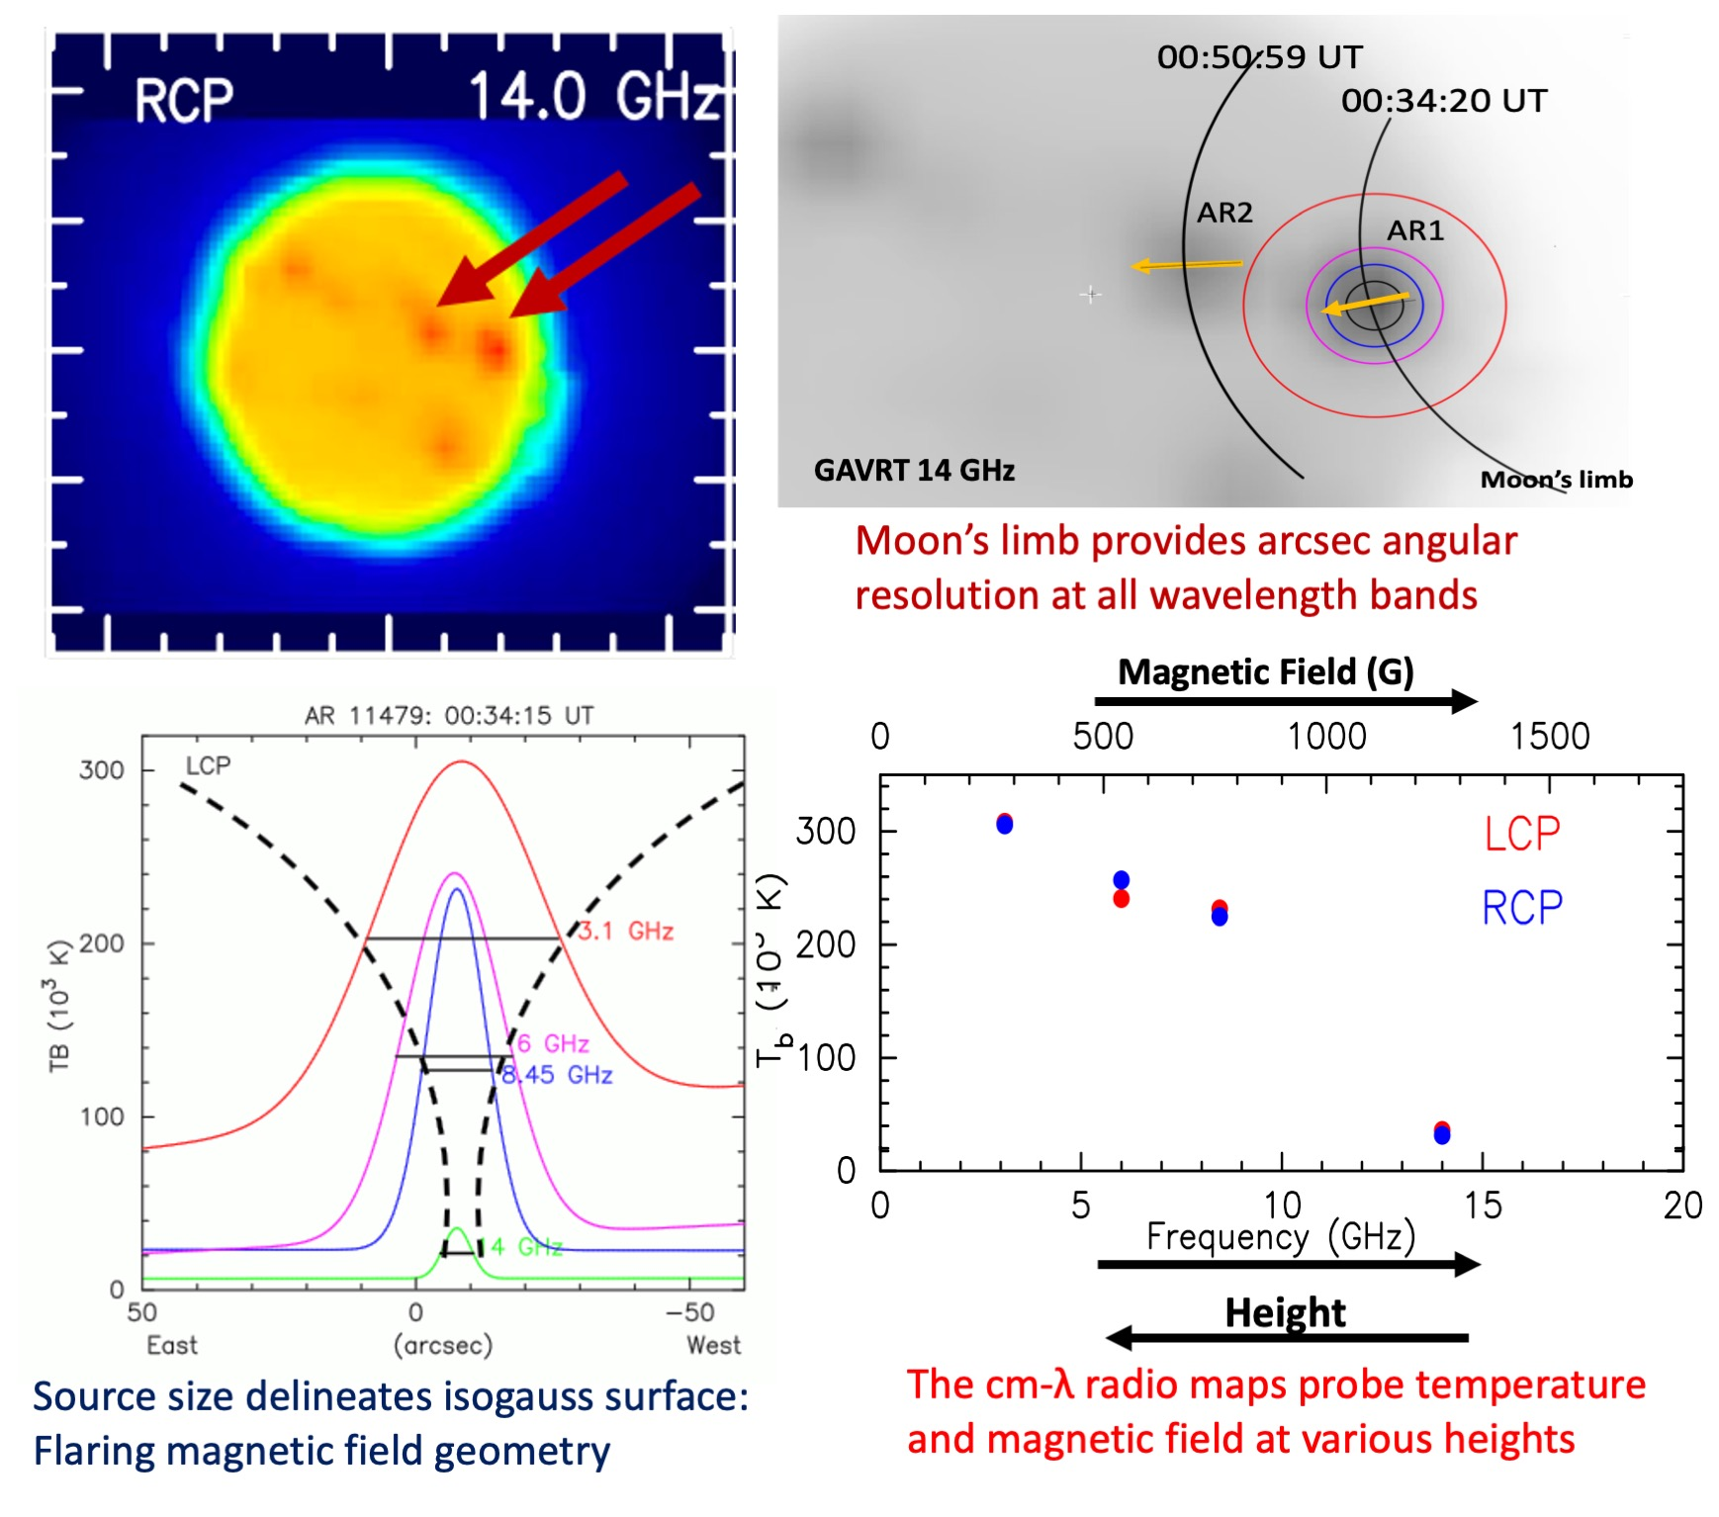
Radio Observations of 2012’s Solar Eclipse Velusamy, Kuiper, Levin, et al.
National Aeronautics and Space Administration
Jet Propulsion Laboratory
California Institute of Technology
Science Question: How do storms on the Sun’s turbulent surface transport energy to the surrounding solar corona? Can radio observations of the corona probe the local temperature and magnetic field?
Data & Results: The corona above known sunspot regions was scanned at radio (cm) wavelengths during the 2012 solar eclipse. As the lunar limb moves across the solar surface, sunspots are gradually concealed, enabling a 100-fold improvement over the nominal telescope resolution. Fits to the emission as a function of wavelength provide constraints on the temperature and magnetic field above each sunspot region.
Significance: The primary aim of this observing program was K-12 science education, successfully achieved while obtaining high-quality solar radio observations. The analysis demonstrated GAVRT’s ability to probe layers of the solar corona above active sunspot regions.
Reproduced with permission from PASP, © IOP
Sunspots identified by their pre-eclipse radio emission (top left) were observed by GAVRT,
the Goldstone Apple Valley Radio Telescope, at 2 to 10 cm wavelengths during eclipse (top right). Derived brightness scans probe the coronal magnetic field distribution in layers above the sunspot (lower panels).
Velusamy, Kuiper, Levin, et al. (2020), PASP 132, 094201
https://doi.org/10.1088/1538-3873/aba10b
This work was supported by NASA’s Deep Space Network.
Notes:
1
You may add comments here to clarify the work or the results.

Slide 2
National Aeronautics and Space Administration
Jet Propulsion Laboratory
California Institute of Technology
Contact:
Thangasamy Velusamy
Principal Research Scientist
169-506, Jet Propulsion Laboratory, Pasadena, CA 91109
Thangasamy.Velusamy@jpl.nasa.gov
Citation:
“Goldstone Apple Valley Radio Telescope Observations of 2012 Solar Eclipse:
A Multi-wavelength Study of cm-lambda Gyroresonance Emission from Active Regions”
Velusamy, T., Kuiper, T.B.H., Levin, S.M., et al. (2020), PASP 132, 094201
https://doi.org/10.1088/1538-3873/aba10b
Data Sources:
Goldstone Apple Valley Radio Telescope (GAVRT)
Technical Description of Figure:
Sunspots identified in the pre-eclipse radio emission (upper left) were observed by the Goldstone Apple Valley
Radio Telescope (GAVRT) at 2 to 10 cm wavelengths during the 2012 eclipse of the Sun (upper right).
Derived brightness scans probe the coronal magnetic field distribution in layers above the sunspot (lower panels,
where LCP refers to left-hand circularly polarized emission and RCP is right-hand polarized). The large beam sizes
of the radio telescope (~arcminute; shown as a function of wavelength as the concentric circles in the top right panel) are greatly improved by eclipse data where the Moon’s edge scans across the Sun’s surface, providing arcsecond resolution at all wavelengths. Interpretations of coronal temperatures and magnetic fields from cm-wavelength radio maps are made under the framework of gyroresonance emission from above the sunspot region.
Scientific significance, societal relevance, and relationships to future missions:
Use of the Moon’s limb to gradually eclipse Solar sunspot regions enables observations with 100 times finer detail than the telescope’s nominal resolution; without the eclipse, it would not be possible to resolve the Sun’s active regions.
While this project was initiated as part of a science education program, it also demonstrated the ability of GAVRT to probe layers of the solar corona above active sunspot regions. In the near term GAVRT will launch a related Solar Patrol Program, potentially supporting ground-based solar radio astronomy for Parker Solar Probe (PSP).

