Slide 1
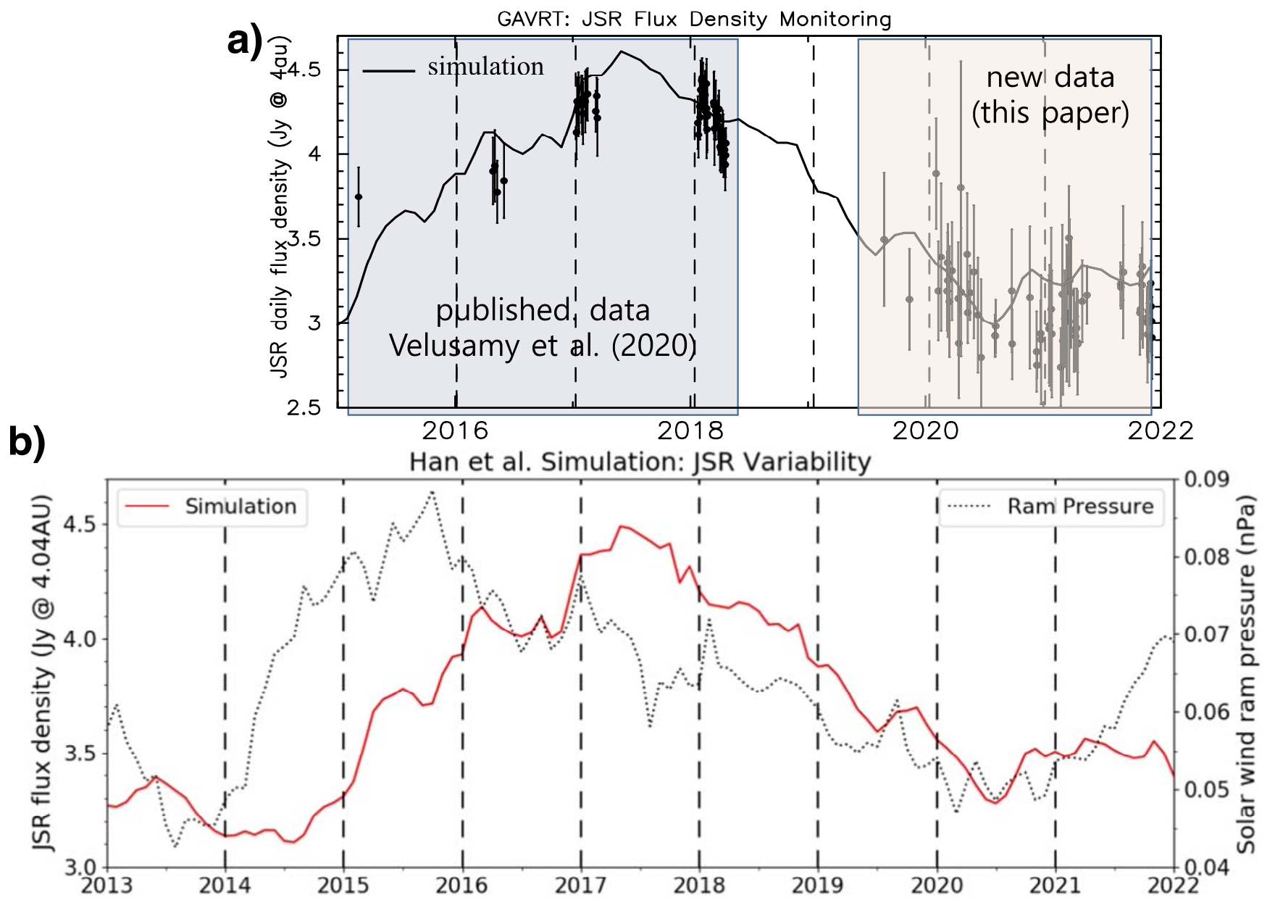
Solar Wind Driven Changes in Jupiter’s Emission Matuszewska, Velusamy, Adumitroaie, et al.
National Aeronautics and Space Administration
Jet Propulsion Laboratory
California Institute of Technology
Science Question: How does the solar wind interact with Jupiter’s magnetosphere and radio emission from its radiation belts?
Data & Results: The Goldstone-Apple Valley Radio Telescope (GAVRT) was used to observe Jupiter’s synchrotron radiation from 2019 to 2021 as part of its K-12 program. Combination with earlier data reveals a new trend in the synchrotron flux variability – increasing from 2015 to 2018, then decreasing until 2021.
Significance: The observed changes in Jupiter’s synchrotron flux provide strong support for models of variability that is driven by ram pressure from the solar wind. Note that this publication was led by a GAVRT high school student.
Reproduced with permission from IOP, ©PASP
Emission from Jupiter’s radiation belts is monitored from 2015 to 2022 (points in the upper panel). The variations in flux are a remarkably close match to a simulation of the emission (red line) as driven by ram pressure from the solar wind (dotted line).
Matuszewska, Velusamy, Adumitroaie, et al. (2022), PASP 134, 084401
https://doi.org/10.1088/1538-3873/ac6a7a
Data collection was supported by high school teachers and students as part of the NASA-JPL Jupiter Patrol program.
Notes:
1
You may add comments here to clarify the work or the results.

Slide 2
National Aeronautics and Space Administration
Jet Propulsion Laboratory
California Institute of Technology
Contact:
Dr. Thangasamy Velusamy
Principal Research Scientist
169-506, Jet Propulsion Laboratory, Pasadena, CA 91109
Thangasamy.Velusamy@jpl.nasa.gov
Citation:
“Variability of Jupiter’s Synchrotron Radiation: Goldstone Apple Valley Radio Telescope (GAVRT) Observations II”
Matuszewska, K., Velusamy, T., Adumitroaie, V., Arballo, J., et al. (2022), PASP 134, 084401
https://doi.org/10.1088/1538-3873/ac6a7a
Data Sources:
Goldstone Apple Valley Radio Telescope (GAVRT)
Technical Description of Figure:
Synchrotron emission from electrons trapped in Jupiter’s radiation belts was observed by the GAVRT radio telescope at
13 cm wavelength from 2019 to 2022 (upper panel; points on the right side) and compared with data from 2015 to 2018 (left side).
Significant variability (>1 Jy) is readily apparent. The changes in flux are a remarkably close match to a simulation of the emission
(red line in the lower panel and black line in the upper panel) as driven by ram pressure from the solar wind (dotted line).
Scientific significance, societal relevance, and relationships to future missions:
The observed changes in Jupiter’s synchrotron flux provide strong support for models of variability that is
driven by ram pressure from the solar wind.
This science result involved direct contributions from high school students and teachers as part of GAVRT’s
NASA-JPL Jupiter Patrol program.

