Slide 1
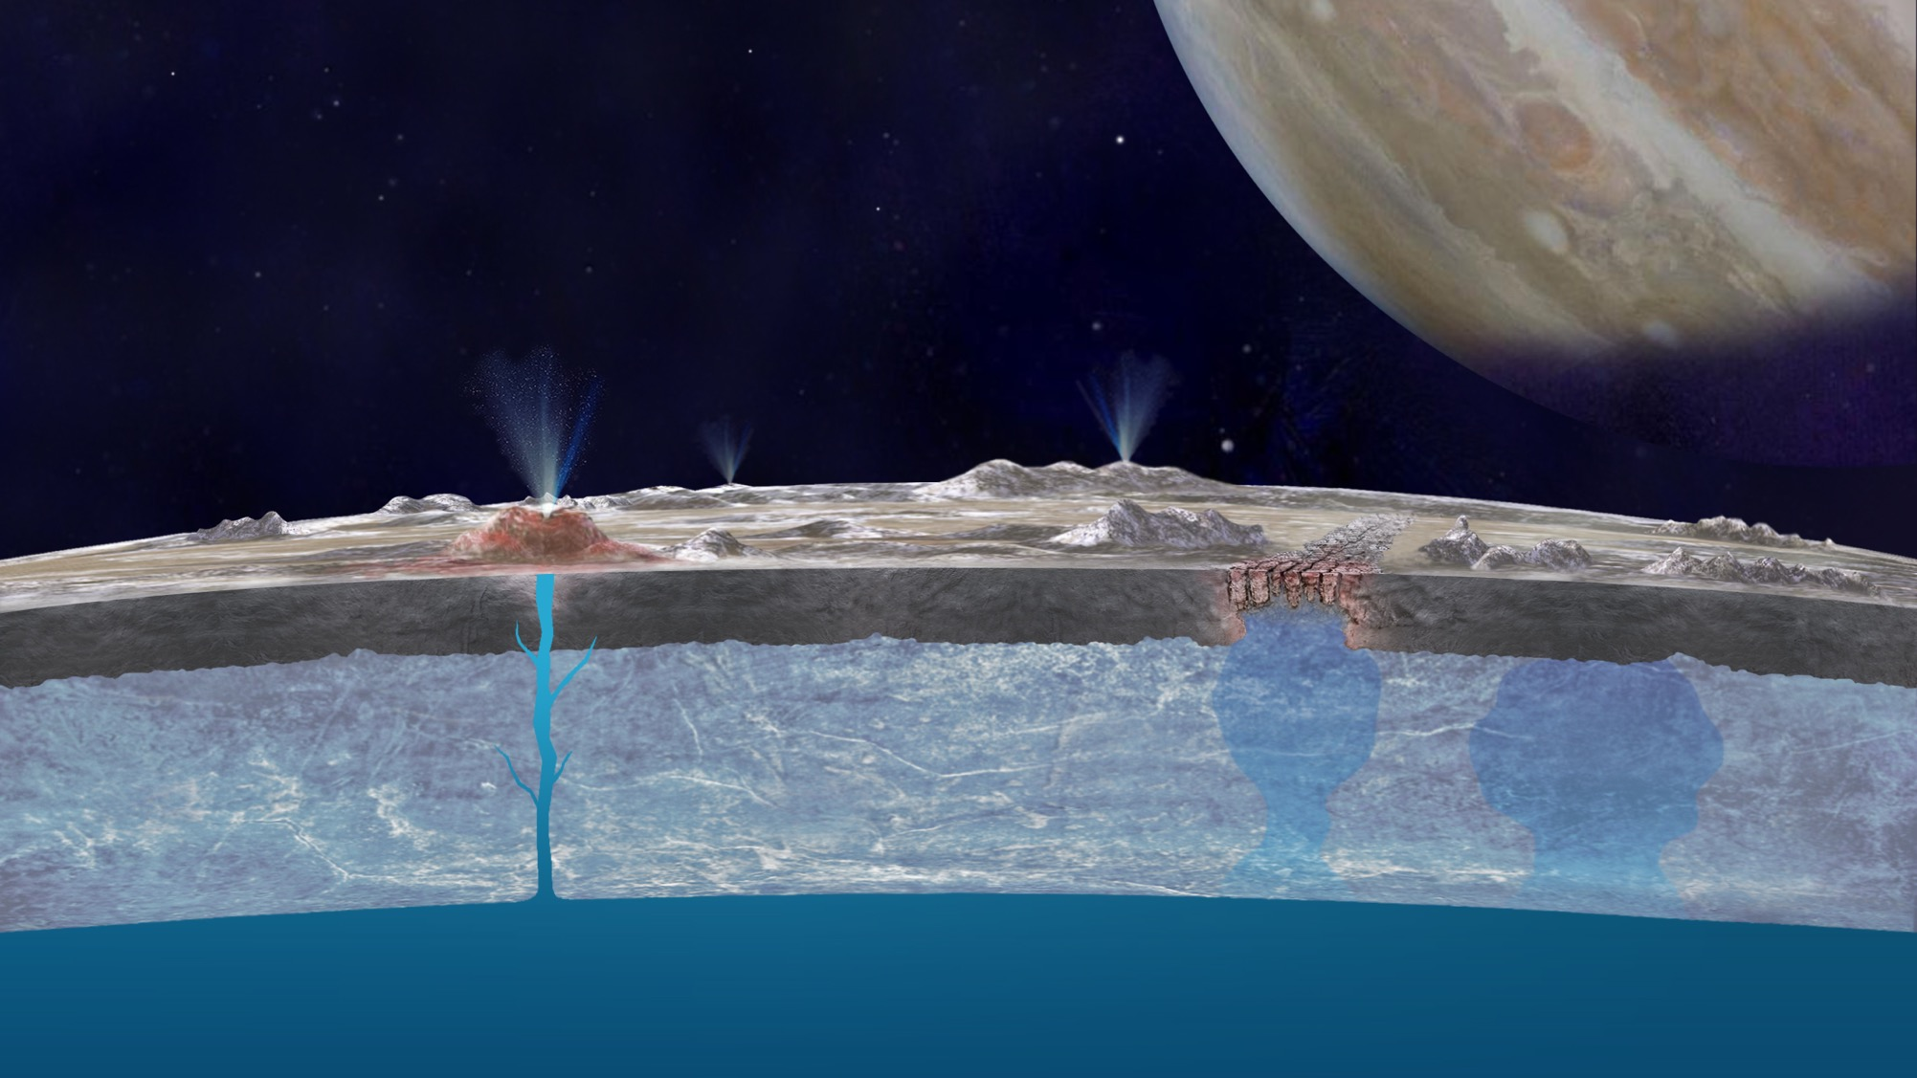
Probing Europa’s Ocean Composition from Surface Salt Minerals Tuan Vu et al. (3227)
National Aeronautics and Space Administration
Jet Propulsion Laboratory
California Institute of Technology
Background: This work investigates the feasibility and precision with which the chemical composition of Europa’s subsurface ocean can be inferred from its surface expression via in-situ techniques. The salt minerals that form upon freezing of a simple brine system containing Na, Mg, SO₄, Cl have been quantitatively identified by Raman and X-ray diffraction as a function of cooling rate and ionic concentration.
Data & Results: The composition of the original solution can be retrieved from surface mineral abundances with a precision on the order of a few tens of percent. Glassy Mg-bearing materials and multiple hydrated salts not predicted by chemical models are also frequently encountered, confounding detection and quantification.
Significance: These findings inform analytical protocols for a Raman spectrometer onboard a future Europa lander. Surface materials should be first investigated in their native state (under cold conditions), then again after annealing. Raman quantification of salt mineral abundances will require calibration and/or complementarity from other techniques. In addition, terrains such as diapirs where brines are more likely to freeze close to equilibrium should be considered for exploration in order to gather the most meaningful constraints on their composition and emplacement mechanism.
Roadmap for analysis and qualitative interpretation of Raman data of recently exposed areas on Europa’s surface in terms of hydrated mineral compositions and likely emplacement mechanisms. A dual set of analyses (at 100 K, then after annealing) is required to determine the geologic context of emplacement and constrain the ionic composition of source brines.
Vu, T. H.; Choukroun, M.; Hodyss, R.; and Johnson, P .V. “Probing Europa’s Subsurface Ocean Composition from Surface Salt Minerals Using In-situ Techniques.” Icarus 2020, 349, 113746, doi:10.1016/j.icarus.2020.113746.
This work was supported by awards from the NASA Astrobiology Institute (Icy Worlds, HQ manager: Penelope Boston) and the JPL R&TD program. © 2020 California Institute of Technology. Government sponsorship acknowledged.
Notes:
1
You may add comments here to clarify the work or the results.

