Slide 1
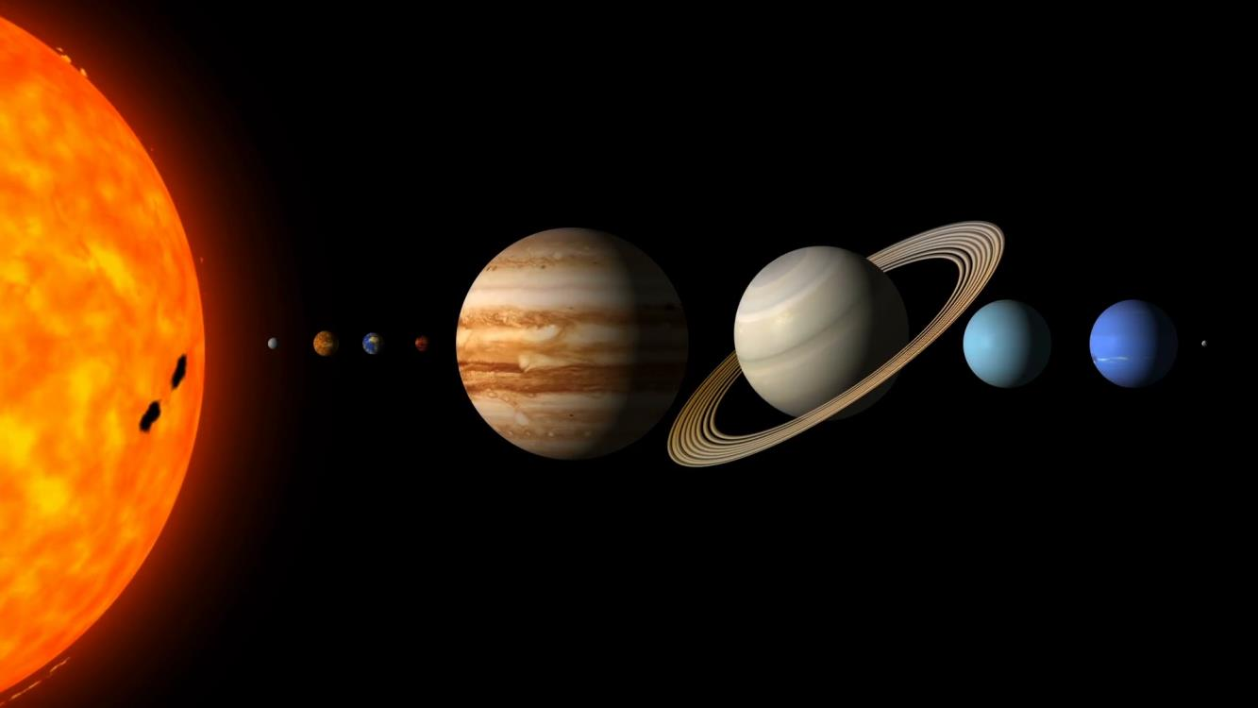
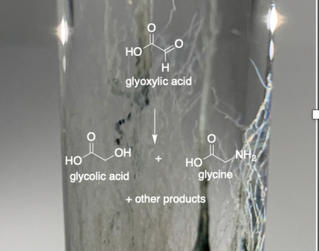
Prebiotic Chemistry in Chemical Gardens
Jessica Weber & Laurie Barge, 3227
Background: Chemical gardens (CG’s) are self-assembling inorganic mineral structures that form at the interface of two fluids; this kind of precipitate may have existed on early Earth and other worlds. CG’s form in gradients and thus exhibit reactive compositions and varied chemical environments in the surfaces / pores, previous work has shown that CG’s are capable of catalyzing various prebiotic reactions. Here we tested whether proto-metabolic organic chemical reactions, previously known to occur in iron mineral systems, can also be driven by chemical gardens formed from iron and silicate.
Data & Results: We tested the reactivity of two metabolically important precursors (pyruvic and glyoxylic acid) and ammonia with iron-silicate CG’s. Only glyoxylic acid was significantly reactive, forming the corresponding hydroxy acid and amino acid. Importantly, we found that the observed organic reactions can be attributed to the silicate in solution, not the iron-containing precipitate (which was the main reactant for other chemistries).
Significance: Chemical gardens have previously been shown to drive important prebiotic chemical reactions including synthesis of nucleobases¹. Being able to also conduct proto-metabolic reactions in the same system means that these important types of prebiotic chemistry could co-occur in the same geological setting. It is interesting that the silicate (rather than iron) was the inorganic reactant driving the proto-metabolic reaction; this might mean that different prebiotic reactions would occur in different locations within the chemical gradients.
Glyoxylic acid reacts in iron-silicate chemical garden experiments to form the hydroxy acid (glycolate) and amino acid (glycine). The silicate, not the iron, was the inorganic component responsible for organic reactivity. This demonstrates that metabolically relevant reactions can occur in chemical gardens in a prebiotic context. Future work will further investigate how silica affects organic reactivity.
Weber J.M. and Barge L.M. (2021) Iron-Silicate Chemical Garden Morphology and Reactivity with Alpha-Keto Acids. ChemSystemsChem, 3, 3, e2000058. https://doi.org/10.1002/syst.202000058.
© 2022 California Institute of Technology. Government sponsorship acknowledged.
¹Bizzarri et al. 2018, Chem. Eur. J., 24, 8126 – 8132
Notes:
1
You may add comments here to clarify the work or the results.

