Slide 1
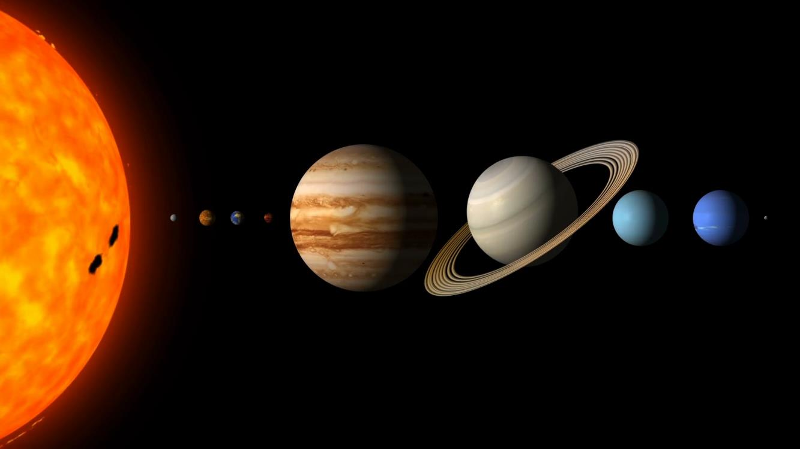
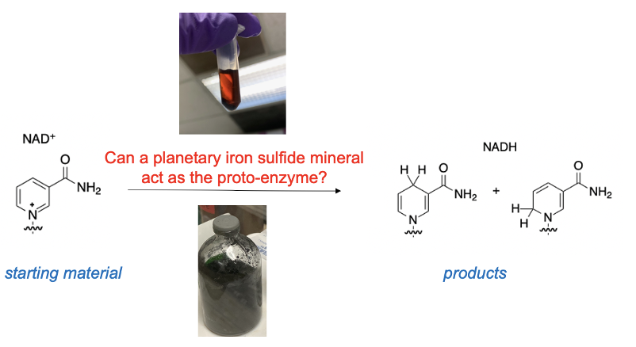
Mineral-Driven Reaction of Metabolic Cofactors Jessica M Weber
Background: The origin of metabolism is not well understood but the first proto-metabolic reactions took place in a geological environment. It has been proposed that minerals could have served as the first “enzymes” before the evolution of proteins; and maybe this is why enzymes today contain FeS clusters. Here, we explored whether NAD⁺ → NADH (a ubiquitous reaction driven by an enzyme in biology) could have been originally mediated by simple iron minerals under early Earth conditions.
Data & Results: We were able to react the cofactor, NAD⁺, with FeS minerals under early Earth conditions to produce a redox reaction (to NADH). The reaction did not occur without mineral present; therefore, the mineral was acting as the “proto redox enzyme”.
Significance: Since this important metabolic reaction could be mediated by minerals as opposed to enzymes, this is a complex organic reaction that might be possible in planetary environments. This not only addresses possible processes for the origins of life on Earth but also for other worlds that may have mineral/organic interactions.
Figure showing general reaction scheme of reducing cofactor NAD⁺ with images of mineral reaction and reaction sample.
Weber, J. M., Henderson, B. L.; LaRowe, D. E., Goldman, A. G., Perl, S. M., Billings, K., Barge, L. M.* "Iron-sulfur minerals drive NAD⁺ reduction under prebiotic Earth conditions.” Astrobiology 2022, 22, 25-34.
This work was supported by an award to Dr. Laurie Barge under the NASA/NSF Ideas Lab for the Origins of Life, ‘‘Becoming Biotic: Recapitulating Ancient Cofactor-Mediated Metabolic Pathways on the Early Earth.’’
© 2022 California Institute of Technology. Government sponsorship acknowledged.
Notes:
You may add comments here to clarify the work or the results.

