Slide 1
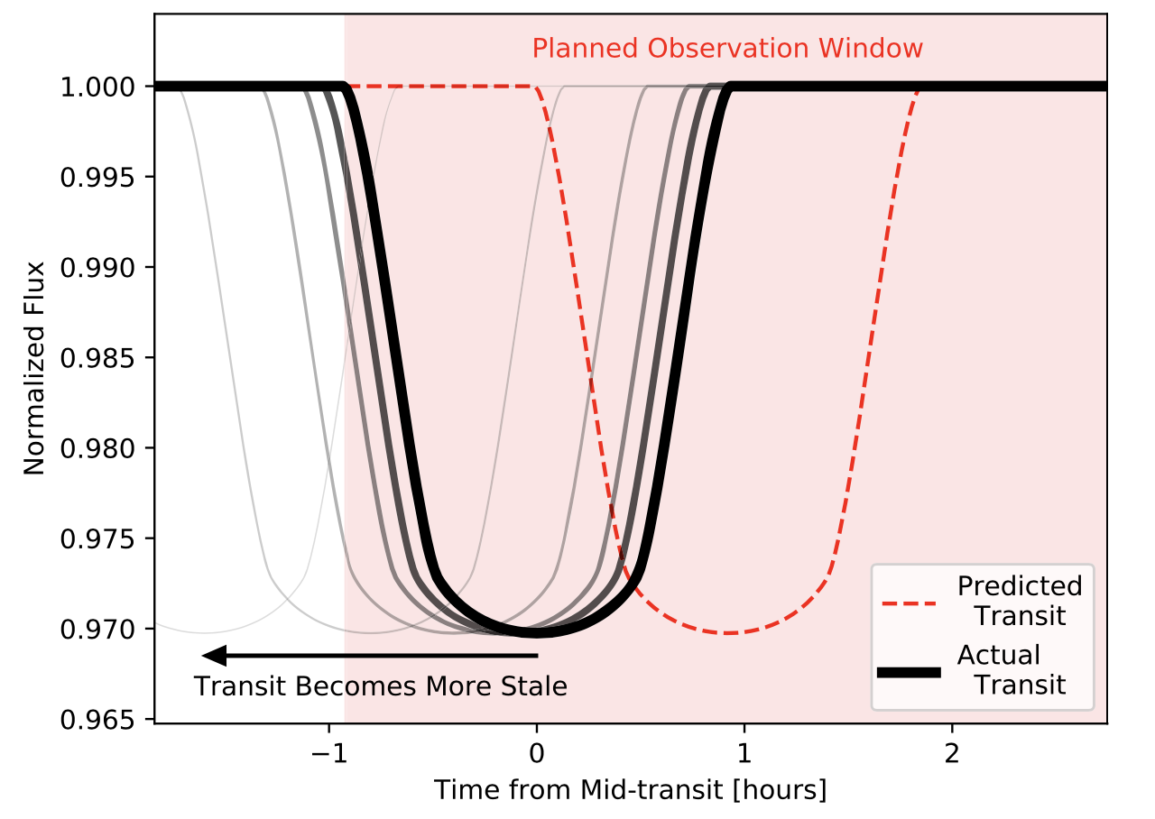
Citizen Science with Transiting Exoplanets Robert Zellem et al.
National Aeronautics and Space Administration
Jet Propulsion Laboratory
California Institute of Technology
Science Question: What types of atmospheres do exoplanets have? How can we observe them most efficiently?
Data & Results: Many transiting exoplanets could have their atmospheres characterized by upcoming space-based telescopes, but only if the times of their future transits are known. Small ground-based telescopes – even those operated by amateurs – are able to efficiently pin down the transit times of many potential targets.
Significance: Observing time on space-based telescopes – in particular the future flagship mission, JWST – will be at a premium. By pinning down transit times beforehand, a community-wide effort by citizen scientists can greatly enhance the science return of these missions.
Reproduced with permission from PASP, © IOP
Thousands of exoplanets have been detected as they transit across the face of their parent stars, but the timing of future transits becomes increasingly uncertain. Follow-up observations to characterize the planets’ atmospheres may miss the transit entirely.
Zellem, Pearson, Blaser, et al. (2020), PASP 132:054401
https://doi.org/10.1088/1538-3873/ab7ee7
This work was supported by JPL internal funding.
Use of data from NASA’s Exoplanet Archive is acknowledged.
Notes:
1
You may add comments here to clarify the work or the results.

Slide 2
National Aeronautics and Space Administration
Jet Propulsion Laboratory
California Institute of Technology
Contact:
Robert Zellem
Research Scientist and Technologist
169-237, Jet Propulsion Laboratory, Pasadena, CA 91109
Robert.T.Zellem@jpl.nasa.gov
https://orcid.org/0000-0001-7547-0398
Citation:
“Utilizing Small Telescopes Operated by Citizen Scientists for Transiting Exoplanet Follow-up”
Zellem, R., Pearson, K., Blaser, E., et al. (2020), PASP 132:054401
https://doi.org/10.1088/1538-3873/ab7ee7
Data Sources:
NASA Exoplanet Archive
Technical Description of Figure:
A planned observing window (pink shading) is centered on the predicted time for a future planet transit (red dashed line).
The time of this transit, however, has some uncertainty. As time passes, our knowledge of the planet’s orbit becomes increasingly out of date, and the actual transit time occurs earlier (black lines). Follow-up observations to characterize the planet’s atmosphere may miss part of the event or might even miss the transit entirely.
Scientific significance, societal relevance, and relationships to future missions:
The results have immediate application to several upcoming space-based missions. For JWST (NASA’s upcoming flagship mission) and ARIEL (an ESA mission with NASA contribution), thousands of days of telescope time can be saved. By enabling more efficient observing plans on these premium telescopes, a citizen science observing program will allow many more exoplanet atmospheres to be characterized, particularly those on longer-period orbits.

