Slide 1
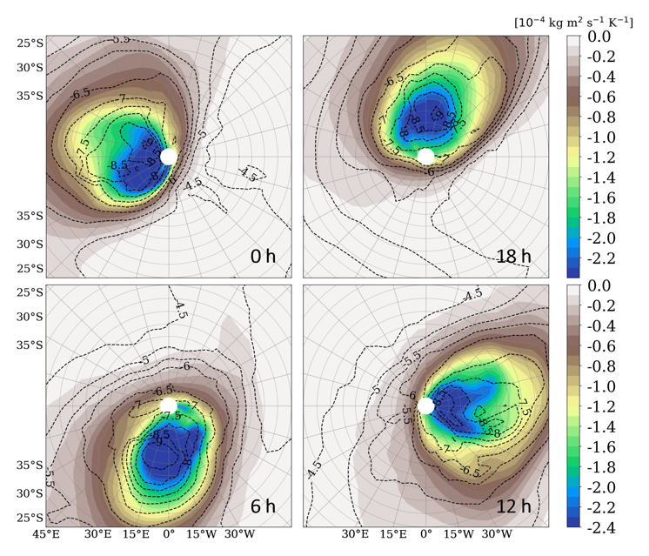
Mars Climate Sounder Observes Diurnal Variations of Dust during the 2018 Global Dust Storm
Armin Kleinböhl
[10⁻⁴ K m² s⁻¹ kg⁻¹]
Night Day
Global Dust Storms (GDS) on Mars lift dust well into the middle atmosphere and have a profound effect on atmospheric temperatures and the overall circulation. Dust storm studies to date have focused on the interpretation of dayside measurements or diurnal averages.
The Mars Climate Sounder (MCS) observes strong diurnal variations in the vertical and latitudinal distribution of dust during the 2018 GDS. The dust reaches the highest altitudes and the southernmost latitudes in the late afternoon. The diurnal variations in the dust are largely driven by the enhanced diurnal tide during the GDS, which pushes a remnant of the southern polar vortex off the pole and forces it to circulate following the apparent motion of the sun (see Figure).
On Earth, the winter polar vortex can be pushed off the pole by sudden stratospheric warmings but the disturbances due to the dust-enhanced tide observed here are more vigorous than what we know from Earth.
Day
Night
Night
Day
Day Night
Polar views of atmospheric dust mass mixing ratios (base-10 logarithm, dashed lines) and the absolute value of potential vorticity (a measure of vortex intensity, shaded contours) in the south polar region of Mars during the Global Dust Storm of 2018 at ~30 km altitude and L_{s}=210◦. Shown is output from a Mars Global Climate Model at four local times covering a Martian day, in agreement with MCS dust observations. The solid black lines indicate the terminator. Regions with little dust correspond to areas of high potential vorticity. The diurnal tide enhanced by the GDS forces the nearly dust-free polar vortex off the pole and keeps it in the early morning hours as it circulates around the pole.
Kleinböhl, A., et al., Diurnal variations of dust during the 2018 Global Dust Storm observed by the Mars Climate Sounder, J. Geophys. Res., 125, e2019JE006115, doi:10.1029/2019JE006115, 2020.
This work was supported by the NASA Mars Data Analysis Program (NNN13D465T, M. Schulte).
© 2020 California Institute of Technology. Government sponsorship acknowledged.

