Slide 1
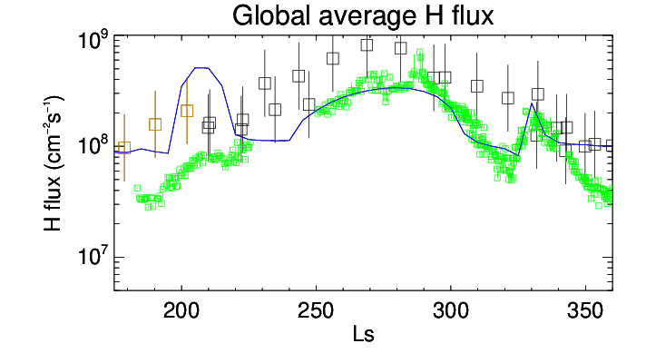
Hydrogen Escape on Mars Dominated
by Water Vapor Photolysis above the Hygropause
Armin Kleinböhl
National Aeronautics and Space Administration
Jet Propulsion Laboratory
California Institute of Technology
On Mars, water loss to space largely occurs through the decomposition of water vapor with subsequent hydrogen escape. Open questions include: What is the relative importance of seasonal vs. dust storm driven escape? What is the predominant mechanism that leads to the decomposition of water vapor?
We create a global atmospheric climatology from measurements by four instruments on three Mars orbiters (MCS on MRO, NGIMS on MAVEN as well as ACS and NOMAD on ExoMarsTGO). We use a photochemical model constrained by this climatology to model hydrogen escape for the dusty season of one Mars year and compare the modeled escape rates with measurements.
Seasonally-recurring hydrogen escape during perihelion season is more important than dust-storm driven impulsive escape because it acts over a longer time period than typical dust storm durations. In addition, water vapor photolysis is more important for hydrogen production than upper atmospheric ion chemistry, and this water photolysis occurs largely above the hygropause. Modeled hydrogen escape rates agree well with measurements.
Globally averaged hydrogen escape flux calculated by the photochemical model (blue line) in comparison to hydrogen escape rates derived from MAVEN measurements (symbols). IUVS ECH measurements from Mars Year 34 are shown in green while SWIA measurements from Mars Year 34 are shown in orange and from other Mars years are shown in black.
Our findings demonstrate the importance of the mechanisms investigated here for improving quantitative estimates of long-term water loss on Mars. Integrated loss due to hydrogen escape extrapolated from present day rates is still lower than required to explain the loss of at least 80–85% of Mars’ original water inventory. Future studies should focus on changes in the large-scale atmospheric circulation and the hygropause in response to variations in obliquity in order to close this gap.
Kleinböhl, A., et al. (2024). Hydrogen Escape on Mars Dominated by Water Vapour Photolysis above the Hygropause, Nat. Astron., 8, 827-837, doi:10.1038/s41550-024-02268-x
This work was supported by NASA’s Mars Data Analysis Program (80NM0018F0719, M. Schulte, M. Mayyasi).
Notes:
Please use this template for science nugget submissions. Although the use of the template is not mandatory for science nugget submission, it is the format that is provided to leadership (i.e., if you send in science nuggets in a different template, that’s OK, but KVK will rework them into this one).

