Slide 1
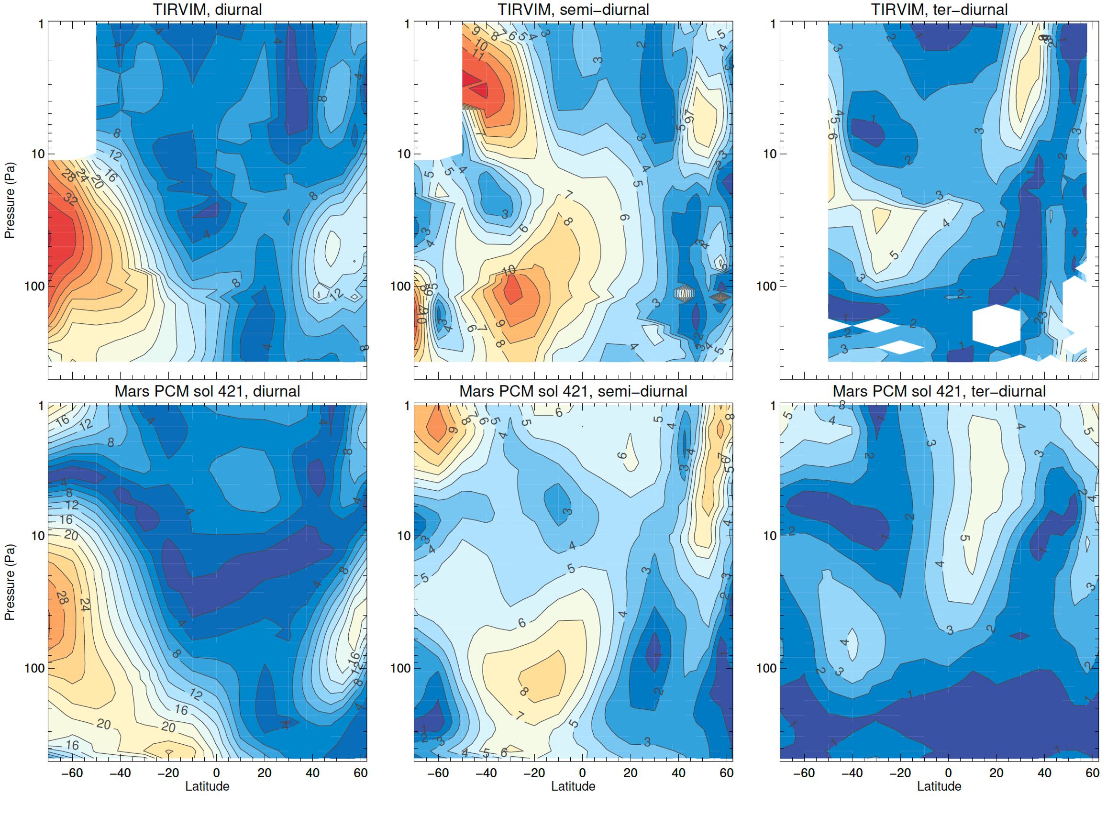
Perturbed Atmospheric Temperature during Global Dust Storms on Mars – Synergies between Mars Reconnaissance Orbiter and ExoMars Trace Gas Orbiter
Sandrine Guerlet, Armin Kleinböhl
National Aeronautics and Space Administration
Jet Propulsion Laboratory
California Institute of Technology
Global Dust Storms are the most distinctive feature of the Martian atmosphere. What are their effects on temperature variability over the course of a Martian day, so-called atmospheric thermal tides?
We use a combination of thermal infrared measurements of temperature by the Mars Climate Sounder (MCS) on Mars Reconnaissance Orbiter (MRO) and by the Atmospheric Chemistry Suite on ExoMars Trace Gas Orbiter (TGO). The differences in local time coverage of these two datasets allow the characterization of tides with unprecedented precision.
The Martian Global Dust Storm of 2018 caused profound increases in amplitude of the diurnal and semi-diurnal components of the atmospheric tides. For the first time, a ter-diurnal tidal component was also identified. The characteristics of this temperature variability were largely reproduced by the Planetary Climate Model for Mars when driven by a dust climatology based on MCS dust observations.
Amplitude (in K) of the diurnal (left), semi-diurnal (middle) and ter-diurnal (right) migrating tide derived from combined MRO and TGO measurements (top), and from the Planetary Climate Model (bottom) during the Global Dust Storm of 2018.
Characterization of temperature perturbations during dust storms and their comparisons to Global Climate Models allow us to evaluate how well these models represent the Martian atmosphere, especially with respect to the forcing caused by the radiative effects of atmospheric dust.
This work was supported by NASA’s Mars Data Analysis Program (80NM0018F0719, M. Schulte).
Guerlet, S., et al. (2023). Thermal tides on Mars before and during the 2018 Global Dust Event as observed by TIRVIM-ACS onboard ExoMars Trace Gas Orbiter, J. Geophys, Res., 128, e2023JE007851, doi:10.1029/2023JE007851
Notes:
Please use this template for science nugget submissions. Although the use of the template is not mandatory for science nugget submission, it is the format that is provided to leadership (i.e., if you send in science nuggets in a different template, that’s OK, but KVK will rework them into this one).

